Slide 1
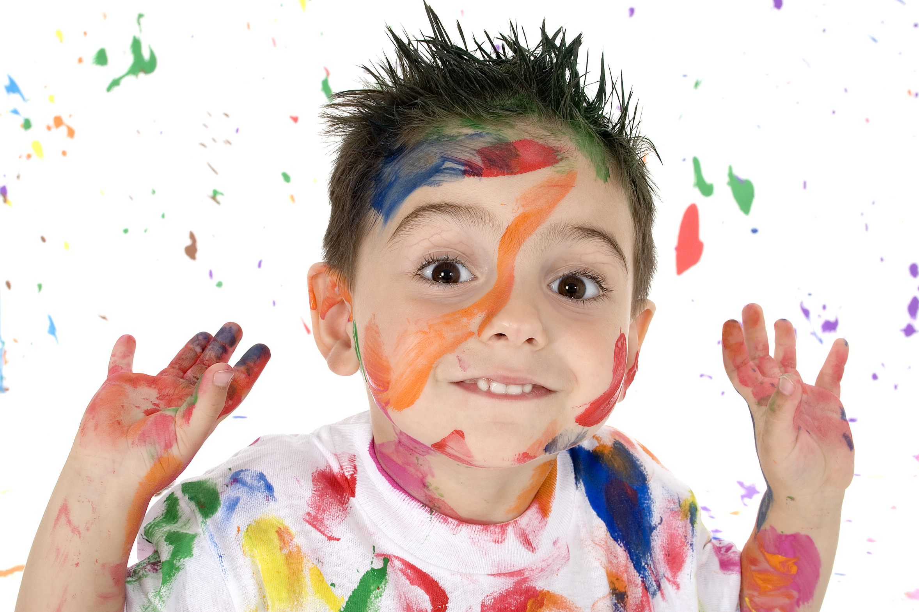
Social and Emotional Development of a Toddler

Slide 2
Children Need Love
What is the best way to show a toddler love?
  Give hugs
  Tell the child that they are loved

Slide 3
Egocentrism
Self-centered behavior
It is the tendency to perceive, interpret, and understand the world in one’s own terms.
Having the inability understand the view point of others.
Toddlers assume that other people think and feel as they do in this stage.

Slide 4
Egocentrism
If you ask them to perform any activity, they will do it in their own style.
They do not care about the specific instructions they were given to complete the task.
For example: If you ask a toddler to bring you three purple flowers, they will not do so. They will bring you flowers of a certain color(s) that they like.

Slide 5
Negativism
Doing the opposite of what others ask to be done.
Toddlers are developing a strong sense of being a separate little person at this stage.
They begin to realize that they too have ideas, wants and new abilities.

Slide 6
Negativism
Parents also recognize all the new skills their child is exhibiting and begin to set limits.
Limits don’t sit very well in the mind of a toddler, which begins the “NO!” battle.

Slide 7
Stubborn
When the child does what they want or what you ask them to do in their own way and in their own time.
This is their way of showing a desire for control and independence.

Slide 8
Temper Tantrums
A release of violent anger or frustration exhibited by screaming, kicking, crying, etc.
Giving into temper tantrums teaches toddlers how to get their way.
This can then in turn make temper tantrums occur more often.

Slide 9
Temper Tantrums
Remember two things when a child is having a temper tantrum:
  Prevent them from harming themselves or others.
  Enforce limits you have set

Slide 10
Factors that Influence Tantrums
Over tired
Disruption in normal routine
Too much excitement
Frustration of too many choices
Frustration of too many limits
Lack of language ability
Lack of firm, realistic limits

Slide 11
Dealing with Temper Tantrums
Show video clip

Slide 12
What Would You Do?
You have just picked James up from his caregiver’s home. It’s been a long day for both of you. James is tired and hungry. So are you. As you approach the grocery store, you decide to stop and grab some bread and milk.

Slide 13
What Would You Do?
Stacey just had a birthday party. She received several nice, new toys from her grandparents. Now her cousin, Matthew has come over for cake and ice cream. He sees the toys and immediately wants to play with them. Stacey throws a temper tantrum and grabs all the toys in her arms and yells, “No! Mine!”

Slide 14
What Would You Do?
You have an important meeting at 3 p.m. It is now 2 p.m. and you are getting ready to go. You look downstairs and see that your toddler has strewn toys all over the basement. You yell at him to hurry up and get the toys put away. He just sits down on the floor and begins to scream, “No go!”

Slide 15
What Would You Do?
When you came home from the grocery store yesterday, you went to put the new cereal in the cupboard. There you found several partially full boxes of cereal. You placed them on the cupboard for breakfast the next morning. However, Greg, your toddler, does not want any of them. He is having a tantrum and yelling, “No, no! Cookie!”

Slide 16
Fears
A natural emotion that can help a child avoid dangerous situations while others must be overcome in order for the child to develop in a healthy way.

Slide 17
Fears
Imitation Fear
  When a fear is passed on to a child through observation and imitation of the individual’s actions
  Example: A caregiver runs away from a dog and the child learns to do the same.
Separation Anxiety and Stranger Anxiety
  Stronger emotions than they were in the infant stage.

Slide 18
Jealousy
The child may not understand that the caregiver has enough love for everyone.
Sibling Rivalry
  Competition between siblings for parent’s attention and affection.

Slide 19
Autonomy
Erickson’s autonomy vs. shame and doubt
Autonomy means independence, wanting to be able to do things for one’s self.
It is important for a caregiver to allow for autonomy within reasonable expectations.
The caregiver still has the main responsibility of meeting the child’s basic needs.

Slide 20
Autonomy
Provide an atmosphere, tools, and skills so that the child will be successful in their attempt for autonomy and will want to continue taking risks.
The opposite is the child having feelings of shame and doubt in their own abilities and what they think that their caregiver thinks of them.

Slide 21
Social Development
Learning to share is one of the first social skills that toddlers learn.
Toddlers:
  Have a short attention span
  Are not patient
  Struggle to play cooperatively with others

Slide 22
Play
A toddler still engages in solitary and onlooker play and begins parallel play.
Parallel Play
  Playing next to another child, but not with them.

Slide 23
Summary
Toddlers are at a very curious stage.
They wonder about many things and have many fears.
They deal with these fears in unique ways.
Imaginary friends, security objects, temper tantrums and separation anxiety are some of their concerns.

