Slide 1
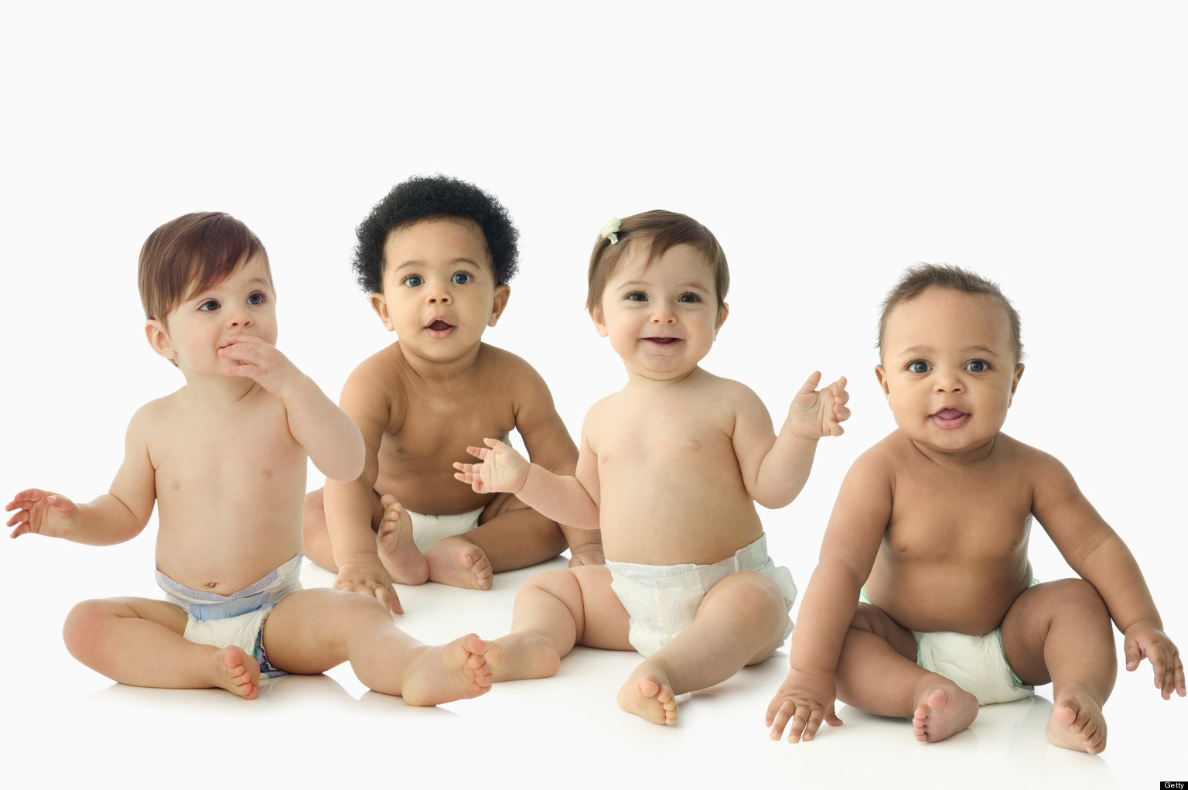
Genetics and Heredity

Slide 2
Genetics and Heredity
Genetics: The study of heredity and the variation of inherited characteristics.
Heredity: The passing on of physical or mental characteristics genetically from one generation to another.
Vision, height, weight, blood type and eye color are factors determined by heredity.

Slide 3
Sex Cells
Female Sex Cell
Called an ovum or egg
Contains the XX chromosomes
Male Sex Cell
Called the sperm
Contains the XY chromosomes

Slide 4
Chromosomes
Rod shaped chemical compounds that carry genetic coding.
The genetic coding transmits characteristics from the parent to the child.
Found in both sperm and ovum/egg.
Each mature sperm and egg cell contains 23 pairs of chromosomes, 46 total.

Slide 5
Genes
Genes: Carry inherited traits which pass on physical characteristics from one generation to another.
Trait: A distinguishing quality or characteristic.
There are hundreds of genes on each chromosome.
They are the building blocks of chromosomes.
They can be dominant or recessive.

Slide 6
Dominant Genes
The stronger genes.
Need only one to pass on the characteristic.
The trait seen in the child.

Slide 7
Recessive Genes
The weaker genes
Need two to pass on the characteristic.
Will only produce a trait when it is transmitted by both parents at the same time.

Slide 8
Gene Example
B = Brown eyes (dominate gene)
b = Blue eyes (recessive gene)
BB = Brown eyes
bb = Blue eyes
Bb = Brown eyes, but carries the recessive blue eye gene

Slide 9
Gender of a Child
Chromosome combinations determine the gender.
An XY combination will produce a male child.
An XX combination will produce a female child.
The father determines the sex of the child.

Slide 10
Gene-O-Gram Assignment
Now you get a chance to see where your traits come from.
Complete the Gene-O-Gram assignment
Examples to use: Medical, physical, talents (musically, athletically, etc.), character traits (eye and hair color, personality, etc.)
Due next class period.

Slide 11
Summary
Each person is a unique individual.
Studying genetics and heredity help us understand how that works.

