Slide 1
Crisis Management
Addictive Behaviors
Notes:
Start this off doing this activity- Catch the Finger:
1. Everyone stand in a circle.
2. Right hand palm up.
3. Left hand pointer finger placed on neighbor’s right palm.
4. I will call out “Ready, Set, Go!”
5. On “Go” you will try to capture the finger of your right neighbor while escaping from your left neighbor.

Slide 2
Teen Traps
Depression
Addictions
Laziness
Endless entertainment
Suicide
Entitlement
The world revolves around me.
I can do whatever I want, it’s my life.
Nothing bad will ever happen to me.
SELFISHNESS

Slide 3
I’m not doing drugs or alcohol so what’s the big deal?
Internet Surfing
Sleeping
Prescription Drugs
Eating Disorders
Food
Obsessions
TV
Self-Mutilation
Card Games
Overspending
Texting
Video Games
Gambling
Pornography
Cutting

Slide 4
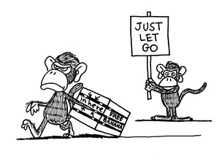
The Monkey Trap
monkey trap (plural monkey traps)
(literally, probably folk-lore) A cage containing a banana with a hole large enough for a monkey's hand to fit in, but not large enough for a monkey's fist (clutching a banana) to come out. Used to "catch" monkeys that lack the intellect to let go of the banana and run away.
(figuratively) A clever trap of any sort, that owes its success to the ineptitude or gullibility of the victim.

Slide 5
The Roots of Addiction
6- You’re bored or curious.
1- You feel insecure & desperately want to belong.
5- You want to escape from your current problems.
2- Your friends are doing it & you feel pressured by them.
3- You are trying to hide pain from the past. Like a death in the family, a divorce, or being abused.
4- You feel confined and want to rebel.

Slide 6
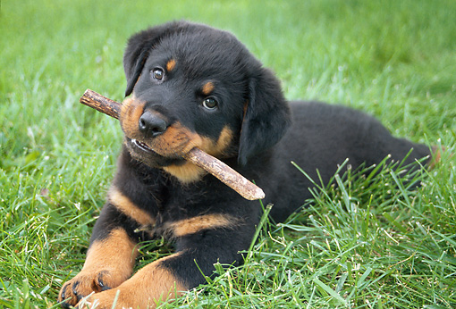
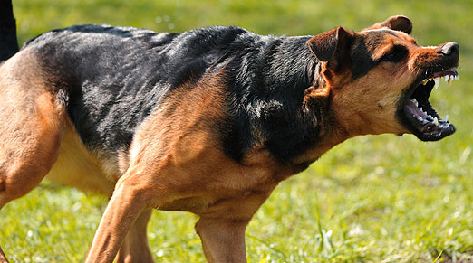
Realities of Addiction
Addictions can become stronger than you.
Addictions don’t just affect you.
Addictions destroy dreams.
Starts small, somewhat innocent, no big deal…
Becomes dangerous, controls everything, MUST have it to feel normal!

Slide 7
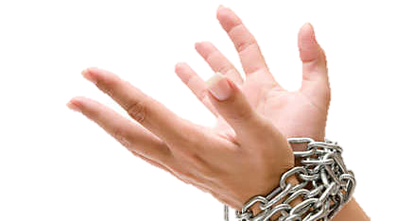
Addictions Can…
Cloud judgment
Affect memory
Change taste buds
Inhibit perception
Slow bodily functions/reaction time

Slide 8
Pornography
Did you know?
Porn works just like a drug.
Dr. Judith Reisman writes that pornography creates chemical reaction in your brain just like a drug does: “Viewing pornography triggers adrenaline and the production of testosterone, oxytocin, dopamine, and serotonin. It’s a drug cocktail you’re hit with”
Porn is highly addictive.
Notes:
Talk with principals about whether you can teach this slide in class…

Slide 9
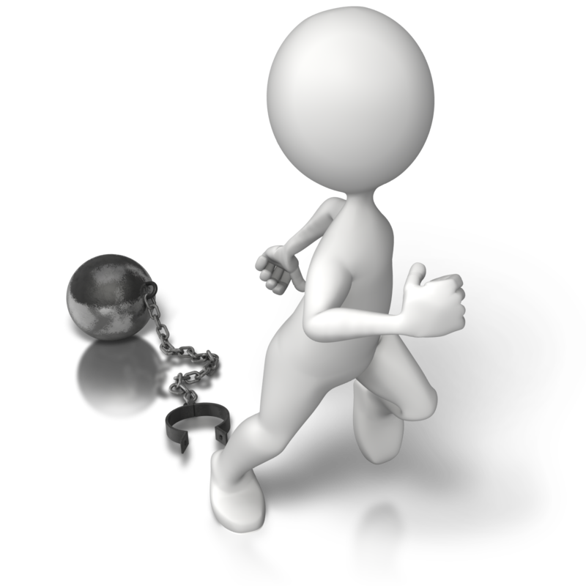
Defeating an Addiction
It’s much easier to break an addiction now while you are still a teen than it will be later.
Admit It
Own up that you have a problem
Get Help
You are much better off if you don’t battle an addiction alone. Some great help sources are parents, good friends, support groups, counselors, and teachers.
Do It NOW!
It will only get harder the longer you wait.

Slide 10
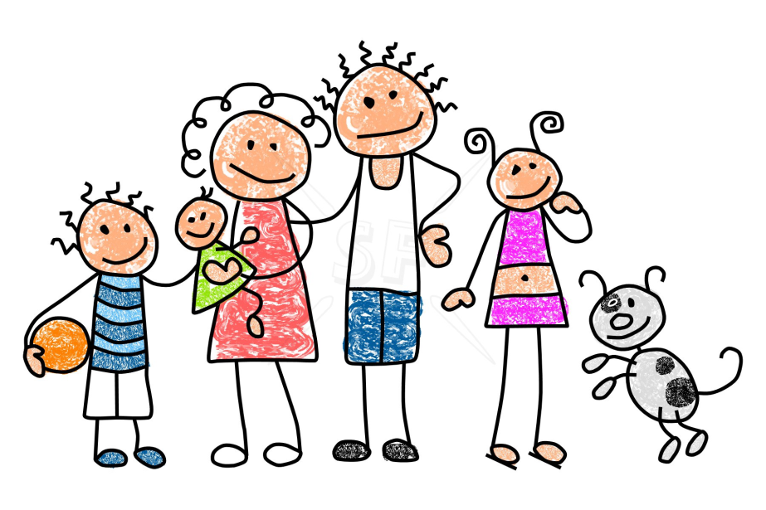
The Anti-Addictions
Exercise
Sports
Music
Service
Hobbies
Learning
Family
Faith
Friends
Journal Writing

Slide 11
Depression & Suicide
“No one cares about me!”
“It doesn’t matter if I live or die.”
“No one would even notice I’m gone.”
“I just can’t face ______ again.”
“All my problems would be gone if I was gone, too.”
Notes:
Avoid decisions that lead to a permanent solution to temporary problems.

Slide 12
Clarence - It’s A Wonderful Life
“Each mans life touches so many other lives. When he isn’t around it leaves an awful hole."

Slide 13
Depression and Suicide
You are NOT alone!
These feelings don’t mean you are crazy, weak or flawed. You just have more pain than you can cope with alone.
With time and support you can overcome your problems.
Notes:
http://www.helpguide.org/articles/suicide-prevention/suicide-help-dealing-with-your-suicidal-thoughts-and-feelings.htm

Slide 14
Ways to Cope
Realize that suicide is a permanent solution to a temporary problem/crisis.
There are many people who want to help you.
Don’t keep these feelings to yourself.
Tell someone you trust and don’t let fear, shame or embarrassment prevent you from seeking help.
Notes:
http://www.helpguide.org/articles/suicide-prevention/suicide-help-dealing-with-your-suicidal-thoughts-and-feelings.htm

Slide 15
GET BUSY SERVING OTHERS!
You are NEEDED and WANTED and LOVED!!
Feeling down, go help someone else!

