Slide 1
What’s On Your Plate?

Slide 2
HEALTHY EATING PATTERNS

Slide 3
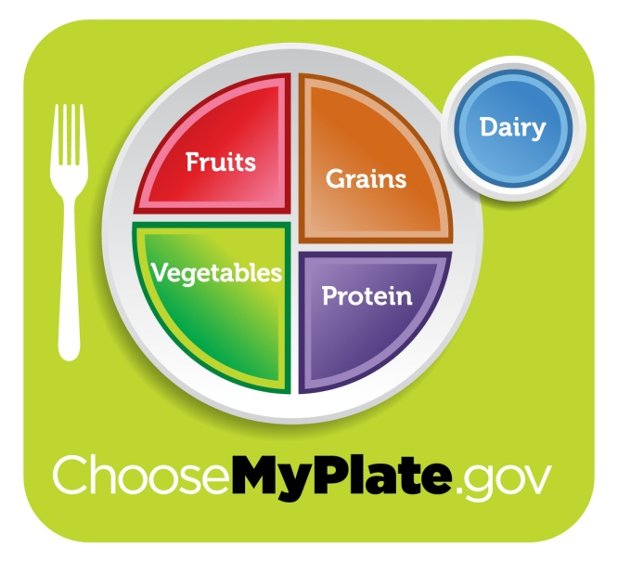
All Food Groups Are Needed!
Each food group provides some, but not all of the nutrients you need.
No one single food or food group can provide all nutrients.
Eating a variety ensures you get all nutrients.

Slide 4
People have different caloric needs depending on:
Age
Gender
Activity Level

Slide 5
Characteristics of Healthy Eating Patterns
Reading and understanding food labels
Portion control
Functions and caloric value of the six nutrients.

Slide 6
History of USDA Food Guides
2011
MyPlate
Notes:
2011: MyPlate
Introduced along with updating of USDA food patterns for the 2010 Dietary Guidelines for Americans.
Different shape to help grab consumers’ attention with a new visual cue
Icon that serves as a reminder for healthy eating, not intended to provide specific messages
Visual is linked to food and is a familiar mealtime symbol in consumers’ minds, as identified through testing.
“My” continues the personalization approach from MyPyramid.
Have the students check their answers to the slide. How did they do?
Hand out new worksheet (Choose My Plate sectioned but not labeled)
Have the students color and label each food groups as we discuss it together.

Slide 7
Fruits Group
Examples
Strawberries
Bananas
How much?
2 cups
Notes:
Examples
What are your favorite fruits?
How much?
Adult men and women – 2 cups
Tip
Make half your plate fruits and vegetables
Choose fresh, frozen, canned, or dried
Use as snacks, salads or desserts
Choose whole or cut-up fruits more often than fruit juice

Slide 8
Fruits Group Recommendations
Tip: Make half your plate fruits and vegetables.
Use fruits as snacks, salads or desserts.
Choose whole or cut-up fruits more often than fruit juice.

Slide 9
Vegetables Group
Examples
Carrots
Peas
How much?
2 ½ cups
Notes:
Examples
What are your favorite vegetables?
How much?
Adult men and women – 2 ½ to 3 cups
Tip
Make half your plate fruits and vegetables
Eat red, orange, and dark-green vegetables, such as tomatoes, sweet potatoes, and broccoli, in main and side dishes
Keep raw, cut-up vegetables handy for quick snacks

Slide 10
Vegetable Group Recommendations
Tip: Make half your plate fruits and vegetables.
Choose fresh, frozen, canned, or dried fruits and vegetables.
Eat more red, orange, and dark green vegetables.
Tomatoes, sweet potatoes and broccoli in main and side dishes.

Slide 11
Grains Group
Examples
Muffins
Pasta
How much?
6 oz.
Notes:
Examples
What are your favorite grains?
How much?
Adult men and women – 5-8 ounces (1 slice of bread, 1 cup of ready-to-eat cereal, or ½ cup of cooked rice, cooked pasta, or cooked cereal)
Tip
Make at least half your grains whole
Choose 100% whole-grain cereals, breads, crackers, rice and pastas.
Check the ingredients list on food packages to find whole-grain foods.

Slide 12
Grains Group Recommendations
Tip: Make at least half of your grains whole grains.
Choose 100% whole grain cereals, breads, crackers, rice and pasta.
Check the ingredients list on food packages to find whole grain foods.

Slide 13
Proteins Group
Examples
Fish
Eggs
How much?
5 ½ oz.
Notes:
Examples
What are your favorite proteins?
How much?
Adult men and women – 5-6 1/2 ounces (1 ounce of meat, poultry or fish, ¼ cup cooked beans, 1 egg, 1 tablespoon of peanut butter, or ½ ounce of nuts or seeds)
Tip
Vary your protein food choices
Choose a variety of foods including seafood, beans and peas, nuts, lean meats, poultry and eggs.
Keep meat and poultry portions small and lean.
Try grilling, broiling, poaching, or roasting. These methods do not add extra fat.

Slide 14
Proteins Group Recommendations
Tip: Vary your protein choices.
Choose a variety of foods including seafood, beans and peas, nuts, lean meats, poultry and eggs.
Keep meat and poultry portions small and lean.
Try grilling, broiling, poaching or roasting. These methods do not add extra fat.

Slide 15
Dairy Group
Examples
Yogurt
Cheese
How much?
3 cups
Notes:
Examples
What do you usually drink during your meals?
If you drink milk, what percentage of milk do you drink?
How much?
Adult men and women – 3 cups (1 cup of milk, yogurt, or soymilk (soy beverage), 1 ½ ounces of natural cheese, or 2 ounces of processed cheese)
Tip
Switch to skim or 1% milk.
They have the same amount of calcium and other essential nutrients as whole milk, but less fat and calories.

Slide 16
Dairy Group Recommendations
Tip: Switch to skim or 1% milk.
Get your calcium rich foods.
Low-fat or fat-free dairy products have the same amount of calcium and other essential nutrients as whole milk, but less fat and calories.

