Slide 1

Water

Slide 2
Water is Essential
Water is the most important of all the essential nutrients. Why?
The body cannot survive long without water.
Water is contained in most foods.
Drink water instead of sugary drinks.

Slide 3
Functions of Water
Carries water soluble vitamins.
Carries waste products through the body.
Regulates body temperature through perspiration.
Prevents dehydration.

Slide 4
Dehydration
Dehydration occurs from lack of water.
Symptoms:
  Thirst
  Darker urine
Urine should be a pale yellow color.

Slide 5
Prevention of Dehydration
Water prevents dehydration.
Drink water and other fluids frequently.
Don’t wait to be thirsty.
Daily recommendation of water – 64 fl. oz.

Slide 6
Sports/Fitness Activities
For short duration exercise, 60 minutes or less:
  Drink water before, during and after exercise.
For moderate to high intensity activities, lasting longer than 60 minutes:
  Drink sports drinks to help replace carbohydrate loss and electrolyte balance.

Slide 7
Sports/Fitness Activities
Drink according to thirst during the day.
Include fluids with meals.
Drink 8-20 ounces of water an hour before exercise.
Continue drinking during exercise, up to 16-24 ounces of fluid per hour (4-6 ounces every 15 minutes).

Slide 8
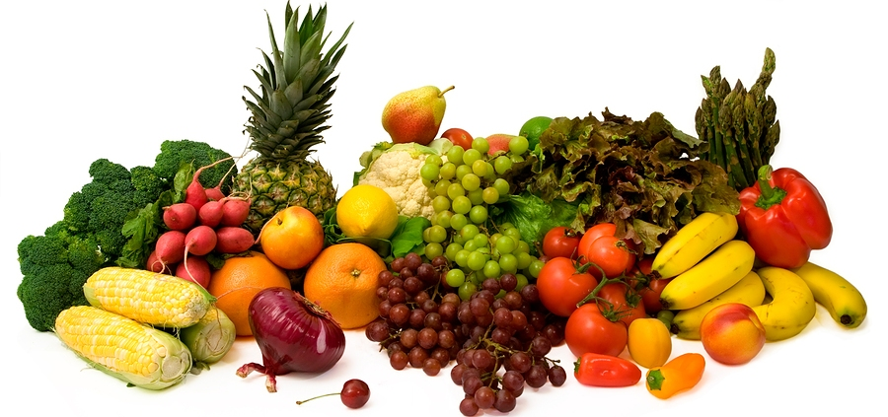
Fruits and Vegetables

Slide 9
Nutrients
Fruits and vegetables provide the following nutrients:
  Vitamin A
  Vitamin C
  Potassium
  Folic Acid
  Vitamin D
  Calcium
  Magnesium
  Fiber
  Water

Slide 10
Fruits and Vegetables
Fruits and vegetables contain no cholesterol.
Fruits and vegetables are low in calories, fat and sodium.
Vary your fruits and vegetables.
  What does that mean?
  Why do we need to vary our fruits and vegetables?

Slide 11
Destroying Nutrients
Three things can destroy nutrients found in fruits and vegetables:
  Air
  Heat
  Water

Slide 12
Oxidation
Define:
  Browning that occurs when fresh fruits are cut and exposed to the air.
  This is caused by an enzyme in the fruit.
Prevention:
  Dipping or covering fruit with liquid containing ascorbic acid.
  Wait to cut the fruit until ready to eat.

Slide 13
Eating Fruits and Vegetables
Before eating your fruits and vegetables wash them to remove any pesticides and dirt that might remain on the skins.
Choose whole or cut-up fruits more often than fruit juice.

Slide 14
Preparation Methods
The following are preparation methods that preserve the most nutrients for fruits and vegetables:
  Eating them raw
  Microwave
  Bake/Roast
  Steam
  Stir Fry
  Simmer
  Sauté

Slide 15
Preparation Methods
Cook in larger rather than smaller pieces when possible.
Use a small amount of water.
Cook only until fork tender.
Save the cooking liquid to use in soups or gravies for added nutrients.

Slide 16
Selecting Fruits and Vegetables
Select fresh fruits and vegetables that are:
  Firm
  Free from decay
  Crisp
  Smooth
  Dense (heavy for size)
  Free from bruises
  Have good color

Slide 17
Seasonal Fruits and Vegetables
Seasonal fruits and vegetables are:
  Lower in cost
  Plentiful
  Better quality

Slide 18
How Long Will They Last?
Buy only what fruits and vegetables you will be able to store and use.
They will last about one week in the refrigerator.
Fruits will ripen and spoil faster at room temperature.

Slide 19
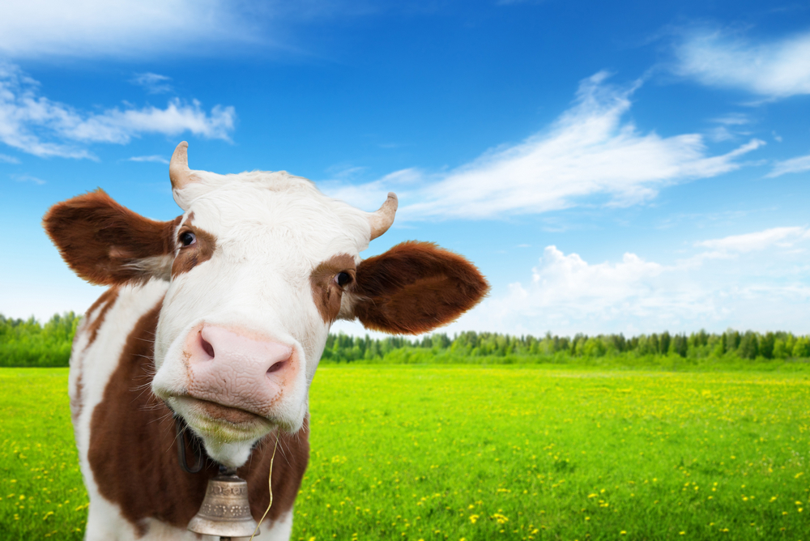
Farm-to-table

Slide 20
Farm-to-Table Steps
Farm
  Use of good agricultural practices.
Processing
  Monitor at critical control points.
Transportation
  Use clean vehicles and maintain the cold chain.

Slide 21
Farm-to-Table Steps
Retail
  Follow the food code guidelines
Table
  Always follow the Four C’s of safety: Clean, cook, control cross contamination, chill.

Slide 22
Summary
Water is the most important of all the essential nutrients.
Fruits and vegetable are naturally healthy for you.
Prepare them correctly to conserve as many nutrients as possible.

