Slide 1
The Proposed New Food Label Information

Slide 2
Why is it important for foods to have labels?
Brainstorm

Slide 3
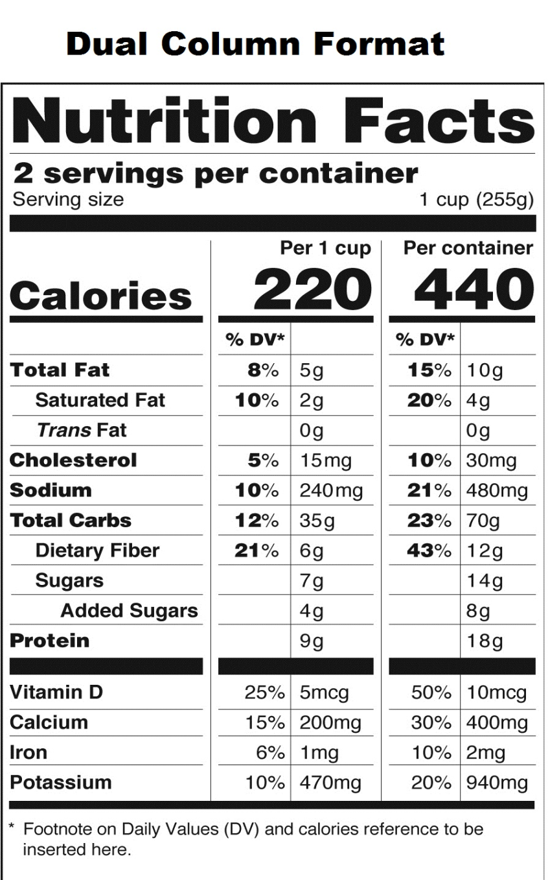
Parts of the proposed new label:
Serving size and number of servings per container.
If you ate both of these servings, you would have to double the calories, fat, etc.

Slide 4
Calories:
The amount of energy we get from a food
Teenagers need about 2000 calories per day
If we get too many calories and not enough exercise, it will be stored as fat

Slide 5
Total Fat:
Based on a 2000 calorie diet, you would need about 65 g of total fat per day

Slide 6
Sodium:
Also known as salt
Goal is to keep daily intake below 2400 mg
Most commonly found is processed foods

Slide 7
Carbohydrates:
Total Carbs (Complex Carbohydrates) contain fiber and create a longer lasting energy
Fiber prevents constipation and different types of cancers

Slide 8
Sugars
Provides and immediate source of energy
Used very quickly (sugar rush) followed by an energy crash

Slide 9
Protein
Protein is used to build, maintain and repair muscles, especially our heart

Slide 10
Vitamins and minerals
Four vitamins and minerals listed
Most difficult in getting enough of these in our diet.

Slide 11
Compare the two labels:

Slide 12
Career Tie-in
What would be a career that would involve the subject we are discussing today?
Clinical Dietitian
Teaching clients how to recognize healthy and unhealthy foods.
Work in hospitals, nursing care facilities and other health care facilities.

Slide 13
Point Cards
An easy way to see if a food is healthier for you is to add up points
One point is assigned if a food has:
200 or fewer calories
10% or less total fat
10% or more dietary fiber
10% (5 grams) or more protein
10% or more of any vitamins or minerals

Slide 14
For Example:
Whole Wheat Bread (per slice):
Grain group
100 Calories
3% fat
11% dietary fiber
5g protein
0% Vitamin A
0% Vitamin C
6% Calcium
6% Iron

Slide 15
Counting points activity
You are now going to practice counting points on various food placed around the room.
Read the label and record all of the information.
At your desk, figure out the points for each food, using the points card.
Turn in your work when you are done.

