Slide 1
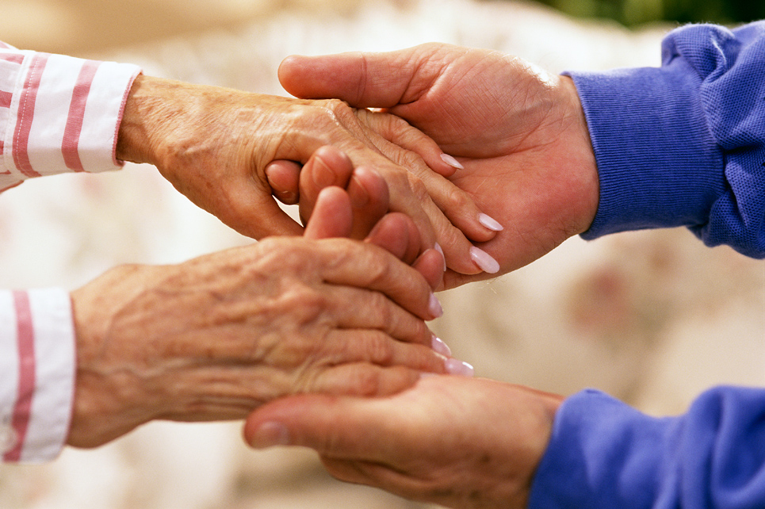
Teens and the Elderly

Slide 2
You’re Only Old Once
Read Dr. Seuss's book, “You’re Only Old Once”

Slide 3
What Age is Old?
At what age are you considered to be old?
Infancy = 0-2 years old
Preschool = 2-5 years old
Childhood = 6-12 years old
Adolescence = 12-17 years old
Early Maturity = 17-25 years old
Maturity = 25-55 years old
Late Maturity = 55-75 years old
Old Age = 75 years and older

Slide 4
Grandparents
What are some special things you have done with or remember about your grandparents?
Is there any food you especially associate with your grandparents?
How many of you have had a special relationship with either a grandparent or older friend or neighbor?

Slide 5
Grandparents
What do you see as the role of a grandparent?
How are grandparents of today different from grandparents:
25 years ago
50 years ago
100 years ago
Define Grandparent:
The parent of your father or mother.

Slide 6
What Do You Have in Common?
Both of you are at the crossroads in your lives and have anxieties about the future.
The elderly are into the empty nest time of life.
The youth are preparing to take on the nest.
Your emotions cycle severely because of hormonal changes.
The elderly’s hormones are shutting down.
The youth’s hormones are becoming more active.

Slide 7
What Do You Have in Common?
Your bodies are in a state of change.
The elderly are slowing down.
The youth are speeding up.
You are both heavy users of drugs.
The elderly use prescription drugs.
The youth use substances.

Slide 8
What Do You Have in Common?
You both are obsessed with excess time.
The elderly person’s responsibilities have diminished.
The full impact of the youth’s responsibilities is yet to come.
You are both concerned about your independence.
The elderly from their children.
The youth from their parents.

Slide 9
What Do You Have in Common?
You both suffer from dimensions of loneliness and depression because you are largely unemployed.
The elderly are out of the work world and don’t feel needed anymore.
The youth are not in the work world yet and don’t have the sense of being needed.

Slide 10
What Do You Have in Common?
You are both preoccupied with driving
The elderly to maintain driving status.
The youth to begin driving.
You are both victims of discrimination
The elderly are too old.
The youth are too young.

Slide 11
What Do You Have in Common?
You are both prime candidates for abuse and criminal activity
The elderly have lost their strength and the ability to defend themselves.
The youth haven’t learned how to defend themselves yet.

Slide 12
What Do You Have in Common?
You both face disapproval of any marriage plans.
The elderly from their children.
The youth from their parents.
They don’t have much money.
The elderly often live on social security or fixed incomes.
The youth must depend on their parents for spending money.

Slide 13
The Elderly Lab
The following activities are meant to simulate life as an elderly adult.
Follow the directions closely and have fun!☺

Slide 14
Memory Loss
Study the following slide and remember all of the items you can.
You will have two minutes to study the items.

Slide 15
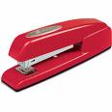
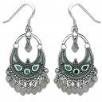
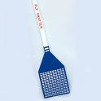
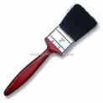
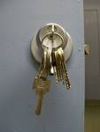

Slide 16
Memory Loss
Take out a piece of paper and write down all of the items you can remember.

Slide 17
What Items Did You Remember?
Kleenex
Fly Swatter
Stapler
Tennis Ball
Safety Pin
Pen
Planner
Scissors
USB
Sticky Note
Earrings
Paint Brush
Butterfinger
Chapstick
Book
Paper Clip
Shoe/Sandal
Watch
Camera
Thread
Super Glue
Screw Driver
Lotion
Germ X
Keys
Tide Pen
Cell Phone
I-pod
Shoelaces
Ruler

Slide 18
Arthritis
Using the duct tape found on the front table, tape your fingers together in the following manner:
Pinky and ring fingers together
Middle and index fingers together
Do not tape your thumb

Slide 19
Arthritis
Now let’s see how well you can write!
Take out another piece of paper.
Write your first and last name in the top right hand corner of the paper.
Number your paper from 1 to 10.
Answer the following questions.

Slide 20
Arthritis
What color of shirt are you wearing?
How many buttons are on your clothes today?
What is your favorite vacation spot?
What is your middle name, if you have one?
What color is the sky?

Slide 21
Arthritis
What is your favorite food?
How tall are you?
What color is your hair?
Do your shoes have laces?
Was this activity hard?
You may now remove the tape from all of your fingers and place it in the garbage can.

Slide 22
Vision
Come to the front of the classroom and select a pair of glasses.
For those students who already have glasses, please remove them for this activity.

Slide 23
Vision
Simple Simon met a pieman going to the fair; Said Simple Simon to the pieman "Let me taste your ware" Said the pieman to Simple Simon "Show me first your penny" Said Simple Simon to the pieman "Sir, I have not any!" Simple Simon went a-fishing for to catch a whale; All the water he had got was in his mother's pail. Simple Simon went to look if plums grew on a thistle; He pricked his fingers very much which made poor Simon whistle. He went for water in a sieve but soon it all fell through; And now poor Simple Simon bids you all "Adieu"
Please return your glasses to the front when you are done.

Slide 24
Taste
Come choose a cookie from the front table.
When you have returned to your seats, feel free to eat your cookie.
Was anything missing? What did it taste like?

Slide 25
How Was This Experience?
So…how was it being an elderly adult for a moment?
I want you to write about your experiences today in class for your homework assignment.
Elderly Lab Reaction Assignment – Due next class period.

Slide 26
Summary
Get to know your grandparents a little better. You may be surprised how much you have in common.
You experienced a little of what elderly adults face every minute of everyday. Be more patient with them and help where you can.

