Slide 1
Teens and Siblings

Slide 2
Siblings
Brothers and sisters in a family.
This includes step and half brothers and sisters.
Next to the parent-child relationship, the sibling relationship is probably the strongest.

Slide 3
Sibling Relationship
They have deep sharing of emotions.
Teaching and socializing is often the role of the older brother or sister.
The older sibling is not only a teacher, but a caretaker and companion.
Can be the best of friends or the worst of enemies.
Why would this be true? Give some examples.

Slide 4
Sibling Roles
Playmate
Companion
Teacher
Learner
Protector
Dependent
Role Model
Intimidator
Brown-noser
Aggressor
Victim
Tattle-tale
Baby
Adversary

Slide 5
Sibling Rivalry
Competition or jealousy among children of the same family for their parents’ affections or for dominance.
It is extremely common.
Sometimes persists into adult life.

Slide 6
Causes of Sibling Rivalry
Age
Developmental stage
Personality
Need for attention from parents
Need for protection from parents

Slide 7
Supportive Sibling Behavior
Any action that helps or encourages a sibling.
Can take place in the home or outside the home.
Give some examples.

Slide 8
Birth Order
The order in which you and your siblings are born.
Impacts your personality and development.

Slide 9
When it comes to Birth Order, remember…
There are exceptions in every trait.
Focus on positive traits of each birth order.
Become aware of your uniqueness.
Use the information to understand yourself, siblings and others.
Do not use traits as labels or stereotypes.

Slide 10
Birth Order Quiz
Which birth order are you?
Decide which category best describes you as a person.

Slide 11
Birth Order Quiz - Category A
Manipulative
Charming
Usually gets his/her way
Blames others for things that happen witty
A show-off
Loves people
Good salesperson
Draws favorable attention

Slide 12
Birth Order Quiz - Category B
Perfectionist
Reliable
Makes lists
Conscientious
Well-organized
Serious
Critical
Does well in school
Usually neat and tidy

Slide 13
Birth Order Quiz - Category C
Acts as a go-between in family conflicts
Has the fewest pictures in the family photo album
Avoids conflict
Has many friends
Extremely loyal to peer group (gets mad if parents criticize friends)
Seems to do things differently than the rest of the family
Independent

Slide 14
Birth Order Quiz Results
Every word in these descriptions may not be exactly as you are, but you are to choose the one that fits the best.
Category A: Youngest
Category B: Oldest
Category C: Middle

Slide 15
Oldest Child
Quickly learn how to please their parents.
Are very reliable
Serve as a surrogate parent to younger siblings.

Slide 16
Oldest Child Characteristics
Guinea pigs
Perfectionists
Reliable
Conscientious
List makers
Well-organized
Critical
Scholarly
Loyal
Serious
Goal-oriented
People pleasers
Conservative
Supporters of law and order
Believers in authority and ritual
Self-reliant
Controlling

Slide 17
Top Careers for Oldest Child
Government
Engineering
Information Technology
Science
Note: 100% of astronauts who have gone into space were either eldest children or eldest sons.

Slide 18
Famous Oldest Children
Oprah Winfrey
One of the most influential and wealthy women in the world.
Winston Churchill
One of the greatest wartime leaders in history.
Walter Cronkite
Famously reported the assassination of President JFK AND the 1969 moon Landing.

Slide 19
Middle Child
Difficult to categorize
Avoid being boxed in
Have a more go-with-the-flow attitude than their older siblings
Unbiased and levelheaded
Good negotiators and mediators between their siblings

Slide 20
Middle Child Characteristics
Independent
Loyal to peer group
Good friends
Find companionship outside the home
Follows the crowd
Competes for attention
Peacemaker
Somewhat rebellious

Slide 21
Top Careers for Middle Child
Public service
Education
Law enforcement
Caretaking
Construction
Note: 65% of middle children put money into their savings account each month. They are also more likely to be asked for money from a sibling.

Slide 22
Famous Middle Children
Barbara Walters
First women to co-host a nightly evening news show.
Martin Luther King Jr.
Leader of the civil rights movement.
John F. Kennedy
President of the United States 1961-1963

Slide 23
Youngest Child
Receive the least discipline
Fewest responsibilities
Learn that being funny and adorable gains attention and approval
“The baby” of the family

Slide 24
Youngest Child Characteristics
Manipulative
Charming
Blame others
Shows off
People persons
Good salespersons
Uncomplicated
Self-centered
Fun-loving
Outgoing
Messy
Class clowns
Attention-seeking
Personable
Manipulators
Affectionate
Absentminded
Carefree
Not taken seriously

Slide 25
Top Careers for Youngest Child
Design
Editing
Writing
Sales
Art
Information Technology
Note: 85% of youngest children suffer from nightmares.

Slide 26
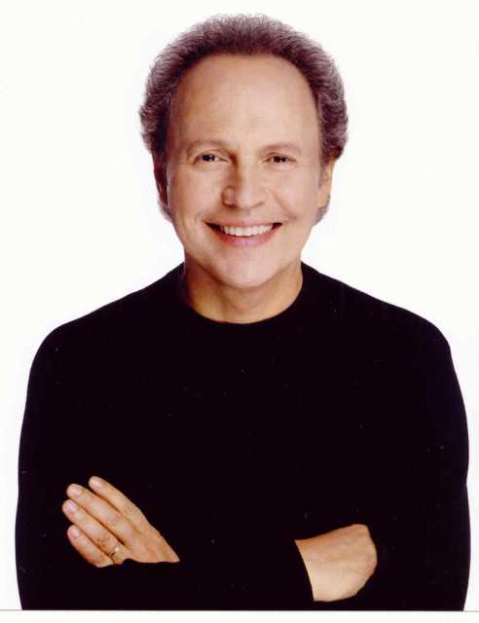
Famous Youngest Children
Mark Twain
American author and humorist.
Prince Harry
Youngest of the two English Princes.
Billy Crystal
Actor and comedian.

Slide 27
Only Child
Typically mature for their age due to time spent with adults.
High achievers
Few will rebel and follow their own path

Slide 28
Only Child Characteristics
Mature
Perfectionist
Conscientious
Diligent
High academic achievement
Organized
Pays attention to detail
Confident

Slide 29
Top Careers for Only Child
Law enforcement
Information technology
Nursing
Engineering
Note: 18% of households are one-child families.

Slide 30
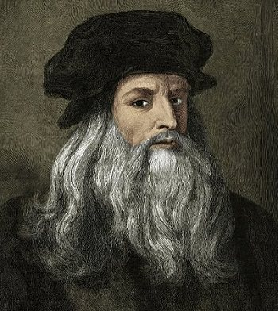
Famous Only Children
Elvis Presley
The best-selling solo artist in the history of music.
Franklin D. Roosevelt
Longest serving President of the United States 1933-1945
Leonardo da Vinci
Famous Italian inventor, painter, sculptor, mathematician.

Slide 31
Guess Your Teacher’s Birth Order
Now that you have a little background on birth order characteristics, let’s see if you can guess various teacher’s birth order.
Let’s review a few behaviors first.

Slide 32
Oldest Child Teacher
Creates complicated projects for student to complete.
Like structure and order in the classroom.
Happiest when students are sitting in nicely arranged desks, in a straight line.
Students are quiet and do as they are told.
Frustrated when the lesson plan is interrupted.

Slide 33
Middle Child Teacher
Interested in the psychological well being as well as the academic achievement of the students.
Seeks out the rebellious students in hope of influencing them in a more positive direction.
Try to achieve order through mutual respect and understanding.
Sometimes strict, but sometimes easy going about classroom rules.

Slide 34
Youngest Child Teacher
More creative, fun loving and adjust well to noise and disorder.
Activities are fun and spontaneous
Students choose their own seats and have a lot of choice in classroom decision making.
All students to take more responsibility so they won’t have to do everything themselves.
Sometimes activities go awry become of poor classroom management skills.

Slide 35
Your Teacher’s Birth Order
Mrs. Masters
Middle
What teachers would you like to know?

Slide 36
Summary
Living with siblings is not always easy, but your siblings will always be part of your life and they can be good friends.
It is in the best interest of the family to understand sibling interaction and sibling dynamics in order to contribute to good relationships.

