Slide 1
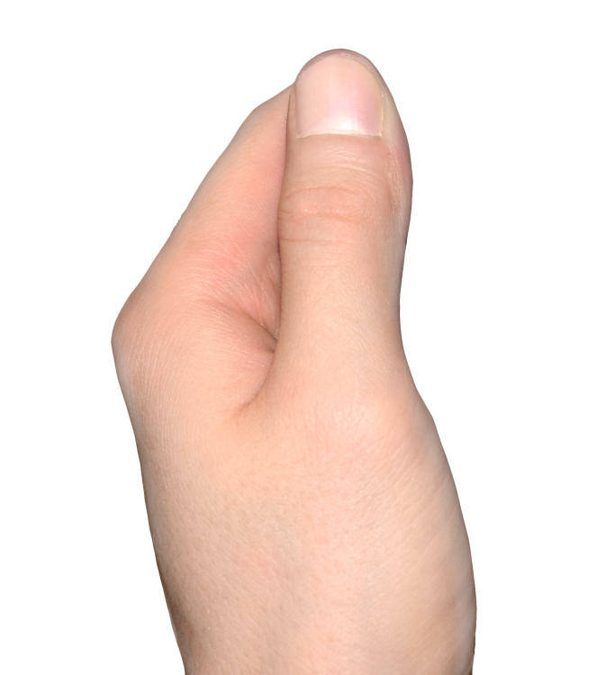
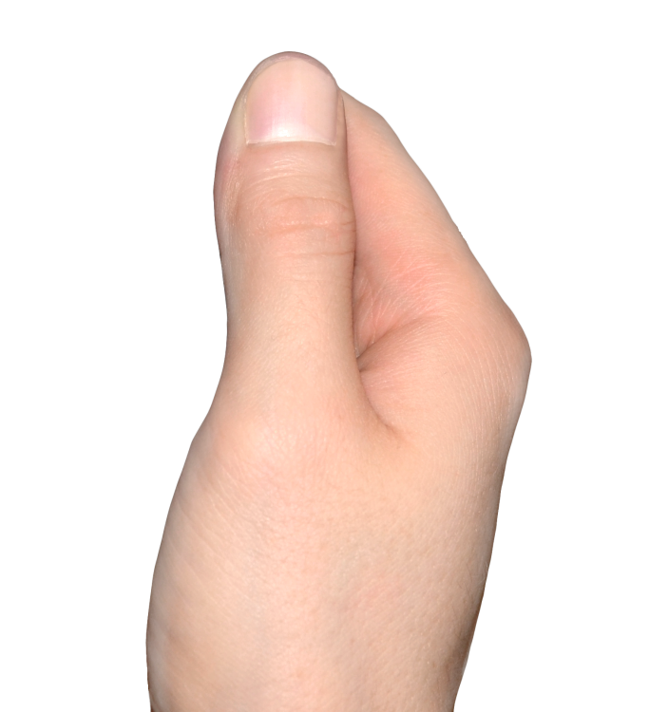

Slide 2
Positive Social Media
Improves relationships and helps to make new friends.
Can enable face-to-face meetings
Helps people become connected with social groups.
Notes:
http://socialnetworking.procon.org/
http://friendship.about.com/od/Social_Networking/tp/Ways-Social-Networking-Ruins-Friendship.htm
http://www.cbc.ca/news/health/social-media-affecting-teens-concepts-of-friendship-intimacy-1.2543158

Slide 3
Negative Social Media
Less to say in person.
False sense of true friendship by how many “friends” or “likes” they have.
More comfortable posting inappropriate content that can never be taken back.
Notes:
http://socialnetworking.procon.org/
http://friendship.about.com/od/Social_Networking/tp/Ways-Social-Networking-Ruins-Friendship.htm
http://www.cbc.ca/news/health/social-media-affecting-teens-concepts-of-friendship-intimacy-1.2543158

Slide 4
Cautions of Social Media
Social Rejection
Bullying/Cyberbullying
Gossiping
Sexual harassment
Abuse
Notes:
Be careful of what you put into print/photo’s online. Once it is out there it is out there and there is NO retrieval. DO NOT put anything online that you would not say to the person face-to-face. Think about the consequences of what you put online- How is it going to make others feel? Is it really important to post? Could it impact someone’s future? Could it impact your future?
This is where we can reinforce Passive, Aggressive, Assertive behaviors.

Slide 5
Social Media & Your Future
Your use of social media can impact your future opportunities.
Think about the consequences BEFORE putting something online!
Notes:
Be careful of what you put into print/photo’s online. Once it is out there it is out there and there is NO retrieval. DO NOT put anything online that you would not say to the person face-to-face. Think about the consequences of what you put online- How is it going to make others feel? Is it really important to post? Could it impact someone’s future? Could it impact your future?
This is where we can reinforce Passive, Aggressive, Assertive behaviors.

Slide 6
A SK YOURSELF…
How is it going to make others feel?
Is it really that important to post?
Could it impact your future career and life?
Could it impact someone else’s future?
Notes:
Be careful of what you put into print/photo’s online. Once it is out there it is out there and there is NO retrieval. DO NOT put anything online that you would not say to the person face-to-face. Think about the consequences of what you put online- How is it going to make others feel? Is it really important to post? Could it impact someone’s future? Could it impact your future?
This is where we can reinforce Passive, Aggressive, Assertive behaviors.

Slide 7
What will
your digital reputation be?
Notes:
Be careful of what you put into print/photo’s online. Once it is out there it is out there and there is NO retrieval. DO NOT put anything online that you would not say to the person face-to-face. Think about the consequences of what you put online- How is it going to make others feel? Is it really important to post? Could it impact someone’s future? Could it impact your future?
This is where we can reinforce Passive, Aggressive, Assertive behaviors.

