Slide 1
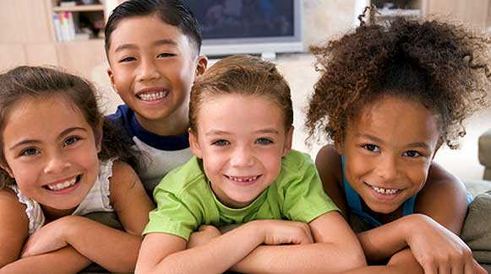
SELF-CONCEPT

Slide 2
Self-Concept
The total picture a person has of themselves.
A composite of the traits, values, thoughts and feelings that we have for ourselves.
Impacts all of the areas of development.

Slide 3
Positive Self-Concept
Get along better with others
Self-confident
Risk-taker
Willing to try new things
Self-reliant
Goal setter

Slide 4
Negative Self-Concept
Show off in front of other children
Put others down
Critical of self and others
Might be a bully to make themselves look and feel stronger
Withdrawn
Insecure

Slide 5
Example of Positive Self-Concept
Sound of Music Video clip – “I Have Confidence”
How is enthusiasm and self-confidence helpful in developing a successful life?

Slide 6
Self-Concept Cycle
AS I SEE MYSELF
HOW OTHERS REACT TO ME
MY ACTIONS
HOW OTHERS SEE ME

Slide 7
Influences on Our Self-Concept
The individual’s self-perception.
Verbal and nonverbal communication with self and others.
Positive and negative interaction with others, self, the environment, and the media.

Slide 8
Promoting a Positive Self-Concept
Let children know that their behavior is appropriate
Allow children to make choices and decisions
Support them as they try new things
Allow for personal independence
Encourage the development of skills and talents.

Slide 9
Praising Children
Children thrive in a climate of love.
Give your child plenty of praise, warmth, and physical signs of affection.
Split into groups and brainstorm positive comments or different ways to say “Good Job”
Share your findings with the class.

Slide 10
Summary
Self-concept is the total picture a person has of themselves.
Understand the self-concept cycle.
Different influences on our self-concept.
Promote a positive self-concept in children.

Slide 11
Homework Assignment
Complete and turn in the “A Look At My Life” worksheet.
This will analyze how your self-concept came to be.

