Slide 1
SANITATION & HYGIENE with
®

Slide 2
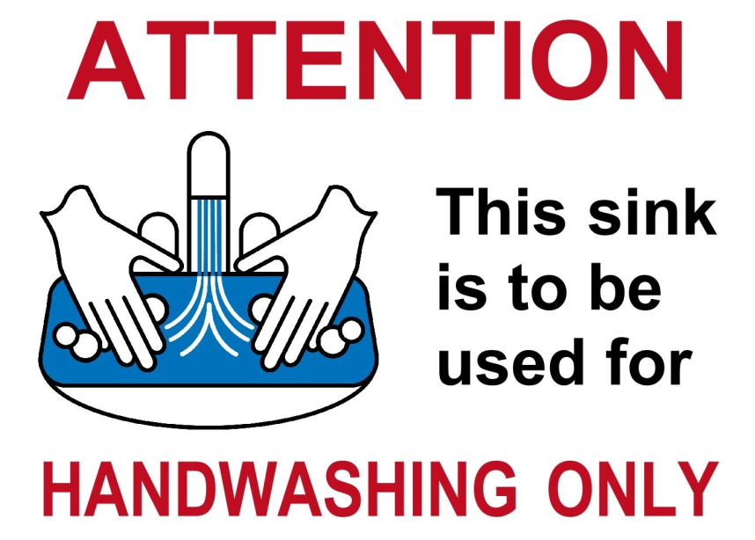
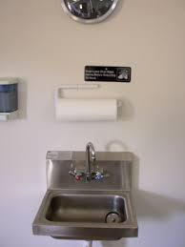
Handwashing Sink
The handwashing sink is to be used for handwashing ONLY.
Never use this sink for other purposes.

Slide 3
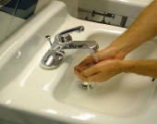
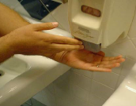
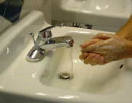
Washing Hands- a 20 second process
Wet hands and arms with warm/hot water.
Apply soap.
Scrub hands and arms vigorously for at least 10-15 seconds.
Rinse hands and arms thoroughly.
Use an antiseptic after washing hands
Wait for antiseptic to dry before touching food or equipment and before putting on gloves.

Slide 4
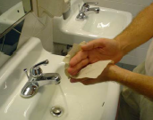
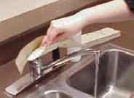
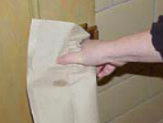
Drying Hands
Dry hands and arms with a paper towel.
Do not use apron or clothing.
Use paper towels to turn off the faucet and open doors.

Slide 5
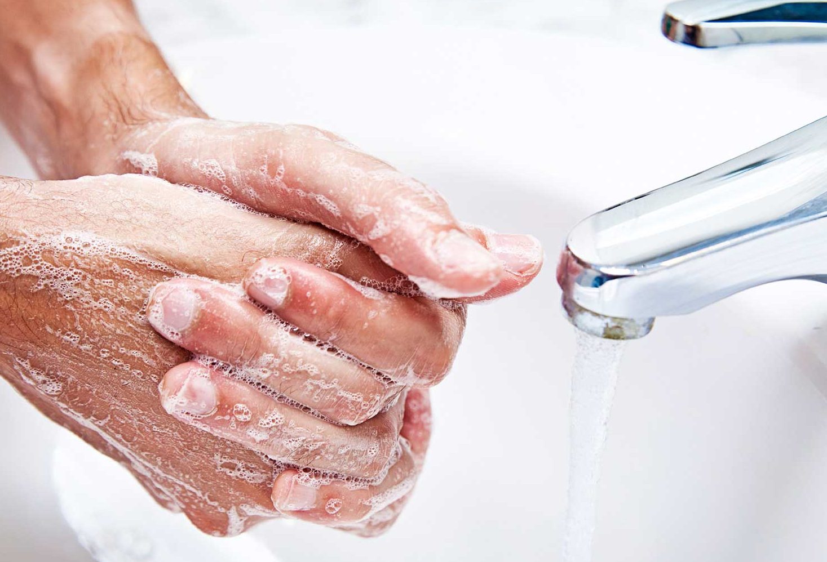
When to Wash Hands
After using the restroom
After coughing/sneezing
Before & after handling raw meat, poultry or eggs
Before putting on gloves
After touching clothing or aprons
After handling money
After handling garbage or trash
After handling dirty equipment/utensils
Before, during and after food preparation

Slide 6
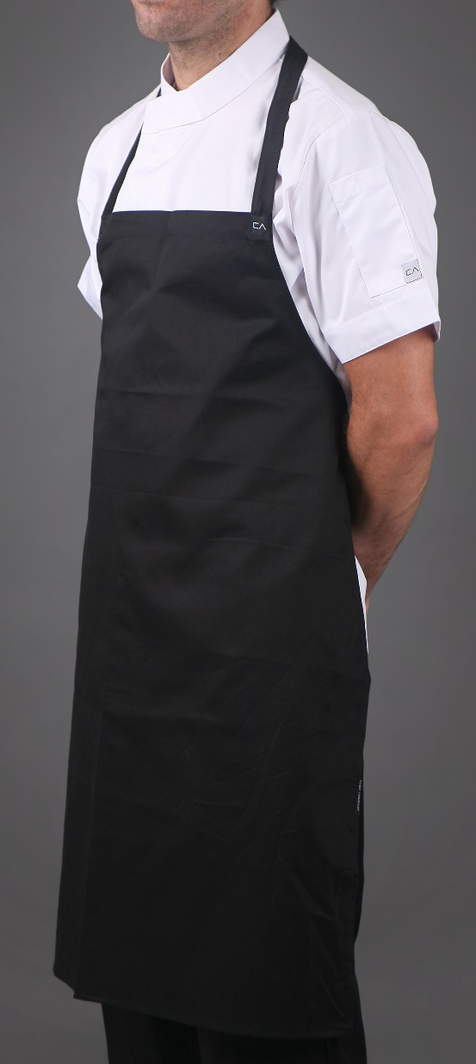
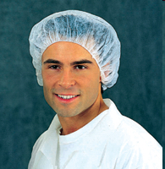
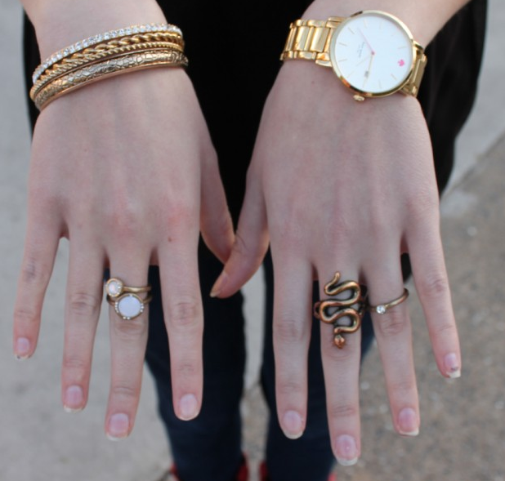
Clothing, Hair and Jewelry
Wear clean clothing and aprons.
Tie back or cover hair.
Remove jewelry from hands and arms including rings, bracelets and watches.
Expect for a plain band

Slide 7
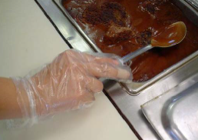
Wearing Gloves
Avoid bare-hand contact with ready to eat foods.
Wear gloves if you have open sores or cuts on hands.
A bandage must cover the wound completely and a glove must be worn over the bandage.
Use the correct size so they fit.
Never rinse, wash or reuse gloves.
Wash hands before putting on gloves and when changing to a new pair.
Change gloves with each new task.

Slide 8
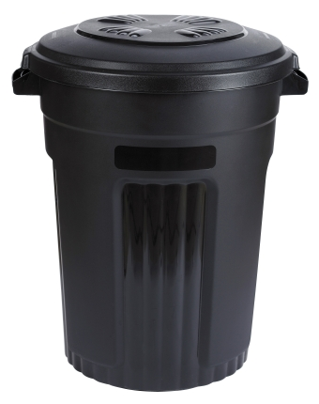
Trash and Garbage
Remove garbage from prep area as quickly as possible.
Do not clean garbage containers in food prep areas.
Use trashcan liners
Clean the inside and outside of garbage containers often.
Close the lids on outdoor containers.

Slide 9
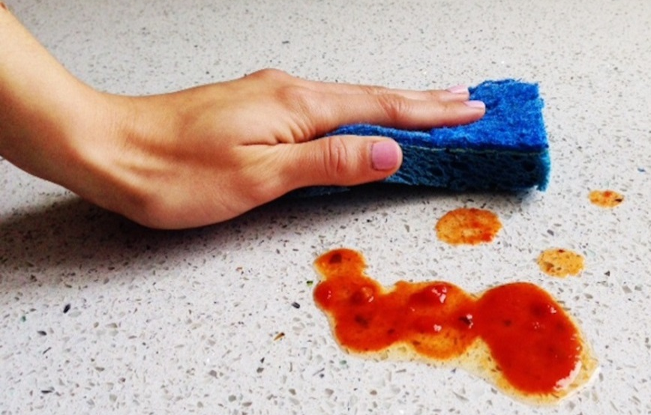
Cleaning and Sanitizing
Keep all work surfaces clean.
Disinfect work surfaces to prevent cross-contamination.
Surfaces that are in constant use must be cleaned and sanitized after 4 hours.
Clean crumbs and spills, store staples in airtight containers and dispose of garbage properly to reduce pests/insects.
If taste testing foods, always use a clean spoon and use it only once.

Slide 10
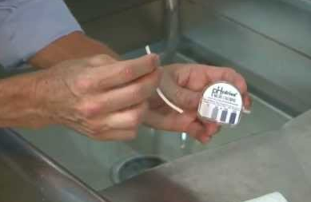
Cleaning and Sanitizing
Store towels for cleaning food spills in sanitizer solution when you are not using them. Never store them in your apron or uniform pocket.
Always use cleaners and sanitizers according to the directions.
Sanitizer must be left on the surface for the correct amount of time to reduce pathogens on surface to a safe level.
Use a test kit to check the sanitizers strength to ensure it is effective.

Slide 11
Cleaning and Sanitizing
To Sanitize:
Clean the surface.
Rinse the surface.
Sanitize the surface.
Allow the surface to air dry.

Slide 12
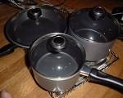
Dish Washing - By Hand
Wash dishes in the following order:
Rinse and Scrape Food
Glassware
Silverware
Dishware (Plates/Bowls)
Kitchen Tools
Pots and Pans

Slide 13
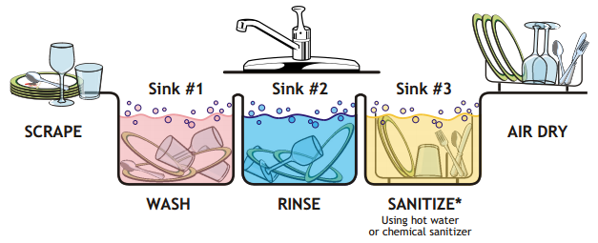
Dish Washing – 3 Sink Method
Scrape, Wash, Rinse, Sanitize and Air Dry

Slide 14
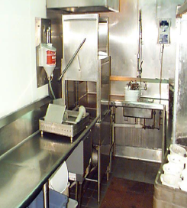
Dish Washing – Dish Machine
Dish machines are used in the industry to quickly clean and sanitize dishes.
Scrape, rinse or soak items before washing.
Never overload the dish racks and use the correct racks.
Frequently check water temperature and pressure.
Change the water when necessary.

Slide 15
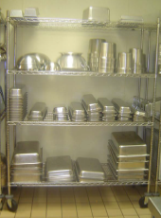
Storing Dishes and Utensils
Store in a clean, dry location.
Store at least 6-inches above the floor.
Store upside down on a clean, sanitized surface.
If storing utensils vertically, store them with handles up.

