Slide 1
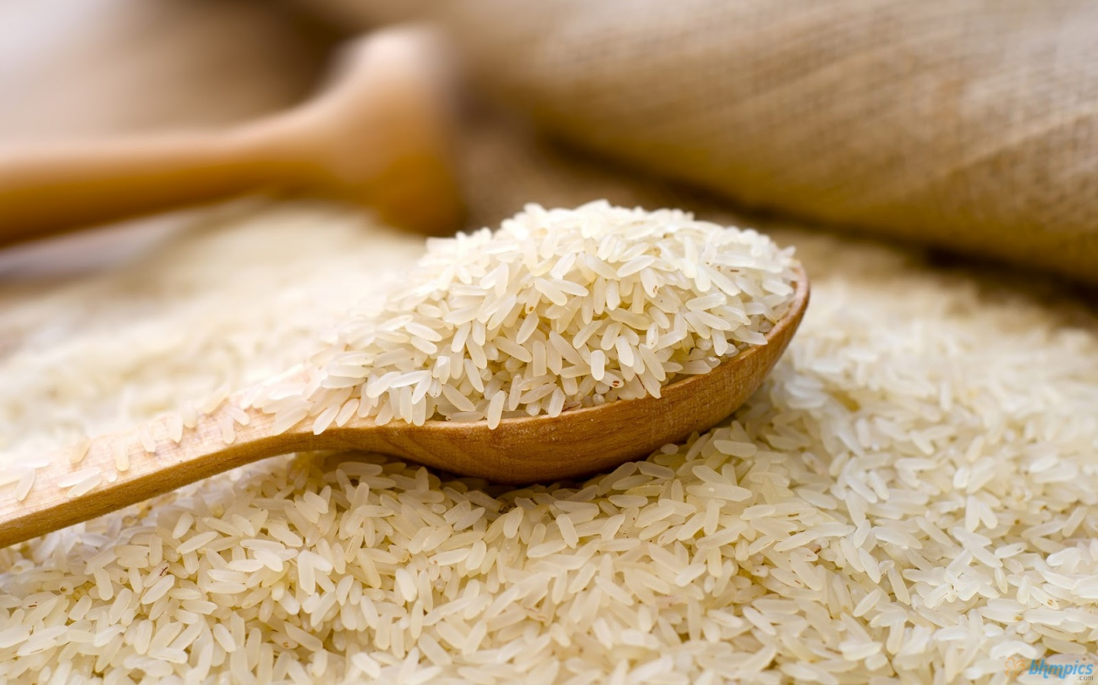
Rice

Slide 2
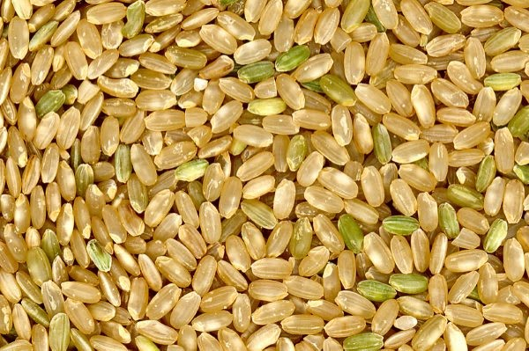
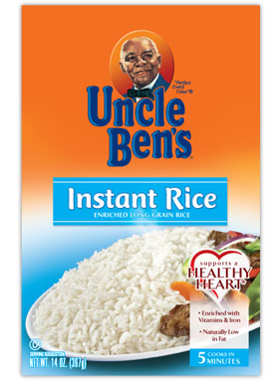
Types of Rice
Brown Rice
The whole grain form of rice.
Instant Rice
Precooked and then dehydrated.

Slide 3
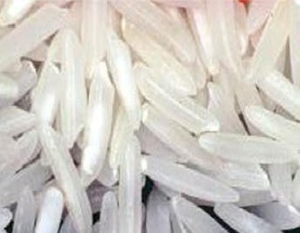
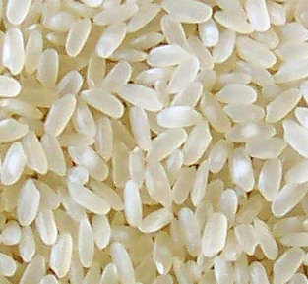
Types of Rice
Long Grain Rice
Stays dry and fluffy
Short Grain Rice
Sticks together
Also known as “Sticky Rice”

Slide 4
How to Cook Rice
Bring water to a boil.
Add rice, cover the pan and reduce heat to a simmer.
Do not remove the lid while rice is cooking.
Rice is done when all the water has been absorbed.
One cup of uncooked rice makes three cups of cooked rice. This makes a 1:3 ratio.

Slide 5
Oriental Fried Rice Lab
Using the principles we discussed, you will be making an oriental fried rice recipe.

