Slide 1
QUICK BREADS

Slide 2
Quick Breads
Why are quick breads called quick breads?
They are fast and easy to prepare.

Slide 3
Leavening Agents
Baking powder
Baking soda
Eggs
Steam
No yeast

Slide 4
Examples of Quick Breads
Muffins and biscuits
Pancakes and waffles
Corn bread
Nut/fruit bread

Slide 5
Purpose of Ingredients
Flour
Main ingredient
Provides structure
Liquid
Provides moisture

Slide 6
Purpose of Ingredients
Leavening
Makes bread rise
Fat
Provides tenderness
Provides richness
Provides some flavor

Slide 7
Purpose of Ingredients
Salt
Provides flavor
Sugar
Provides flavor
Provides browning

Slide 8
Assembly of Quick Breads
Step # 1
Mix dry ingredients together.
Step # 2
Mix liquid ingredients together.
Step # 3
Combine the two together.
Step # 4
Mix lightly only until dry ingredients are moist/lumpy.

Slide 9
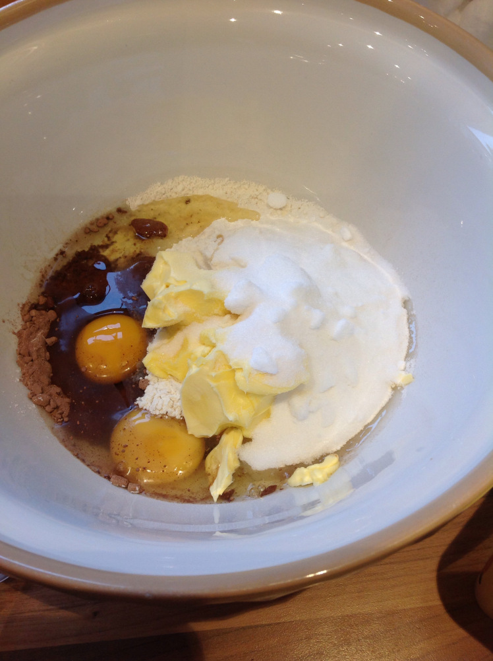
Under Mixing
Crumbly
Dry
Very few tunnels

Slide 10
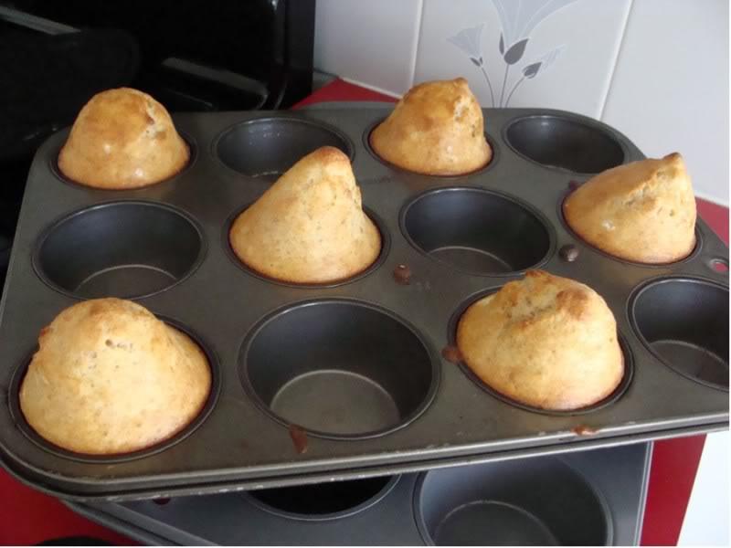
Over Mixing
High peaks on top.
Holes and tunnels inside.
Bread will be tough.
Notes:
High peaks on top instead of round tops.
Holes and tunnels in the muffins resembling Swiss cheese.

Slide 11
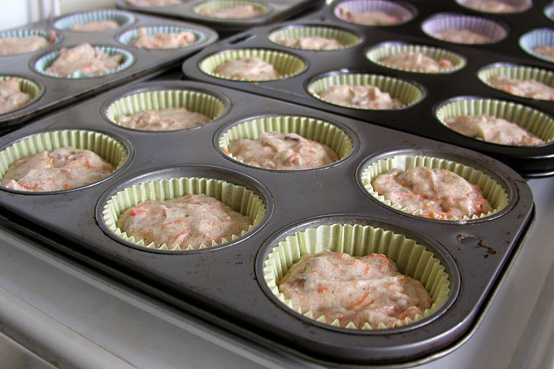
How to Fill Muffin Cups
2/3 full
Notes:
How full should you fill your muffin tins to? 2/3 full.

