Slide 1
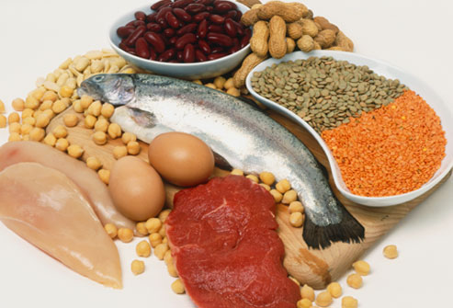
PROTEIN, EGGS AND MILK

Slide 2
protein

Slide 3
Facts About Protein
Primary function is to build and repair body tissue.
Protein provides 4 calories per gram.
Keep meat and poultry portions small and lean.
Include at least 8 oz. of cooked seafood per week.

Slide 4
Amino Acids
Amino acids are the building blocks of protein.
There are 22 amino acids.
Of those amino acids, 9 are essential.
The body cannot manufacture essential amino acids so they must be obtained from food.

Slide 5
Complete Proteins
Contains all nine of the essential amino acids.
Come from animal sources
Meats, poultry, dairy, eggs
One exception, tofu (from soybeans) is the only complete protein from a plant source.

Slide 6
Incomplete Proteins
Contains some of the nine essential amino acids, but not all.
Come from plant sources.
Grains, dried beans, nuts and seeds

Slide 7
Complementary Proteins
When two or more incomplete proteins combined together provide all of the essential amino acids.
A grain combined with any nut, seed or legume.
For example:
Beans with rice
Peanut butter with whole wheat bread

Slide 8
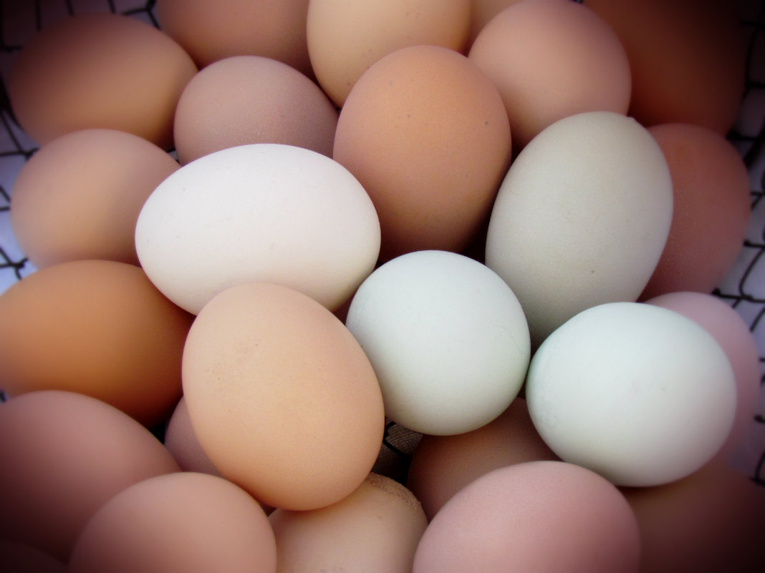
EGGS

Slide 9
Functions of Eggs
Binder
Definition
They bind other ingredients and hold them together
Recipe Example
Meat Loaf

Slide 10
Functions of Eggs
Thickener
Definition
Used for thickening foods
Recipe Example
Pudding

Slide 11
Functions of Eggs
Coating
Definition
Glue one food to another by being dipped into a beaten egg and then rolled in crumbs or flour.
Recipe example
Breading on chicken

Slide 12
Functions of Eggs
Leavening Agent
Definition
Give height or volume to many products by being whipped between 2½ to 4 times their normal volume.
Recipe Example
Angel Food Cake

Slide 13
Functions of Eggs
Emulsifier
Definition
Keeps other ingredients working well together by not separating the fat and acid.
Recipe Example
Mayonnaise

Slide 14
Cooking Eggs
Eggs are toughened by heat or by long exposure to heat.
Methods of Cooking Eggs
Hard Cooked
Soft Cooked
Scrambled
Fried
Poached

Slide 15
Appropriate Storage of Eggs
Store eggs in the original container in the refrigerator.
When properly stored in the refrigerator, eggs may be used for several weeks.

Slide 16
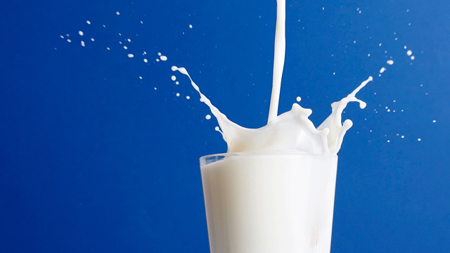
MILK

Slide 17
Facts about Milk
Recommendations for teens and adults
3 cups daily
Eat calcium rich foods from the Dairy Group
Switch to fat free or low fat milk

Slide 18
Processing of Milk
Pasteurized
Milk has been heat treated to remove harmful bacteria.
Homogenized
Milk has had the fat particles broken down and evenly distributed so the fat will not separate from the milk.
Fortified
Vitamins A and D have been added to the milk.

Slide 19
Raw/Unpasteurized Milk
Most of the nutritional benefits of drinking raw milk are available from pasteurized milk without the risk of disease that comes with drinking raw milk.
Raw milk made into other products like soft cheese, ice cream and yogurt can still cause dangerous illnesses.

Slide 20
Raw/Unpasteurized Milk
When consuming these products, make sure they are made from pasteurized milk.
Raw/unpasteurized milk can carry dangerous bacteria such as Salmonella, E-coli, Campylobacter and Listeria.

Slide 21
Milk Replacements
Examples
Almond milk
Soy milk
Rice milk
Comparable with milk in regards to nutritional value.
Viable substitute for people with special dietary needs.

Slide 22
Cooking with Milk
Milk products scorch easily
Need to be cooked at a low temperature with constant stirring.
Heating milk in the microwave prevents scorching.

Slide 23
Healthier Cooking with Milk
Reduce fat in recipes by using a lower fat content milk.
Substitute yogurt for mayonnaise or sour cream.
Substitute fat-free (skim) or low-fat (1%) milk for whole milk.

Slide 24
Milk Comparison Activity
This activity is completely optional.
It is worth extra credit points.
There is an alternative activity for those sensitive to lactose.

Slide 25
Summary
Recognize what foods are considered complete, incomplete or complementary proteins.
Eggs are very versatile and have many different functions when used in recipes.
Switch to fat free or low fat milk.

Slide 26
Homework Assignment
Now let’s apply what was learned today!
Complete the Protein Hunt worksheet.
This will be due next class period.

