Slide 1
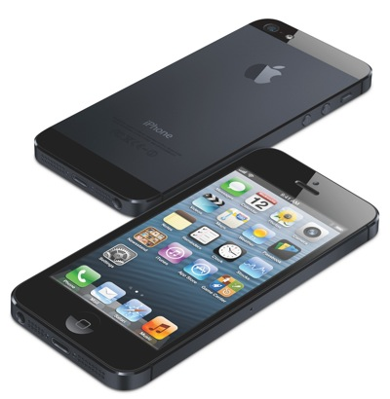
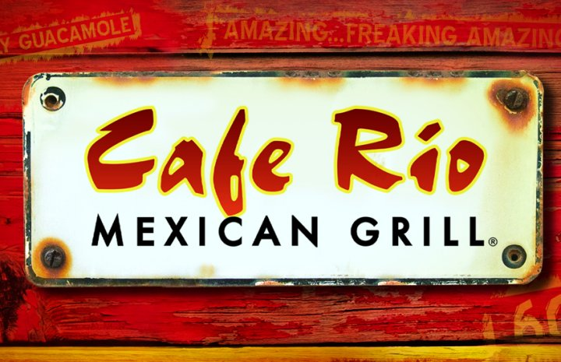
Promoting

Slide 2
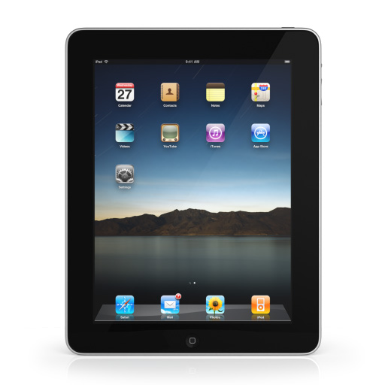
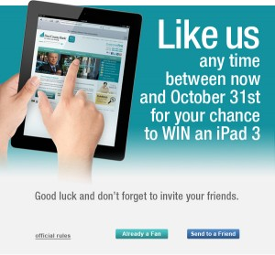
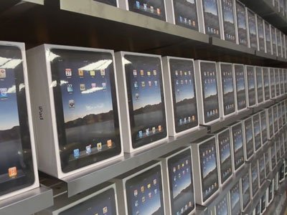
DEVELOP
↓
PROMOTE
↓
DISTRIBUTE

Slide 3
What are the
Four P’s
of Marketing?

Slide 4
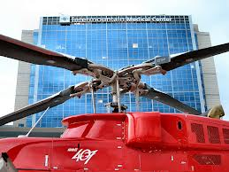
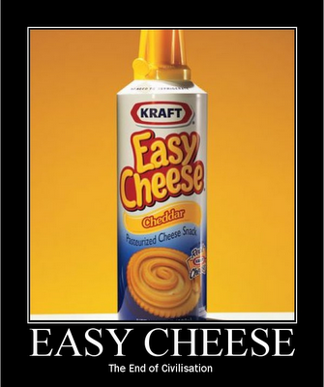
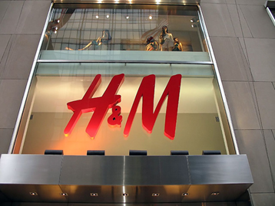
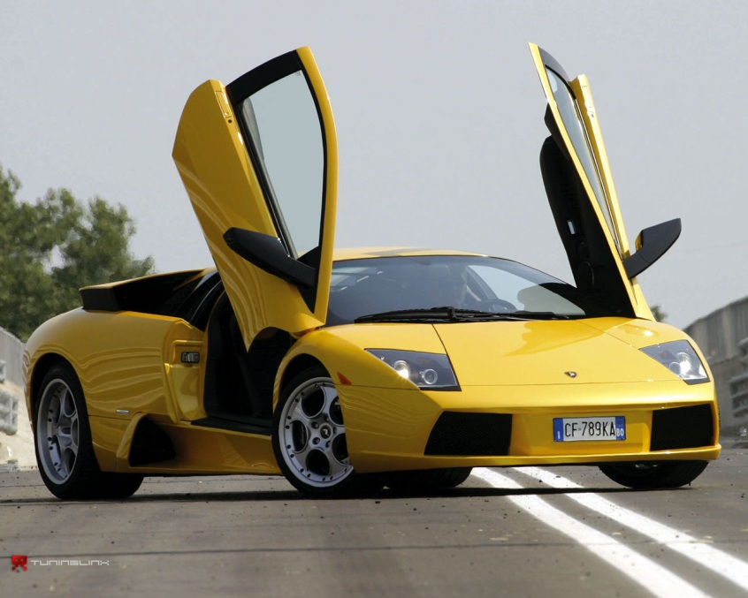
PRODUCT
►What are you selling to the customer? (goods, services, ideas)

Slide 5
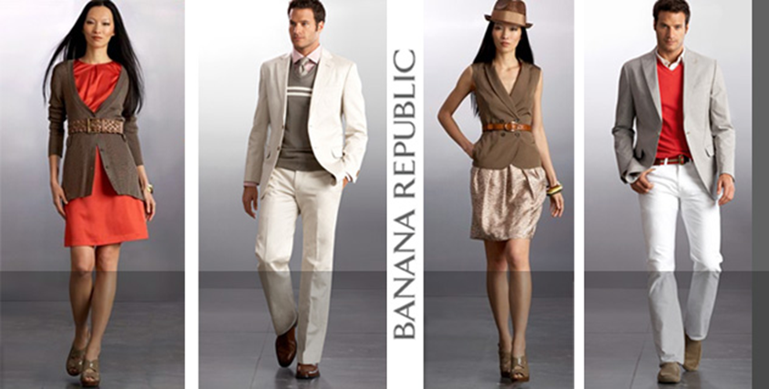
What are Products?
Goods: Car, Food, Home, and Clothes
Services: Hospital, TV Repair, Auto Mechanics, Carpet Cleaning, House Cleaning, Babysitting
Ideas: Internet, Training, Computers, Printed Materials, Inventions

Slide 6
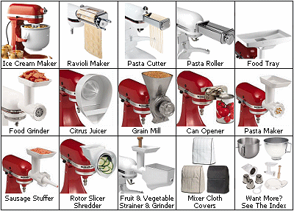
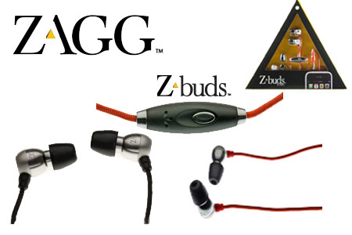
What Matters Most?
1. Features
2. Brand
3. Quality Level
4. Format/Packaging

Slide 7
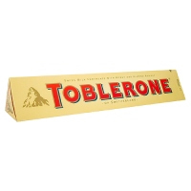
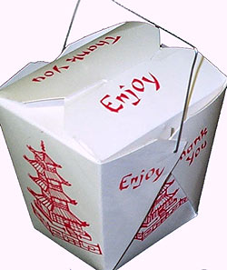
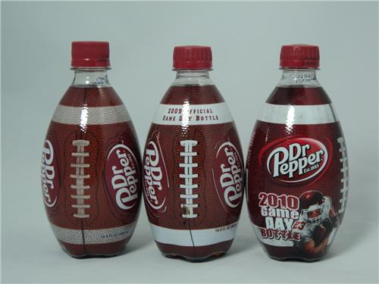
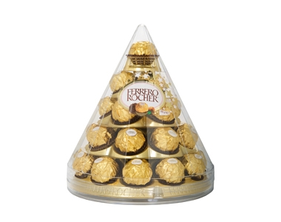
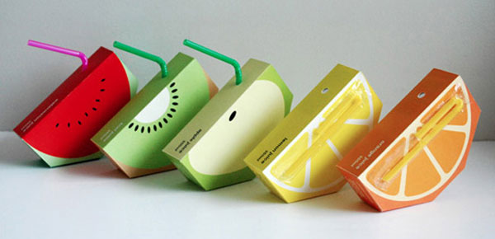
Packaging

Slide 8
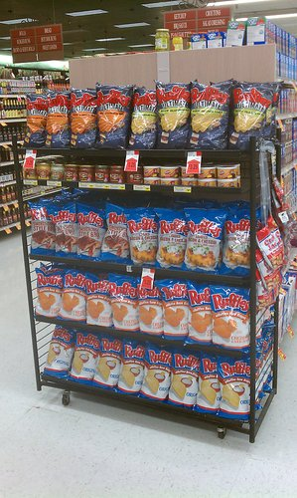
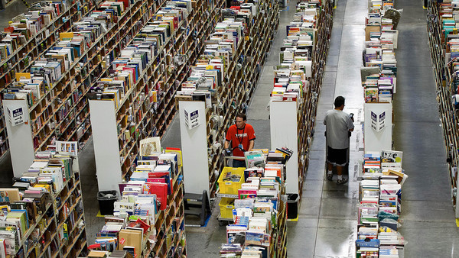
Place
Locations
Transport
Coverage
Inventory

Slide 9
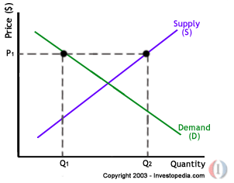
PRICE
List Price
Discounts
Allowances

Slide 10
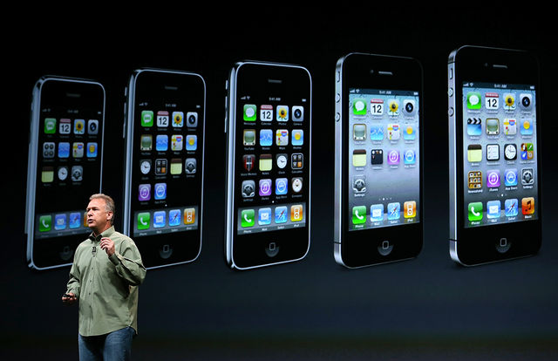
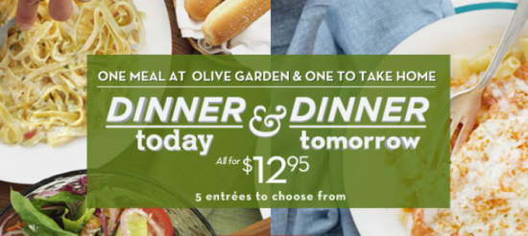
Promotion
►Advertising, Public Relations, Direct Marketing, Social Media, Events

Slide 11
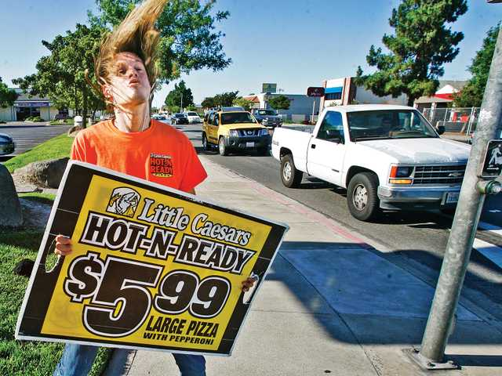
Advertising: The activity of attracting public attention to a product or business.
What are some good advertisements you have seen?

Slide 12
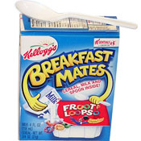
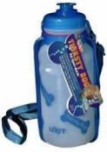
Failures
Colgate TV dinners
Breakfast Mates
Thirsty Dog
Why fail? …infuse the water with flavors like
crispy beef (for dogs) and tangy fish (for cats).

Slide 13
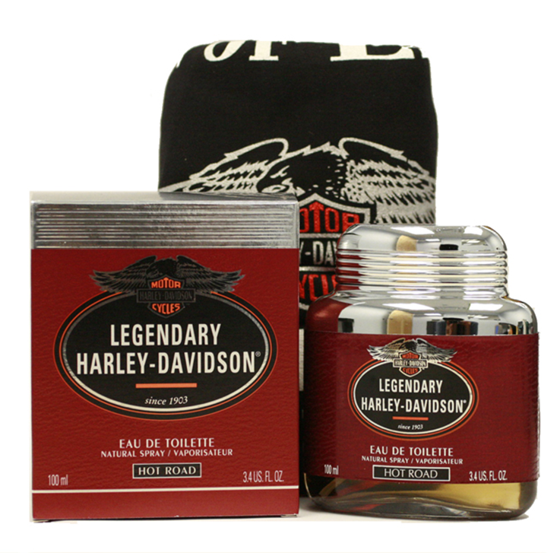
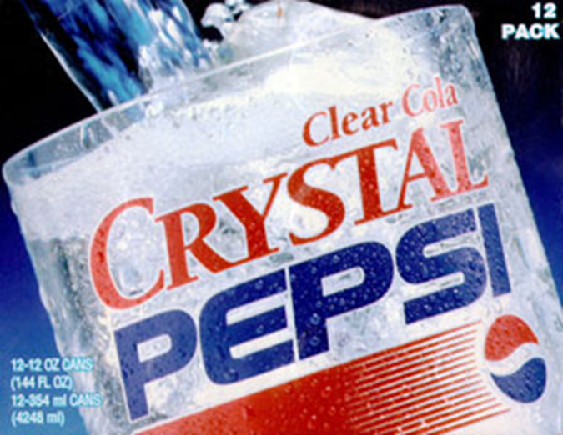
Failures
Harley Davidson Cologne
Crystal Pepsi

Slide 14
Your Promotion
How are you going to promote your items?
Design a logo/slogan. What look should it have?
Create a promotion for your food item. Include:
The number of tickets it will cost
Name of your product
Make it easy to read
Eye catching designs, colors, etc.

Slide 15
Packaging
What will your packaging look like?
How are you going to present your food item?
The rest of the hour is yours to create! ☺

