Slide 1
Prenatal Development

Slide 2
On-Going Prenatal Care
Often there is a direct correlation between the health of the expectant mother and the health of the unborn baby.
If the mom is healthy and taking care of herself, getting proper medical care, eating nutritiously, gaining the appropriate weight, the baby will most likely be healthy.

Slide 3
On-Going Prenatal Care
If the mom has health problems or is taking harmful substances into her body, the baby can be born with problems.

Slide 4
Prenatal Terminology
Umbilical cord
The connection between the fetus and the placenta.
It is 20 inches long.
Passes oxygen and nutrients from the mother to the child
Returns waste products from the child back to the mother.

Slide 5
Prenatal Terminology
Placenta
An organ attached to the endometrium lining in the uterus.
Filters and transfers nutrients and oxygen to the fetus.

Slide 6
Prenatal Terminology
Amniotic fluid
Guards against jolts
Keeps the fetus at a constant temperature
Keeps the fetus from forming a connection to the endometrium lining.

Slide 7
Prenatal Terminology
Amniotic sac
Holds the amniotic fluid
Very strong, clear and transparent membrane sac that surrounds the fetus
Before delivery, it is broken to allow the baby to exit out of it.

Slide 8
Prenatal Terminology
Uterus/womb
The uterus is called a womb when a fetus is growing inside of it.
Birth canal/vaginal canal
Called the birth canal during delivery of the fetus.

Slide 9
Stages of Prenatal Development
Prenatal development
The development of the baby before it is born.
The prenatal period lasts 40 weeks
There are three stages of prenatal development: Zygote, Embryo, Fetus

Slide 10
Stage 1: Zygote
This stage begins at conception and lasts until the zygote is implanted in the mother’s uterus.
Zygote grows to be about the size of a pinhead.
Roots grow from the zygote into the wall of the uterus where they can receive nutrients from the mother’s blood.
Length of time: First two weeks of pregnancy.

Slide 11
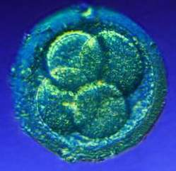
Example of a Zygote

Slide 12
Stage 2: Embryo
Embryo is attached to the mother by the umbilical cord, which reaches from the embryo’s stomach to the wall of the uterus.
Embryo is inside the amniotic sac.
Length of time: 3rd through the 8th week of development.

Slide 13
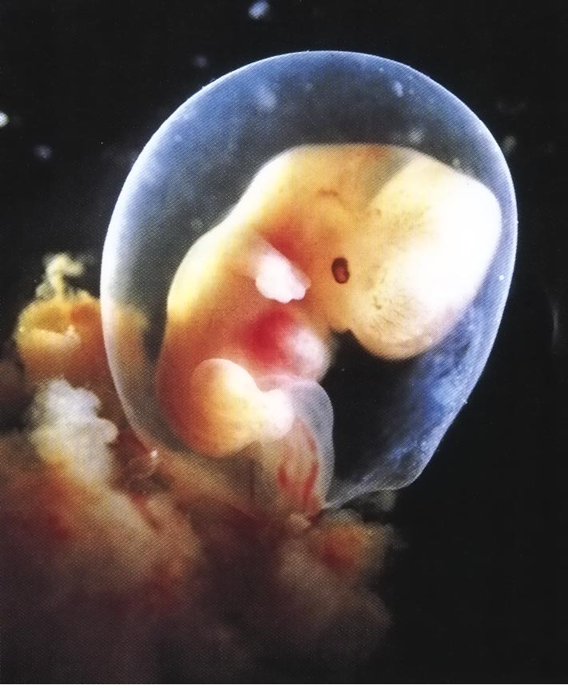
Example of an Embryo

Slide 14
Stage 3: Fetus
Body parts, organs and systems that were formed during the embryo period will become much more developed and begin to function.
The fetus will begin to resemble a human being.
Length of time: 8th week until term of delivery.

Slide 15
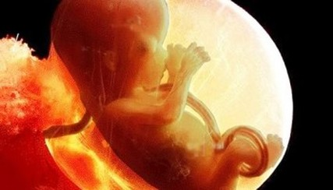
Example of a Fetus

Slide 16
First Trimester
The most critical and greatest time of risk and vulnerability for birth defects depending on what the mother does or does not do during the pregnancy.
Signs and symptoms of pregnancy are more likely to occur.

Slide 17
First Trimester
The majority of the physical development occurs (every physical feature and vital organs form, heart beats and brain waves begin).
There is small maternal weight gain.

Slide 18
Second Trimester
Quickening occurs during the 5th month
Slight fetal movements felt by the mother
Increased organ development.
Physically the easiest trimester on the mother.

Slide 19
Third Trimester
Physically the most demanding time for the pregnant mom due to discomforts of pregnancy.
Lanugo (fine hair) and vernix (waxy substance) both covering the fetus’s body begin to go away.
Fetus grows and gains weight rapidly: 5-6 lbs.

Slide 20
Third Trimester
Builds antibodies the last month to help the baby have a healthier start once outside of the womb and living as a separate being from the mother.
Lightening occurs during the ninth month.
Dropping movement of the baby into the Mom’s pelvic region in a head-down position in preparation for delivery

Slide 21
Multiple Births

Slide 22
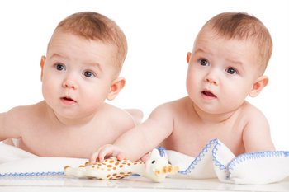
Identical Twins
One ovum (egg) is fertilized by one sperm and then splits into two or more.
Resemble each other
Are of the same gender

Slide 23
Fraternal Twins
Developed from two ovum (eggs), each fertilized by a separate sperm cell.
Don’t have to resemble each other.
Don’t have to be the same gender.

Slide 24
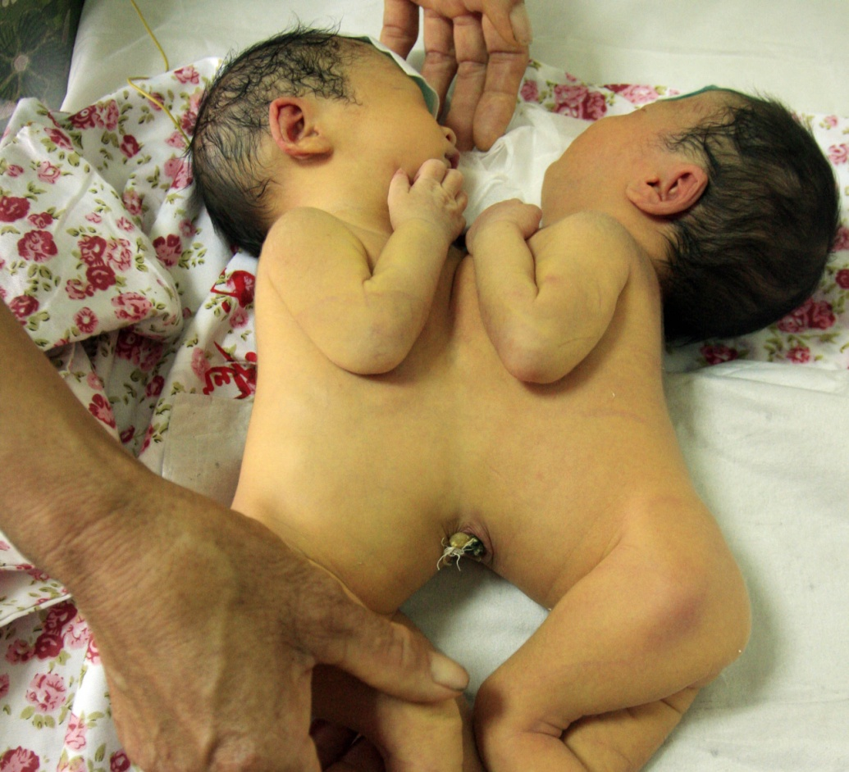
Conjoined Twins
Develop when the fertilized cells (identical twins) do not completely split apart before developing.

Slide 25
Summary
Early and on-going prenatal care.
Prenatal terminology
Three stages of prenatal development
Three trimesters in a pregnancy
Multiple births

Slide 26
Fetal Growth Activity
Split into nine groups.
You are going to create a visual representation of the fetus from one to nine months.
You will measure both weight and length of the fetus.

Slide 27
Assignment
Prenatal Care Assignment
Performance Objective – Very important to complete!!
Due next class period.

