Slide 1
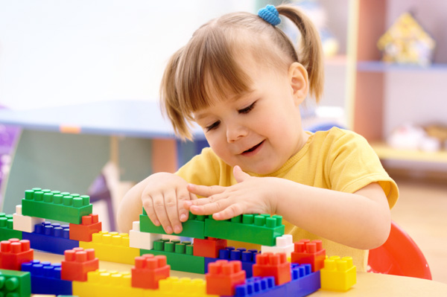
Physical Development of a Toddler

Slide 2
Age of a Toddler
Newborns
Birth to 3 month
Infants
3 months to 1 year
Toddlers
1 year to 3 years

Slide 3
Walking
Shows the beginning of the toddler stage.
Generally walk and run with their feet further apart than an adult.
Alternating feet while going downstairs is a challenge for them.
They are mobile, curious and want to be independent.
Create a safe environment for them to explore in.

Slide 4
Development of Motor Skills
Growth tends to slow down as the child gets older, but there is rapid growth in the arms and legs.
Review – What are gross and fine motor skills?
Tricycles and Big Wheels will encourage gross motor skills.
Puzzles and coloring encourage fine motor skills.

Slide 5
Suggested Toys
Can build with blocks
Struggle to use scissor and markers.
Toys should not have any small parts.

Slide 6
Self-Help Skills
Tasks that the child can do on their own.
Feeding
Simple finger foods
Dressing
Snaps, zippers and buttons are difficult to manage
Elastic waistbands, slip-on shirts

Slide 7
Self-Help Skills
If the child is old enough to do it or wants to attempt it, the caregiver should let them and not be so concerned with the end result.
The process is more important than the final product.

Slide 8
Nutrition
Good nutrition is the cornerstone for healthy child development.
A child’s nutrition affects the health, development, and function of their whole body – brain, heart, eyes, immune system.
What a child eats will have a big influence on their mood, behavior, thoughts, and emotions.

Slide 9
Proper Nutrition
Follow the guidelines set forth by the Food and Drug Administration.
Because a toddler’s growth is slowing down, they will eat less than they did in their first year.
Due to their small stomachs and frequent need for energy (calories), it is best to feed them 6 small meals, which include snacks, every 3-4 hours.

Slide 10
Proper Nutrition
Give smaller serving sizes/portions.
Use their hand or 1 Tbsp per age as a guide for the serving size portion.
Help children to enjoy fresh fruits and vegetables.
Provide foods rich in necessary nutrients that are easy to digest and appealing to the senses.

Slide 11
Proper Nutrition
Limit salty, sweet and fatty foods.
Use convenience and packaged foods cautiously.
Packaged foods are high in salt, fat, sugar, preservatives, artificial colorings and flavors.
If it comes in a bright package or with a prize, it usually is not the best choice to eat.

Slide 12
Proper Nutrition
Adequate amount of liquids
Mostly water
100% fruit juice
Low-fat milk

Slide 13
Toilet Training
Begins when the child is emotionally and physically ready.
Treat accidents matter of fact so there is no pressure or feelings of shame and doubt.
If the child fights toilet training or is struggling still after a few weeks, stop and wait about 3 weeks before trying the training again.

Slide 14
Physical Challenges of a Toddler
Put a puzzle together with your eyes closed. Try it again with eyes open but only give yourself one minute to finish it.
Color a picture with a crayon between your toes.
Cut out a picture with your left hand if you’re right handed or vice versa.
With a piece of paper on your head, draw a picture of a dog.

Slide 15
Summary
The toddler stage begins when the child starts to walk.
When the toddler begins walking, a whole new world opens up before them as they develop rapidly.
Toddlers love to explore everything.

