Slide 1
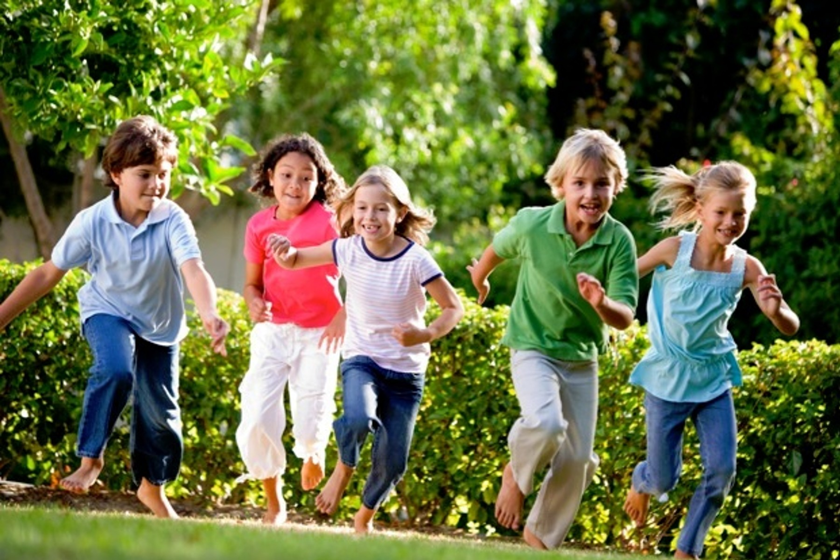
Physical Development of a Preschooler

Slide 2
Physical Characteristics
Physical growth slows down greatly.
Size varies due to individual growth patterns.
Bodies have become straighter and slimmer.
Protruding stomach from babyhood flattens.
Neck becomes longer.
Legs lengthen and grow straighter and firmer.

Slide 3
Physical Skills
Very active and energetic.
Skills are practiced by participating in the action again and again.
There begins to be a refinement and practice of gross and fine motor skills.

Slide 4
Gross Motor Skills
Define:
Larger movements your body makes with their arms, legs, feet, or entire body.
Examples:
Running, jumping and throwing

Slide 5
4 Year Old Gross Motor Skills
Stand on tip toes
Throwing and catching
Hopping on one foot
Alternates feet walking up and down the stairs
Walking backwards

Slide 6
5 Year Old Gross Motor Skills
Improved speed and coordination
Turning somersaults
Skipping
Balancing on one foot

Slide 7
Let’s Practice Gross Motor Skills
Bring your chair up to the front
Make a circle
Take one out so there is one less chair than there are students
Let’s play musical chairs! ☺

Slide 8
Fine Motor Skills
Define:
Smaller movements your body makes with fingers, toes, wrists, lips, and tongue.
More refined manual dexterity (ability to use your hands and fingers)
Better eye hand coordination
Examples:
Cutting, pasting, painting

Slide 9
4 Year Old Fine Motor Skills
Put on and zip up their own coats
Cut with scissors
Complete puzzles
Write letters of the alphabet

Slide 10
5 Year Old Fine Motor Skills
Tie their own shoes
Drawing a person with a head, body, arms and legs
Stay in the line
Using a spoon and fork to eat
Definite hand preference for being right or left-handed

Slide 11
Let’s Practice Fine Motor Skills
You are going to create a Mosaic Flower.
Tear construction paper into about 1” pieces.
Glue them on another piece of construction paper, creating a flower.
You may make any type of flower you’d like.
Be creative and have fun! ☺

Slide 12
Role of Play
Play is a child’s work.
It is how they learn about their world around them and all the areas of development.
Continues with solitary, on-looker and parallel play.
But now because of their ability to share, help, and do things another person’s way, it allows them to engage in cooperative play.

Slide 13
Cooperative Play
Define:
Children play and interact with one another
Examples:
Building a sand castle together
Playing store
Acting out a play

Slide 14
Summary
Preschool children are growing rapidly.
Their heads are more in proportion with their bodies and their coordination is improving.
It is important that adults provide them with toys and equipment to develop both large and small muscles.

