Slide 1
Physical Characteristics and Needs

Slide 2
Do Newborns Look Like This?

Slide 3
Or Like This?

Slide 4
Or Like This?

Slide 5
No…Newborns Look Like This

Slide 6
And Like This

Slide 7
And Like This

Slide 8
Circumcision
The removal of the foreskin on the penis.
This surgery is the parent’s decision.

Slide 9
Jaundice
Causes the baby’s skin and eyes to look slightly yellow
The livers inability to remove the billirubin from the body fast enough.
The baby might be producing too much billirubin.
Billibrubin
Substance produced by the breaking down of red blood cells.

Slide 10
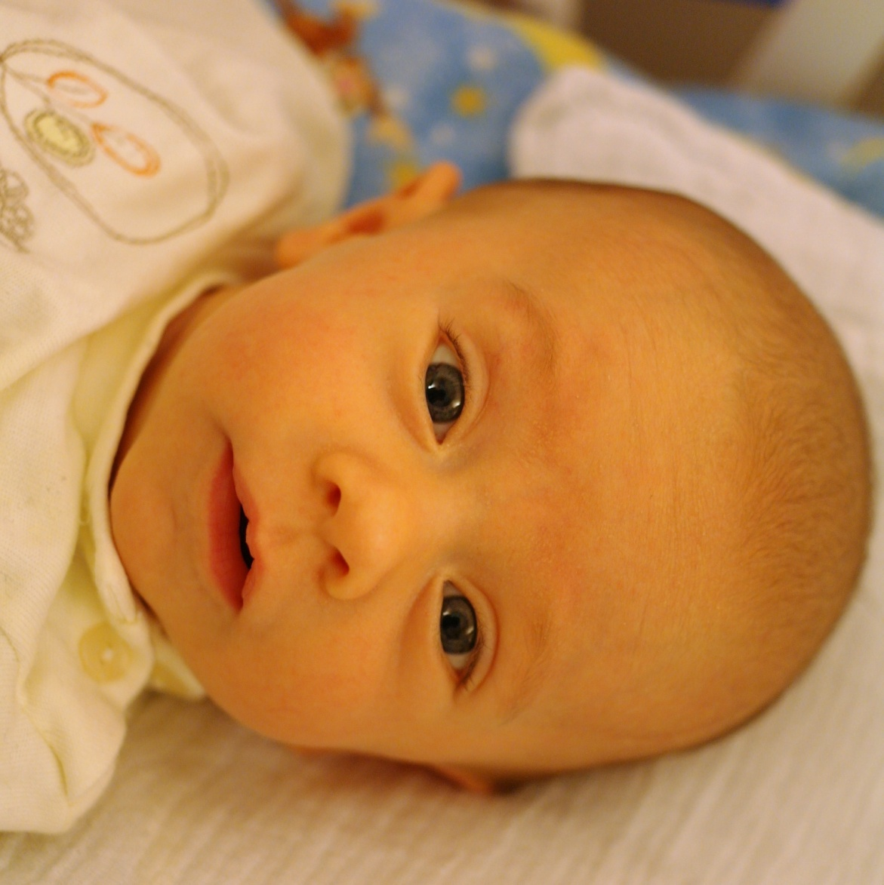
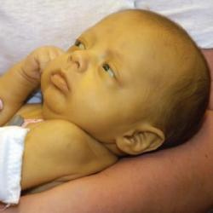
Examples of Jaundice

Slide 11
Head
The baby’s head may be elongated or misshapen as a result of its journey through the birth canal.
May appear too large for its body.
The head is 1/4th of the baby’s total size.
An average of 13 to 14 inches at birth.

Slide 12
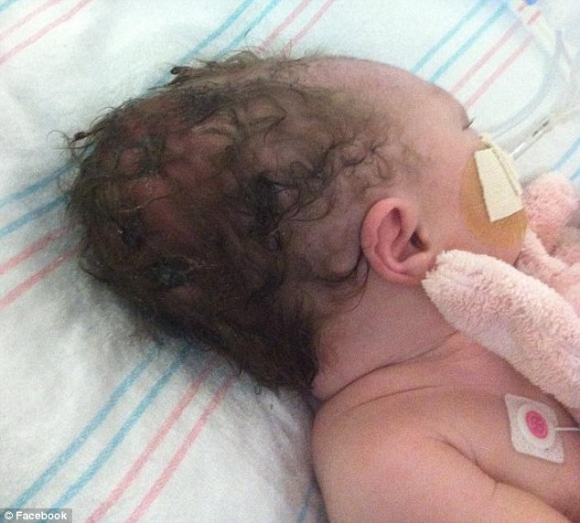
Examples of Heads

Slide 14
Fontanels
This is the space between the bones of the skull in an infant where it is not fully fused together.
Fontanels allow for rapid brain growth.
A child’s brain size can triple in the first two years of life.

Slide 15
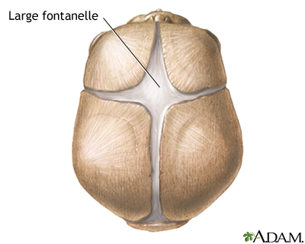

Slide 16
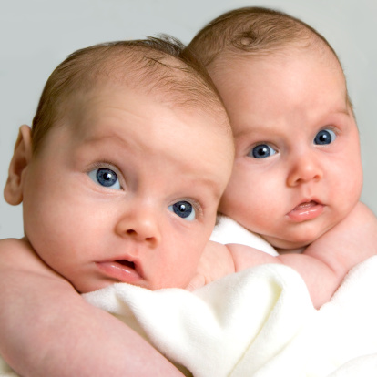
Eyes
Caucasian Babies
Born with blue eyes.
Will go through several color changes in the first few months.
Darken to their final color between 6 and 12 months.

Slide 17
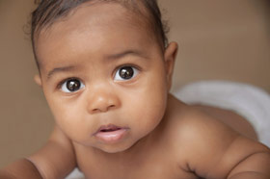
Eyes
Darker-skinned Babies
Born with brown eyes.
Stay brown or turn another dark color, such as a deep green.

Slide 18
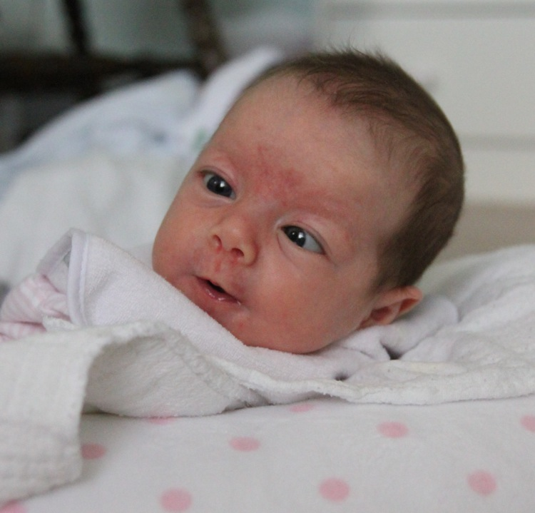
Eyes
May notice the baby looks cross-eyed.
A newborn’s eye muscles are weak at birth.
Over the next few weeks eye muscle strength will improve and the baby can better focus on objects.

Slide 19
Hair
Some babies are born bald.
Others are born with a full head of hair.
Most newborn hair will fall out, and the hair that replaces it may be totally different in texture and color.
In babies who do not have much hair, you may see a pulse beating under the soft spot at the back of its head.

Slide 20
Examples of Hair

Slide 21
Skin
Vernix
A thick cheese-like covering.
It helps to protect the baby’s skin while in the uterus against:
Infections
Becoming wrinkly from the amniotic fluid
Highly moisturizing

Slide 22
Example of Vernix

Slide 23
Skin
Milia
“Whiteheads” found over the baby’s forehead, nose and cheeks.
Plugged immature oil glands.
Disappear in several weeks.
Lanugo
Soft downy hair that cover the baby’s face and body.
Disappear within a few weeks after birth.

Slide 24
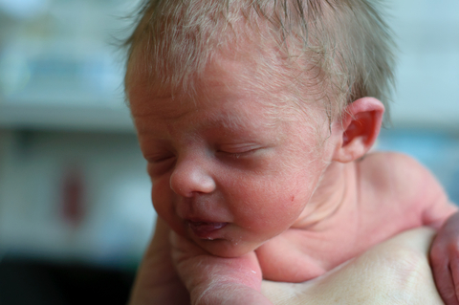
Examples of Milia and Lanugo

Slide 25
Skin
Stork Bites
Pale pink marks on the baby’s face and neck.
Will fade during childhood.
Mongolian spots
Bluish-black marks on the baby’s lower back or bottom.
More common on dark skinned children
Will fade during childhood.

Slide 26
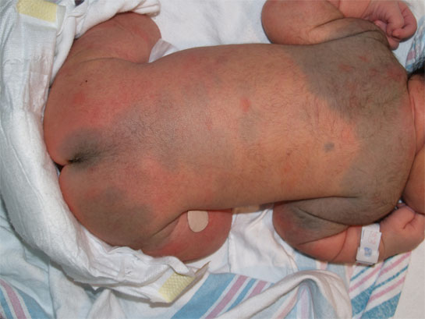
Examples of Stork Bites and Mongolian Spots

Slide 27
Skin
Very sensitive to temperature changes.
Too cold – May appear blotchy with slightly bluish hands and feet.
Too hot – Rash may develop.
Underlying blood vessels show through the new delicate skin, giving it a pinkish or reddish tone.

Slide 28
Skin
Wrinkly skin because the baby just spent nine months in fluid and now is exposed to dry air.
Skin becomes a little dehydrated right after birth.
Circulatory system isn’t quite developed yet, so when the baby sleeps, the hands and feet may look bluish.

Slide 29
Breathing
The abdomen may be round or stick out slightly.
The baby’s breathing is not like an adults breathing.
Babies take little breaths and use stomach muscles to help breathe.

Slide 30
Breathing
May notice short pauses between some breaths.
The rate of breathing is 30 to 60 times a minute.
The baby’s heart rate is rapid at 120 to 160 times a minute.

Slide 31
Chest
The breasts of boy and girl babies may look enlarged after birth.
The hormones that cross the placenta during the last two weeks before birth cause the breasts to fill with milk.
Do not squeeze the breasts.
The enlarged breasts will go away in about two weeks.

Slide 32
Umbilical Cord
Sticky material will collect at the base of your baby’s cord stump until it dries out and falls off.

Slide 33
Genitals
Genitals are the sex organs you see outside the body.
There may be some swelling around the genitals.
The hormones in a girl may cause the baby to have white vaginal drainage.
She may also have slight vaginal spotting, commonly known as a false period.

Slide 34
Feet
Arms and legs may look bent and are held close to the body.
Most newborn babies’ hands are in tight fists.
Legs may appear bowed and the feet might look pigeon-toed because they have rotated inward due to being curled up snugly in the womb for nine months.
After about 6 months, they’ll relax into a straighter position.

Slide 35
Feet
The arms and legs may also appear too short for the body because of their bent appearance.
This is temporary.
By 3 to 4 months, the arms and legs stretch out.

Slide 36
The Newborn’s Senses
Babies can hear loud and soft noises at birth.
Loud noises may cause your baby to startle.
Soft noises may help to calm your baby.
The baby quickly learns the difference in voice sounds.
The baby will turn its head to a familiar voice, especially mom’s and dad’s voice.

Slide 37
The Newborn’s Senses
When showing baby’s objects, hold them 8 to 12 inches from their face.
Hold a baby 12 inches from your face when talking or playing with them so that they can see you clearly.
Newborns can taste and smell at birth.
Babies will be able to taste formula or breast milk.

Slide 38
The Newborn’s Senses
Avoid heavy perfumes and do not smoke around a baby.
A newborn enters the world with virtually no muscle control.
They can’t hold their heads up on their own.
Their movements are mostly reflexes.

Slide 39
Behavior
The newborn baby will spend a lot of time sleeping or eating.
A baby may be very alert and gaze at you, or be very quiet and drowsy right after birth.
Think of it as after birth jet lag.
A baby may fuss briefly, make crying sounds, or even smile.

Slide 40
Behavior
When awake, your baby’s behavior may range from alert to fussy.
When the baby is quietly alert, this is the best time to feed, play and talk to the baby.
Crying is a response to unpleasant stimulation.
A baby needs to be calmed and held.
Babies have an emotional need for bonding right after delivery.

Slide 41
Summary
Be educated on what a baby will look like when it is born will help answer concerns or questions that may arise.

