Slide 1
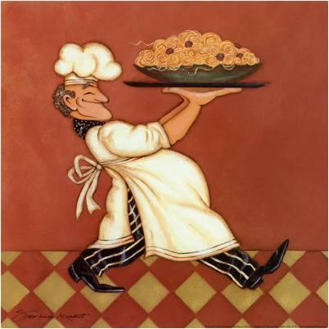
Pasta

Slide 2
Facts About Pasta
Pasta dishes are usually low cost entrees.
Store pasta in a tightly covered container at room temperature.
Fresh or cooked pasta should be stored in a closed container in the refrigerator.

Slide 3
How to Cook Pasta
Bring water to a boil.
Slowly add pasta so as not to stop the boiling.
Cook uncovered until pasta is al dente (firm to the touch)
Stir the pasta occasionally throughout the cooking process.
One cup of uncooked pasta makes two cups of cooked pasta. That makes a 1:2 ratio.

