Slide 1
Teens & Parents:
How to Earn Your Parent’s Trust

Slide 2

Communicate

Slide 3

Always Listen To Them

Slide 4

Give Specific Details

Slide 5

Be Honest

Slide 6

Stay On Task

Slide 7
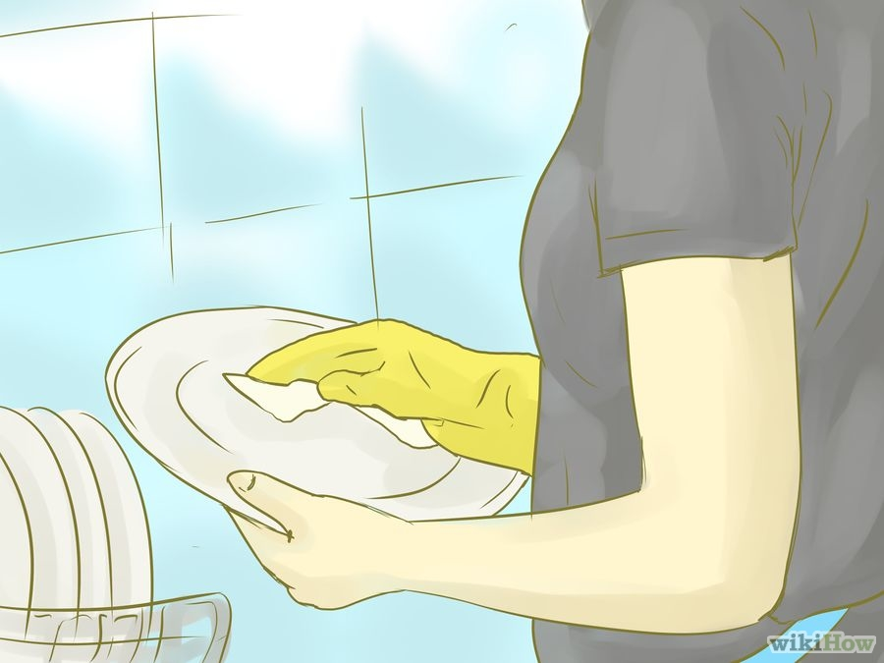
Help Without Being Asked

Slide 8

Be A Good Student

Slide 9

Choose Friends Of Good Character

Slide 10

Follow The Rules

Slide 11

Think Twice

Slide 12

Control Your Emotions

Slide 13

Show That You Care

Slide 14

Show Respect

Slide 15

Trust Your Parents

Slide 16
How To Get Your Parents’ Trust Back If You’ve Lost It

Slide 17

Apologize
Notes:
Try not to expect anything in return. Though it would be nice if the apology immediately fixed everything, that is unlikely to happen. It’s possible that your parents may not know the best way to respond to your apology. The words you use are less important than speaking genuinely. Another part of apologizing is forgiving yourself.

Slide 18

Ask What Will Rebuild Their Trust

Slide 19

Understand Their
Rules and Expectations

Slide 20

Demonstrate Responsible Actions

Slide 21

Alter Your Actions

Slide 22

Set Personal Boundaries

Slide 23

Repair The Damage

Slide 24

Always Be Completely Honest

Slide 25

Control Your Emotions

Slide 26

Hang in there!

