Slide 1
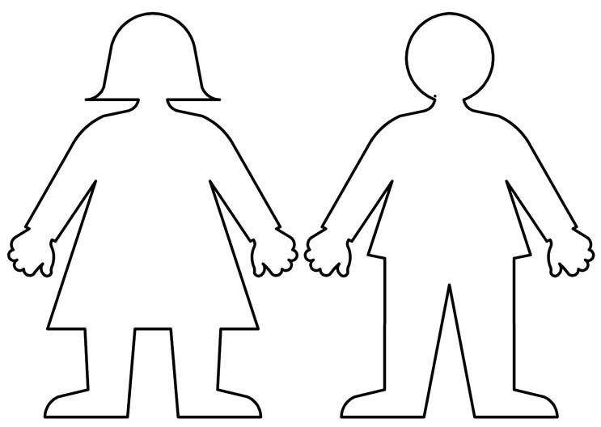
CDA # 1 Aspirations

Slide 2
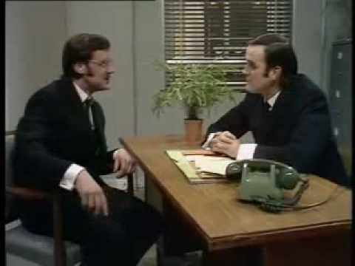

Slide 3
What are CDA Lessons?
Career Development Application
Seventeen lessons taught throughout the school year
Designed to help you learn more…
About yourself
The world of work
How to create a personal plan to achieve college and career success
Today’s lesson will be learning more about yourself

Slide 4
Aspirations
Today will be an exercise to help you think about your hopes and dreams for the future.
That is what an aspiration is.

Slide 5
In-Class Assignment
Each student will be responsible for producing some type of illustration to reflect how they imagine their futures.
Your illustrations will be shared with others.
Each student will grab a cutout to complete their project on.

Slide 6
Questions to Answer in Your Project
Do you have a family?
Where do you live…big city, town, small community, on a farm?
What does your home look like? Do you rent or own your home?

Slide 7
Questions to Answer in Your Project
Describe your workplace. Do you work at home, in a company setting, outside, etc.? If you don’t work from home, how far do you travel to get to work?
How do you get around…public transportation, taxi, ride share, bicycle, your own vehicle (what kind)?
What do you do for fun…hobbies, sports, recreational pursuits, vacations?

Slide 8
Due Date
This project is to be handed in before leaving class today.
We will be using these for our next CDA Lesson #2.
Please make an attractive and engaging way to portray your aspirations at a glance.
This will be graded. So take your time and put your best effort into it.
Have fun and get to work! ☺
And yes…you may work with your friends.

