Slide 1
MICROWAVES

Slide 2
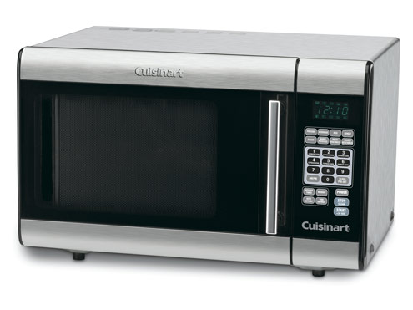
Microwave Oven Pretest
What do you already know about microwaves?
Take this short pretest to see.
This will NOT be graded, so relax!! ☺

Slide 3
Bell Ringer Question
When was the microwave oven first introduced to the public?
1945

Slide 4
Advantages to Microwave Ovens
What are the advantages to cooking in a microwave oven?
Time
Energy
Nutrients

Slide 5
How Do Microwave Ovens Work?
Microwave ovens use radio waves.
Microwaves cause molecules to vibrate.
Vibration creates friction.
Friction produces the heat that cooks the food.
Microwaves penetrate 1½” depth into food.

Slide 6
Microwaves Are Attracted To:
Fat
Sugar
Water Molecules

Slide 7
Microwave Safe Containers
Microwave Safe Plastic
Microwave Safe Glass
Microwave Safe Paper
Do NOT use any metal!! Why?
Shallow, round containers cook more evenly than square containers. Why?

Slide 8
Microwave Cooking Terms
Microwave Cooking Time
The time food needs to cook with microwave energy.
Standing Time
The time food continues to cook after the microwave as stopped.
Quantity/Volume of food in the microwave increases cooking and standing time.

Slide 9
Ways To Increase Even Cooking
Stir and rotate foods for even cooking.
Covering foods holds in the moisture and helps foods to cook more evenly.
Cover foods with:
Plastic wrap
Paper towel
Wax paper
Lid

Slide 10
Browning of Foods
Do microwave ovens brown your food?
Microwave cooking does NOT brown foods or give a crisp crust. Why?

Slide 11
Safety Tips
To prevent burns:
Use pot holders
Direct steam away from your body.
Covering foods while cooking prevents food from splattering in the microwave.
Eggs cannot be cooked in their shell in the microwave. Why?
Pierce potatoes to prevent exploding in microwave.

Slide 12
Sticky Buns
Demonstration

