Slide 1
Introducing the
INFLUENCE OF MEDIA
a tour of positive and negative effects
… and personal role models

Slide 2


Reflect on the following questions:
What affect does media have on my actions? What role models do I have and how are they affecting me and my behavior?

Slide 3

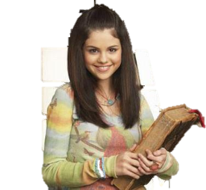
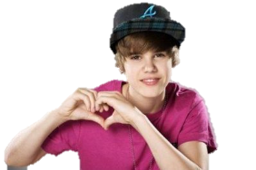
Dramatic Play…
When you were little, who did you pretend to be?
Did you ever try to copy a scene from a tv show or movie?
Have you ever acted like someone you saw on TV or in a movie?
Have you ever noticed your emotions change while listening to a song?
GOOD OR BAD?

Slide 4
Recognize any of these?
Slogan
Product
They’re gr-r-r-r-reat!
Once you pop, you can’t stop!
It’s everywhere you want to be
It keeps going and going and going…
Eat more chicken
Snap, Crackle, Pop
Think different!
Frosted Flakes
Pringles
VISA
Energizer Batteries
Chick Filet
Rice Krispies
Apple

Slide 5
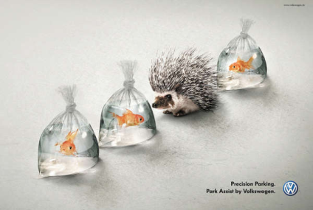

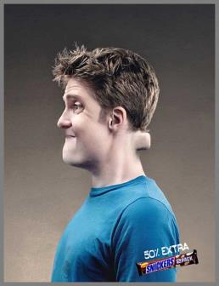
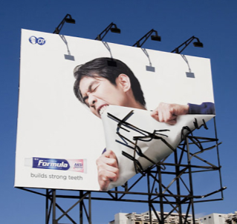
How
About
These?
What
Is Being
Sold?
Notes:
Bookshelf – Ikea
Man in blue shirt – Snickers
Billboard – Toothpaste
Porcupine – Volkswagen

Slide 6
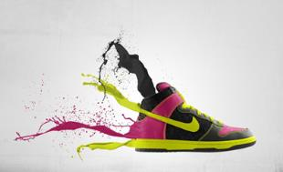
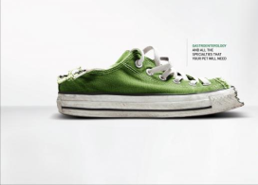

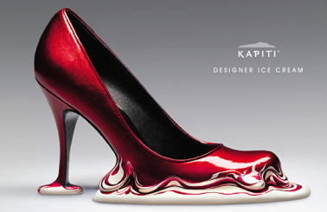
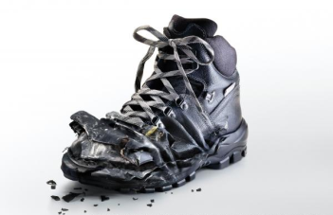
Which ad is actually selling shoes?
Notes:
Nike Shoe: Actual Nike Ad
Red Pump: Selling Kapiti Designer Ice Cream
White Pump on Golf Course: Mastercard Ad
Green Tennis Shoe: Veterinary Hospital
Black Hightops: Suva Car Insurance

Slide 7
Living in the Digital Age
The Good News:
The Bad News:
Average IQ scores steadily rising
Higher ability to task-switch (shifting attention from one task to another)
React more quickly to visual stimuli
Improved ability to sift through large amounts of information rapidly and decide what’s important and what’s not.
New uses of language and symbols that use different parts of the brain
Increased global communication
Lack of critical thinking and problem solving skills
Loss of fundamental social skills
Artificial intimacy
Shorter attention span
Impacts physical health
Loss of reflective capability

Slide 8

So…Do you communicate with your family through media? HOW?
Negative ways I communicate to my family through media…
Positive ways I communicate to my family through media…

Slide 9

Media Moment:
What is your favorite music group to listen to?
What kinds of songs do they usually sing?
What pictures do you have up in your bedroom?
What movies do you usually see?

Slide 10

Media Moment…
What is your favorite song to listen to right now on your ipod?
Can you think of all the lyrics?
Begin writing them down.
Explain the message being sent through this song to your neighbor.

Slide 11
Communication Through Media
Positive or Negative?
“The use of media has become demanding as it fills people’s day-to-day lives and social relationships. We become part of society by being connected through the media. Media is everywhere; the use of media has become part of today’s popular cultures. People in different positions and situations use media in specific ways as each of us have different priorities.” Sunday April 27, 2008, “How does media affect me?” posted by fofa at 11:34pm.
Notes:
It is what it is
Sunday, April 27, 2008
How does media affect me ?
Now-days I cannot imagine myself without the influence of the media; from the time I wake up to the time I fall asleep. We are living in a media culture. It is impossible to escape from the influence of media; it has become part of our daily routine. Just think about it, can you imagine yourself going a day without using any source of media? I can assure you that the answer is no.
The use of media has become demanding as it fills people’s day-to-day lives and social relationships. We become part of society by being connected through the media. Media is everywhere; the use of media has become part of today’s popular cultures. People in different positions and situations use media in specific ways as each of us have different priorities.
The media is the most important link between individuals, as it allows us to become connected. Even though, I am in the USA I can easily communicate with my friend in El Salvador through hotmail. I can even be aware of the news from back home; I can read a Salvadorian paper- El Diario de Hoy- from the internet.
Media helps me connect to the world around me; I use the internet daily to talk to friends and family. I read the newspapers to be informed of the world around me. I read a book in order to enter a world of fantasy. I buy fashion magazines to be aware of latest trends. The media offers me the experience too feel connected in today’s culture.
Posted by fofa at 11:34 PM

Slide 12
Communication through Media:
Positive Effects
Negative Effects
Instant information world-wide
Spreads knowledge
Educates people on basic rights
Skill development (tutorials, etc.)
Informed advertisements
Educational programming
Exaggerated sexuality
Increased aggressiveness (cyberbullying, etc.)
Increased violence and criminal activity
Unrealistic expectations
Increased deception
Information overload
Notes:
How does media affect our lives?
Media plays very a important role and has influence in virtually every aspect of our lives. It is considered as the best source to know about the happenings of world. Newspaper, magazine, radio, television and internet are the different types of media. It greatly affects our lives because media has the power to influence our thoughts. This influence is sometimes positive and sometimes negative.
NEGATIVE EFFECTS
Media is the most influential one for the people to resort violence. Studies have suggested that the exposure to violence on television, movies and video games make the children more aggressive, fearful, less trusting and more accepting of violence. This does not mean that they will start bringing weapons in the school but they will be more aggressive and less trusting towards their friends, teachers and siblings. Some of them may carry out same violent act that they see in the violent programs and eventually become more disposed to commit acts of violence.
In the past, news about some murder, accidents etc. were used to be published in simple sentences or we can say in a way to just inform the people about a particular happening. But now all has changed. Today news is published in an exaggerated manner to attract the attention of people. This is against the ethics of journalism. So instead of being constructive, media plays a destructive role. People who read much of these news or view excessive violence on television, trust less and take the world more frightening than it is.
Sex and violence in media also lead towards the sex crimes in the society. It traumatizes youngsters which result in abuse in the home, streets, towards children etc.
Some advertisements try to influence the people by telling them the importance of branded items. As a result children and youngsters become status conscious and thinks that by using these items they can show their high status in the society. To fulfill their needs or to impress others they many times go violent to get money.
POSITIVE EFFECTS
Every coin has two sides, similarly media also affects positively on the society and people.
Earth has become a global village due to media. We can know about any part of the world within minutes through television and internet. Media is the best way to spread knowledge, information and news from one part of the world to the other.
Media educates the people to know about their basic rights and how to use them. It is also a link between the government and people because all the policies and activities of government are conveyed through media. It has such a great influence that it can make or break government.
Education programs help the people to learn anything through internet, television and radio. Children can develop their skills and intellect by watching these programs because audio and visual media makes it quite easy to understand.
Advertisements help us to know the different products in the market and we can easily make our choices according to our needs.
Weather forecast programs tell us about the weather so that we can take precautions or plan accordingly.
So we can say that media greatly affects our lives both negatively and positively. It must give us factual information and fair analysis of a situation, news etc. Media also works in the way to help, liberate and empower the people.
Source: http://www.letusfindout.com/how-does-media-affect-our-lives/

Slide 13
Psychology Today Magazine, Jan/Feb. 2009
“If you aren’t living according to your values, you won’t be happy, no matter how much you are achieving.”

Slide 14
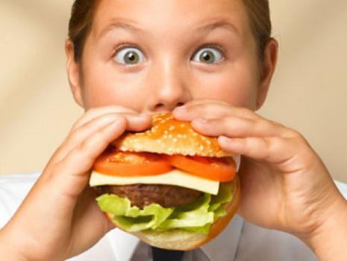
How to Evaluate Media
Source: Whose message is this?
Audience: What group is the target?
Text: What do you actually see or hear?
Subtext: What is the meaning we create from the text in our own minds?
Persuasion Techniques: What techniques are being used to persuade me to believe or do a certain thing?
Point of View: What is the point of view the story is being told from?

Slide 15
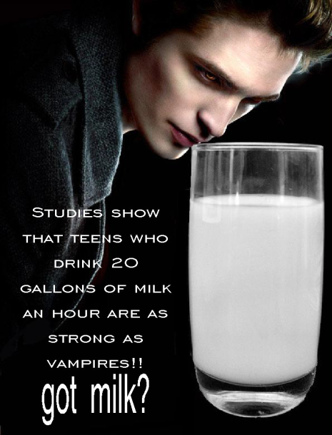
BASICALLY…
Who made it?
Target audience?
Tools of persuasion?
What is being left out?

Slide 16
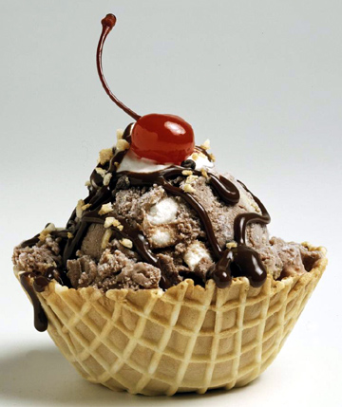
Want some?
The media can make things look really good.
How do you assess what is good and what is bad?

Slide 17
How
about
now?

Slide 18

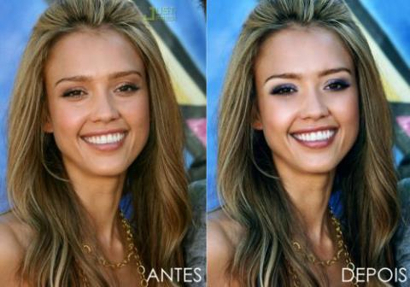
What a difference Photoshop makes!
What a Lie they feed us!
Jessica Alba
Faith Hill
Notes:
What’s the big deal?
Karin Jasper, Ph.D states “Women are encouraged to be over-concerned with their appearance, to invest time and energy in how they look at the expense of other important goals. The media, fashion, and advertising industries have been accused of causing eating problems by their almost exclusive presentation of thin female actors and models.”
She also states “…current advertisements perpetuate the myth that everyone can be thin, they lend reality to what is false. We are led to believe that if we would do all the right things, if we would eat right, exercise right, and think right, then we could all be thin. The fact is that genetic factors contribute to our having a variety of body types.”
In Media Messages by Linda Holtzman she quotes Douglas Kellner saying, “Radio, television, film and other products of the culture industries provide the models of what it means to be male or female, successful or a failure, powerful or powerless…media culture helps shape the prevalent view of the world and its deepest values: it defines what is considered good or bad, positive or negative, moral or evil.”
Holtzman also states “On the one hand, most of us know and can articulate that the programs we are watching are fictional; yet we often believe and internalize the invisible messages we are receiving. This same process occurs as we listen to popular music or watch a feature film.”

Slide 19

What do we think reality is?

Slide 20

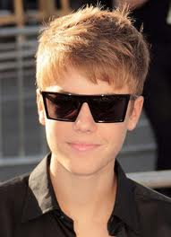
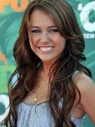


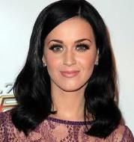


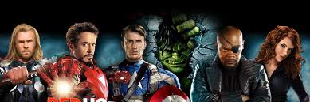
Role Model vs. Idol
Notes:
Being famous and/or wealthy doesn’t automatically make a person a positive role model.
Most media use famous people to promote their products so you will buy it to be like that person!

Slide 21
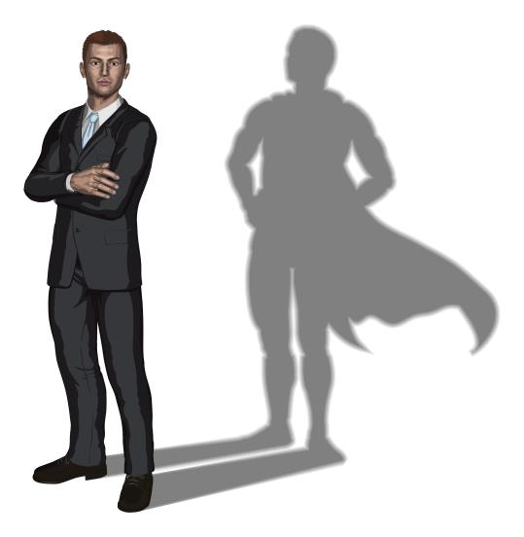
What is a Role Model?
A person who models patterns of behavior, attitudes and values.
Why is it important to have role models that inspire you?
Teens visualize they have the ability to be like that individual and pattern behavior like them.
Helps teens make decisions about his/her life in order to become like that person.

Slide 22
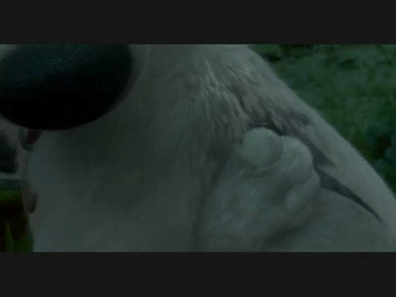
They need a hero…
“Someone who no matter what the odds, will do what’s right!”
“Someone who’ll tell them sometimes the impossible can become possible!” ~Rhino, Disney’s BOLT

Slide 23
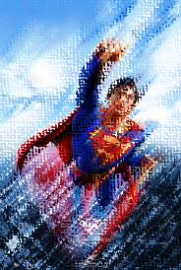
Choosing Role Models
Role models can influence others’ personal behavior, attitudes and values-both positively and negatively.
Successful people surround themselves with others who are successful.
WE MUST BE VERY CAREFUL WHOM WE CHOOSE TO BE OUR ROLE MODELS!
Top Qualities of Positive Role Models:
  Passion and Ability to Inspire
  Clear Set of Values They Stick To
  Commitment to Community
  Selflessness and Acceptance of Others
  Ability to Overcome Obstacles
Notes:
http://www.rootsofaction.com/what-is-a-role-model-five-qualities-that-matter-for-role-models/

Slide 24
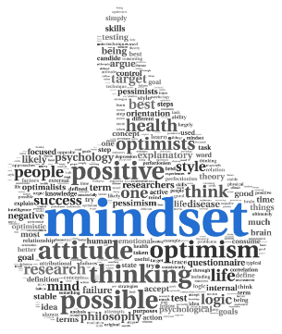
Role Models and Goals
Your mindset about achieving goals can have an influence on what role models you choose.
Growth Mindset:
  Takes on challenges without fear
  Keeps trying during tough times
  Learns from mistakes
  Accepts feedback/criticism
  Seeks learning, improving and success
Fixed Mindset:
  Avoids or fears challenges
  Gives up when things are tough
  Makes excuses
  Doesn’t try so failure isn’t possible
  No personal growth
Teens who have a growth mindset seek role models who also have a growth mindset.
Teens who have a fixed mindset seek role models who also have a fixed mindset.
Notes:
http://www.rootsofaction.com/role-models-youth-strategies-success/

Slide 25

Do you see yourself as a ROLE MODEL for others?
Are you a role model?
For who?
  Families…
  Careers…
  Communities…
You never know who is watching and what your influence will be.

Slide 26
So…
Those with whom we associate have an influence on us. Association with productive, self-sufficient, well-adjusted, happy people can have a positive effect on us that may lead to our success in life!
YOU ATTRACT WHAT YOU ARE!!!

