Slide 1
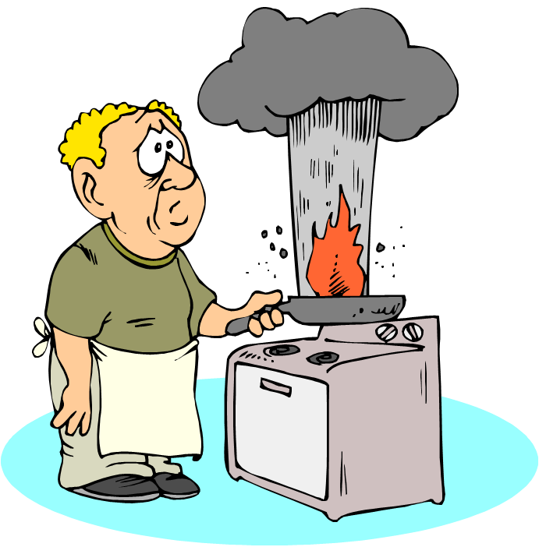
KITCHEN SAFETY

Slide 2
Electrical Appliances
When using electrical appliances…
Your hands should always be?
The floor should always be?
You should always keep them away from what?
Dry
Dry
Water

Slide 3
Electrical Appliances
Before using an electrical appliance, which should be plugged in first?
The cord into the appliance or
The cord into the power source
The cord into the appliance

Slide 4
Electrical Appliances
Before you clean any electrical appliance, what should you do first?
Disconnect the appliance from its power source
Make sure your hands are dry when you disconnect the appliance

Slide 5
Grease Fires
Name four ways to extinguish a grease fire.
Use a lid on the pan
Throw baking soda onto the fire
Throw salt onto the fire
Use a fire extinguisher

Slide 6
Grease Fires
What two items should you avoid using when extinguishing a grease fire?
Water
Flour

Slide 7
Cleaning Supplies
Cleaning supplies should be stored away from what?
Why is it important to keep the original containers of your cleaning supplies?
Lists the chemicals in the container
Poison information
Food

Slide 8
Cleaning Supplies
What two cleaning compounds should you never mix together?
Chlorine
Ammonia
Why?
It will create deadly fumes

Slide 9
Knives
Which is more dangerous to use:
A dull knife or
A sharp knife
Why?
More dangerous and less efficient than a sharp knife.
Dull Knife

Slide 10
Range
When cooking on the range…
What kind of clothing should you avoid wearing?
What type of materials should you avoid having on or near the range?
Plastic
Paper
Loose fitting clothing

Slide 11
Range
When cooking on the range…
Where should the handles of your cookware be facing?
Away from the front of the range

Slide 12
Falls
To avoid falls in the kitchen, what should you do when you have spilled something on the floor?
Clean it up immediately

Slide 13
Burns
To prevent from getting burned, how should you lift the lids off of hot foods?
Open away from you while using the lid as a shield.
What should you use when handling hot baking pans?
Hot pads or oven mitts

Slide 14
Storing/Reaching Items
Where should you store heavy items in a kitchen?
On lower shelves
What should you use when reaching for high objects?
Step stool

Slide 15
First Aid Procedures
How do you properly care for a first degree burn?
Place burned area under cold running water.
How do you properly care for a severely bleeding cut?
Apply direct pressure over the wound.

Slide 16
First Aid Procedures
Before approaching a person suffering from electrocution, what should you do first?
Disconnect the main power source

