Slide 1
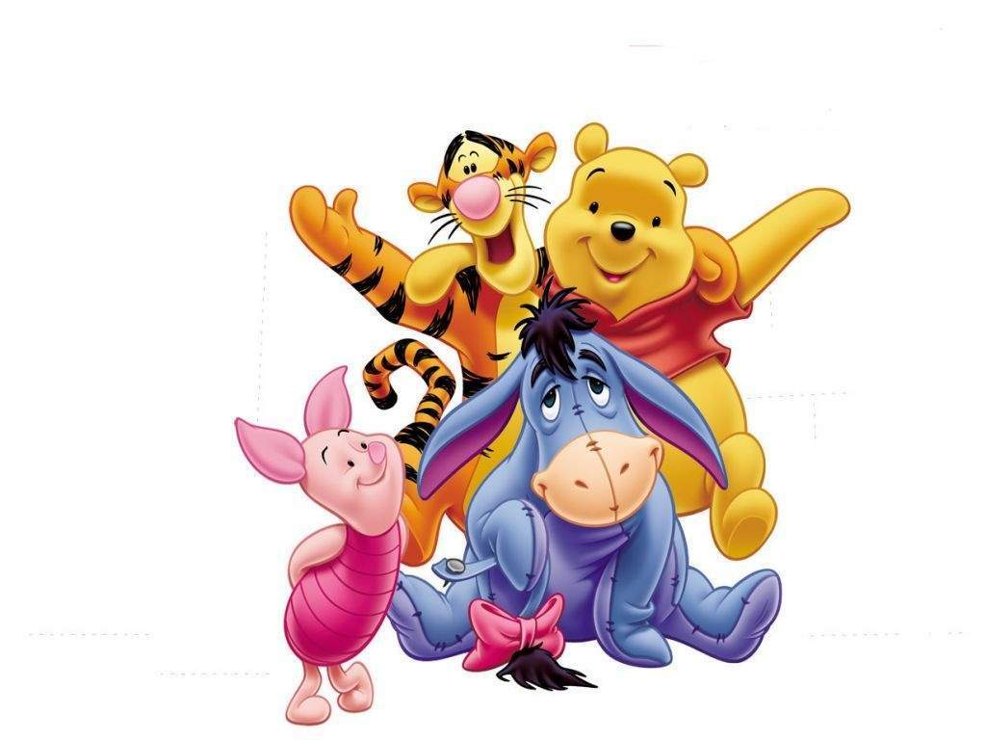
Friendship

Slide 2
Fair Weather Friends
Read the book “Charlie the Caterpillar”

Slide 3
What is a Friend?
A trusted companion.
Someone you can share your good and bad times with.
Someone who believes in you.

Slide 4
What is a Peer?
Usually someone your same age.
Shares common interests or activities with you.
Someone with a similar background (race, religion, education, etc.)

Slide 5
Friends and Peers
Friends can be peers and …
Peers can be friends.
But, friends are not always peers and…
Peers are not always friends.

Slide 6
Friendships
Next to parents, friends have the greatest influence on your behavior.
Choosing your friends is one of the MOST critical decisions you will ever make!
Remember, friends are role models.
Who are you allowing to affect your behavior?
What kind of friend are you going to be?

Slide 7
Types of Friendships
Acquaintances
People you recognize but don’t really know.
Examples:
Classmates you recognize
Friends of friends
Neighbors who live in your area
People who ride the same bus as you

Slide 8
Types of Friendships
Casual Friends
People you share a common interest with like school and activities.
Examples:
It’s someone you’re assigned to work with on a science project
Someone who’s on the debate team with you
Attends your church

Slide 9
Types of Friendships
Close Friends
Friends you hang out with and share some emotions/personal experiences with.
Examples
Go to the movies with
Whose homes you visit and who you invite into your home.
You can argue and express different opinions without being afraid of spoiling the friendship.

Slide 10
Types of Friendships
Intimate Friends
Friends you have had for a long period of time, deep sharing of emotions/experiences.
Examples
Tell you the truth no matter how it may affect you.
They know all about you and you know all about them.
Nothing is kept from the other.

Slide 11
Personal Needs for Friendship
Disclosure
Someone to talk to and confide in.
Feedback
Someone to help analyze what your situations and feelings are.
Empathy
Someone to care about you.

Slide 12
Personal Needs for Friendship
Trust
Keeps things confidential
Social Interests
Someone to go places with.

Slide 13
Negative Friendship Characteristics
Also known as “Toxic” friends
Unsupportive
Take, take, take
Stifling
Making one feel constrained or oppressed
Gives nothing back
Unreliable

Slide 14
Negative Friendship Characteristics
Overly demanding
Talks about everyone…even you!
Always turns the conversation to them and their problems
Your positives are their negatives
Uses sarcasm
“Just kidding!”
“No offence, but…”

Slide 15
How to Handle a Toxic Friend
Recognize the toxicity
How do you feel when you are around them?
Take responsibility
Stand up for yourself. Don’t allow your friends to hurt you.
Set boundaries
Learn it say no.

Slide 16
How to Handle a Toxic Friend
Talk to your nontoxic friends
Ask advice and gain new insights into the friendship.
Suggest help
In a loving way.
End the friendship
If the friendship is doing more damage than good, end it.

Slide 17
Positive Friendship Characteristics
Listens
No putting down or hurting one another
Understanding each other’s feelings and moods
Solve problems together
Sincere compliments

Slide 18
Positive Friendship Characteristics
Disagree without hurting each other
Dependable
Respectful
Trustworthy
Give each other room for change
Care about each other

Slide 19
Making and Being a Friend
Be slow to judge
Try not to judge others on first appearances or impressions.
Get to know new people.
Strangers are just friends waiting to happen.

Slide 20
Making and Being a Friend
Make the effort
Sometimes you have to be proactive and make the effort first.
Don’t just wait for friends to come to you.

Slide 21
Making and Being a Friend
Look for chances to build relationships
Find ways to make relationships stronger
Do small acts of kindness
Say you’re sorry
Be loyal
Keep promises
Listen

Slide 22
Making and Being a Friend
Make yourself more likable
You can’t make people like you, but you can make yourself more likable.
Become aware of your weaknesses and try to improve upon them.

Slide 23
Making and Being a Friend
Be inclusive
Don’t be afraid to allow new people into your group.
You never know what you could be missing out on.

Slide 24
Making and Being a Friend
Treat unkindness with kindness
It’s easy to be nice to people who are nice to you.
The challenge is being nice to those that are not.

Slide 25
Making and Being a Friend
Lift others
Are you the negative friend who brings others down?
Are you the positive friend lifting others up?
Who do you want to be?

Slide 26
Summary
It is important to have many different types of friendships.
Be aware of the positive and negative characteristics you find in your friendships.
Don’t be afraid to make new friends and find out more about your current friends! ☺

