Slide 1
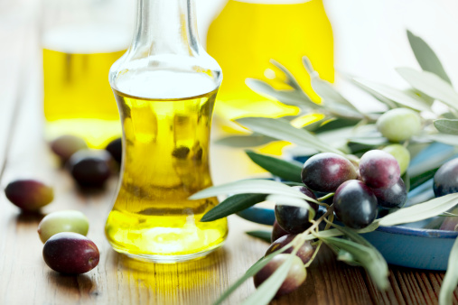
FATS

Slide 2
Functions of Fat
Carrier for Vitamins A, D, E and K
Reserve supply of energy
Adds flavor in food
Satisfies hunger
Protects internal organs from shock and injury

Slide 3
Functions of Fat
Insulates the body from shock and temperature changes
Promotes healthy skin
Helps you feel full longer

Slide 4
Facts About Fats
Fats provide 9 calories per gram.
It is the most concentrated source of energy.
Oils are not a food group, but they do provide essential nutrients.

Slide 5
Cholesterol
Cholesterol is essential for many body processes.
Produces hormones and bile acids.
Cholesterol is a fat-like substance made by the body, thus eliminating the need to include it in your diet.
Cholesterol is found in animal tissues, but is never present in plants.
Two types of cholesterol – HDL and LDL

Slide 6
HDL Cholesterol
Stands for High Density Lipoprotein
Function: Transports excess cholesterol found in the blood stream back to the liver.
Considered “good” cholesterol

Slide 7
LDL Cholesterol
Stands for Low Density Lipoprotein
Function: Takes cholesterol from the liver to wherever it is needed in the body.
Considered “bad” cholesterol

Slide 8
Why is LDL Cholesterol Bad?
If too much LDL cholesterol is circulating in the blood stream:
It can build up in the arteries
Increase the chance of heart disease or stroke.
Factor related to obesity.

Slide 9
HDL and LDL Demonstration

Slide 10
Four Types of Fats
Saturated Fats
Polyunsaturated Fats
Monounsaturated Fats
Trans-Fatty Acids

Slide 11
Saturated Fats
Function
Raise the LDL and HDL levels of cholesterol in the blood
Food Sources
Meat, poultry skin, whole milk, tropical oils, butter, shortening and lard.
Most solid fats are high in saturated fats and are solid at room temperature.

Slide 12
Polyunsaturated Fats
Function
Lower both the LDL and HDL levels of cholesterol in the blood
Food Sources
Corn oil
Soybean oil
Safflower oil

Slide 13
Monounsaturated Fats
Function
Lower the LDL and raise the HDL levels of cholesterol in the blood
Food Sources
Olive oil
Olives
Avocados
Peanuts
Canola oil

Slide 14
Trans-Fatty Acids
Function
Raise the LDL and lower the HDL levels of cholesterol in the blood
Food Sources
Margarine
Snack foods
Fast foods

Slide 15
How to Lower Fat in Diets
Choose lean meats.
Do not eat poultry skins.
Choose lower fat or non-fat dairy products.
Replace solid fats with oils.

Slide 16
Summary
There are several important functions of fat in the diet.
Fat is the most concentrated source of energy.
Eat the healthy types of fat.

Slide 17
Homework Assignment
Now let’s apply what was learned today!
Complete the Too Much Fat In Your Diet worksheet.
This will be due next class period.

