Slide 1
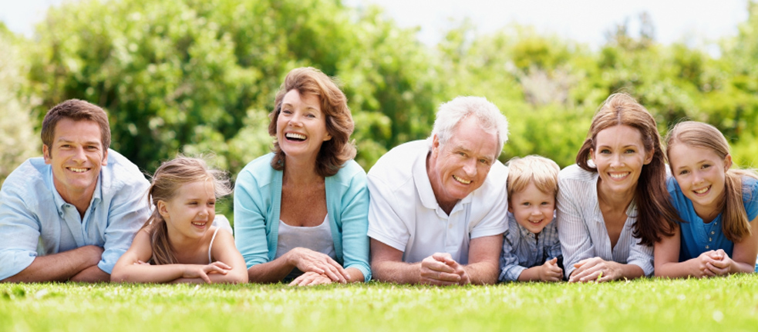
FAMILY RELATIONSHIPS

Slide 2
What Is A Relationship?
An interaction between two or more people.

Slide 3
Who Does A Family Relationship Involve?
Parents
Siblings
Grandparents
Aunts and Uncles
Cousins
Others??

Slide 4
Roles/Responsibilities of Teenagers
* School
* Household Responsibilities
* Family Time
* Employment

Slide 5
What is your role/responsibility in your family?
* How would you describe it?
* How do you think it came about?
* What life experiences have helped to shape it?

Slide 6
How can your attitude and behavior affect your family relationships?
They will either help STRENGTHEN or DESTROY
them.

Slide 7
Ways to Strengthen Family Relationships
* Showing appreciation
* Giving affection
* Being committed
* Spending time together
* Building traditions
* Utilizing creative problem solving
* Practicing constructive communication

Slide 8
Ways to Destroy
Family Relationships
* Refrain from giving affection
* Withholding emotions
* Avoiding certain family members
* Using destructive communication
* Withdrawal from family

Slide 9
Personal Reflection
How is your personal attitude and behavior affecting your family?

Slide 10
Freedom vs. Responsibility
If you want more freedom, you must be more responsible!
Notes:
Example: You want the freedom to make your own decisions about when you come home, who you hang out with, what you do. What is the responsibility associated with those freedoms? You have a responsibility not to get in trouble with you freedom. You have a responsibility not to abuse it.

Slide 11
Freedom vs. Responsibility
Responsibility Required
Freedom Wanted
Choose good friends
Don’t get into trouble
Come home at a reasonable time
Who you hang out with
What you do
When you come home

Slide 12
Responsibility, Trust and Freedom
Responsibility
Trust
Freedom
Trust
Being responsible builds trust
Trust gains you more freedom

Slide 13
Responsibility, Trust and Freedom
What you do with your freedom builds more trust.
If you are trustworthy, you will have more responsibilities.
Responsibility
Trust
Freedom
Trust

Slide 14
Maslow’s Hierarchy of Needs
Esteem Needs
Love & Belonging Needs
Safety Needs
Physical Needs
Self-Actualization
Notes:
Maslow wanted to understand what motivates people. He believed that people possess a set of motivation systems unrelated to rewards or unconscious desires. People are motivated to achieve certain needs. When one need is fulfilled, a person seeks to fulfill to next one, and so on.

Slide 15
Maslow’s Hierarchy
of Needs
Developed by Abraham Maslow, a psychologist researching human motivation and potential.
Physical needs must be met before any others can be achieved.

Slide 16
Maslow’s Hierarchy
of Needs
As teens grow and mature, they become more responsible to provide for their own needs.
Teens can help meet the basic needs of others in the family.

Slide 17
Physical Needs
*Air
*Food
*Water
*Clothing
*Shelter
*Warmth
*Sleep
Notes:
People with lack of shelter, clothing and food focus on this level. The need to fulfill such needs will become stronger the longer they are denied. For example: The longer a person goes without food, the more hungry they will become. People often neglect some of the basic needs in normal life when they eat junk food, go without sleep , don’t exercise.

Slide 18
Safety Needs
*Personal Security
*Financial Security
*Stability
*Health and Well-being
*Order
*Law
*Freedom from fear
Notes:
Strongest in children. One must satisfy lower level basic needs before progressing on to meet higher level growth needs.

Slide 19
Love and Belonging Needs
*Friendship
*Comradeship
*Family
*Affection
*Love
Notes:
Love and belonging needs to be met in work groups, family, friends and romantic relationships. Humans need to love and be loved by others. Deficiencies within this level can impact the individual’s ability to form and maintain emotionally significant relationships. If unfulfilled, may rush to fulfill this need resulting in less than ideal partner.

Slide 20
Esteem Needs
* Achievement
*Mastery
*Independence
*Status
*Prestige
*Self-respect
*Respect from others
Notes:
People act form their ego needs. They value the opinions of others, in order to believe in themselves. Life experiences (road blocks) can cause a person to fluctuate between levels of the hierarchy.

Slide 21
Self-Actualization Needs
*Realizing personal potential
*Self-fulfillment
*Seeking personal growth
*Pursuing peak experiences
Notes:
Maslow noted only one in a hundred people become fully self-actualized because our society rewards motivation primarily based on esteem, love and other social needs. Examples: Best at athletics, painting, inventions, etc..

Slide 22
Building Family Traditions

Slide 23
What are Traditions?
Behaviors and activities you participate in over and over again.
Traditions can be big or small and are unique to each family.

Slide 24
Why are Traditions Important?
Provides a source of identity
Strengthens family bonds
Offers comfort and security
Opportunity to teach values
Chance to pass on cultural heritage
Connects the generations
Creates lasting memories

Slide 25
What Are Some Of Your Favorite Family Traditions?

Slide 26
Family Fun Assignment
Due next class period

