Slide 1
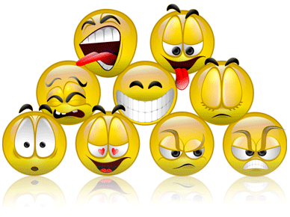
Emotions

Slide 2
What are Emotions?
Indicators of how a person is feeling mentally.
Body expresses emotions in many ways:
Sweaty palms or a racing heart
Shortness of breath or a red face
Butterflies in the stomach
Because of hormonal changes, teenagers experience a wide range of emotions in one day.
There are six basic emotions.

Slide 3
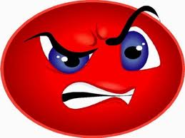
Anger
Rage
Uptight/Upset
Fury
Irritation
Annoyance
Frustration

Slide 4
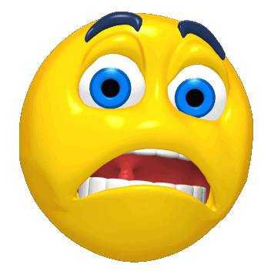
Fear
Terror
Panic
Stress
Startled
Worry
Surprise

Slide 5
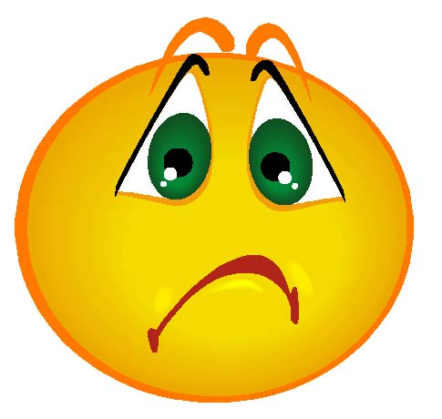
Sad
Depression
Sorrow
Loneliness
Gloomy
Feeling Blue
Unhappy

Slide 6
Hate
Violence
Disgust
Bitterness
Hostility
Dislike
Abhorrence

Slide 7
Love
Affection
Devotion
Caring
Liking
Fondness
Adoration

Slide 8
Happy
Joyful
Positive
Cheerful
Ecstatic
Spirited
Silly

Slide 9
The Hardest Emotion
Anger is one of the hardest emotions to control or express positively.
What can uncontrolled anger lead to?
Arguments
Physical fights
Abuse
Assault
Self-Harm

Slide 10
Physical Effects of Uncontrolled Anger
Headache
Digestion problems
Insomnia
Anxiety
Depression
High blood pressure
Skin problems like eczema
Heart attack/stroke

Slide 11
Well-Managed Anger
What can well-managed anger be useful for?
Motivate you to make positive changes

Slide 12
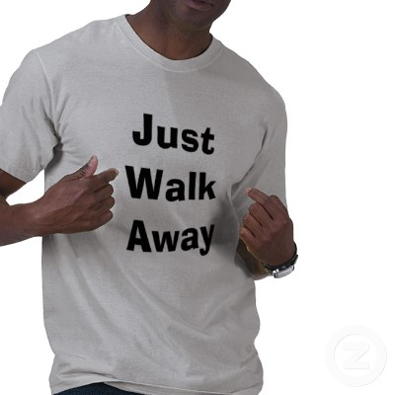
Healthy Way to Express Anger
Walk away from the situation until you have control of your emotions.
Recognize and accept the emotion.
Try to pinpoint the exact reasons why you feel angry.

Slide 13
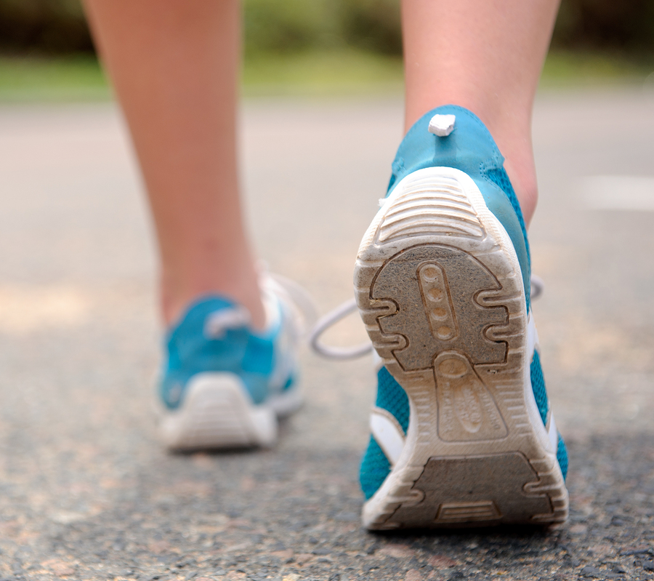
Healthy Way to Express Anger
Problem solve strategies for dealing with the situation in advance.
Do something physical like exercise or playing a sport.
Seek help if needed.

Slide 14
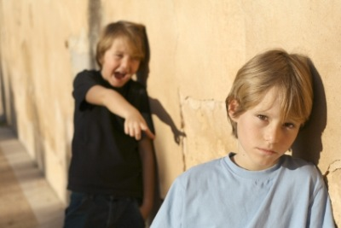
Passive Behavior
People who let others walk all over them.
They follow the “crowd” and allow others to make decisions for them.
They lack the courage to express inner feelings.

Slide 15
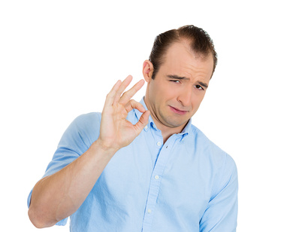
Passive Behavior
They are followers
They are manipulated by others.
They see something wrong, but do nothing about it.

Slide 16
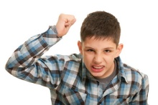
Aggressive Behavior
Always looking for a fight
They are right in the middle of it
Masters at verbal or physical battle

Slide 17
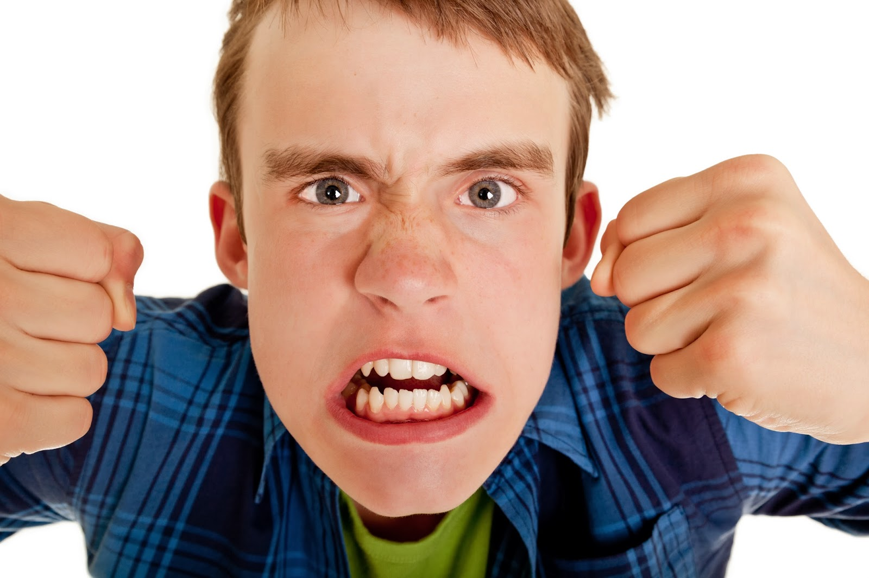
Aggressive Behavior
Thrive on intimidating others
Believe that aggression breeds aggression
They bring out the worst in others.

Slide 18
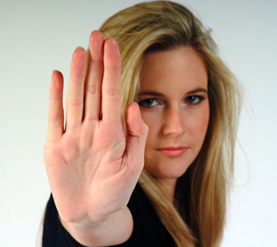
Assertive Behavior
Calmly state feelings in a non-emotional way
Does not allow others to manipulate, intimidate or control their behavior

Slide 19
Assertive Behavior
They use “I” messages
Can walk away and seek help if appropriate
Can tell someone if the situation is harmful, dangerous or against the law.

Slide 20
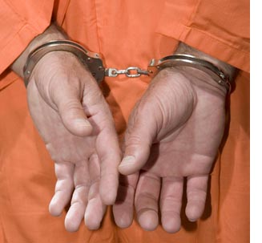
Consequences of Emotions
Legal
The results in choosing behavior that are against the law.
Notes:
Examples:
Going to jail
Restitution for crime victims
Community Service

Slide 21
Consequences of Emotions
Mental
Those factors that affect an individual emotionally because of the behavior.
Notes:
Examples:
Stigmas of going to prison
Living with the fact that someone was harmed or killed
Depression
Other types of mental anguish

Slide 22
Consequences of Emotions
Social
Effects on the community, family, and individuals because of behavior.
Notes:
Examples:
Curfew enforced to keep individuals under control
Not enough prisons and detention centers to house offenders
Unsafe neighborhoods

Slide 23
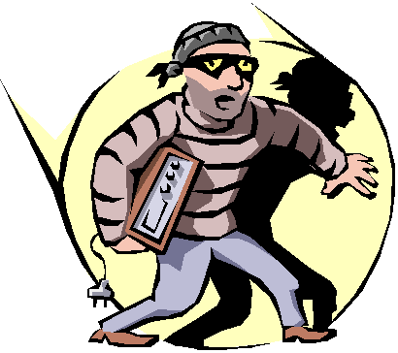
Consequences of Emotions
Ethical
Moral and religious values that are violated because of the behavior
Notes:
Examples:
Adultery
Stealing
Killing
Treason
Perjury

Slide 24
Consequences of Emotions
Physical
Harm or injury that can come to people because of the behavior.
Notes:
Examples:
Loss of life
Serious injury
Loss of home
Job
Family

Slide 25
Consequences of Emotions
Financial
Dollar costs to individuals and communities as a result of behavior.
Notes:
Examples:
Taxes can be raised to support more police protection because of crimes
Victims left without financial support
Costs of trial and lawyers
Tax dollar support of criminals

Slide 26
Assignment
Find an article that depicts uncontrolled emotions on the part of someone or a group of people.
Complete the worksheet and turn in for credit
Due next class period.

Slide 27
Summary
There are six basic emotions
We should express our emotions in a positive way.
We should strive to portray assertive behavior.
There are many consequences of emotions gone wrong.

