Slide 1
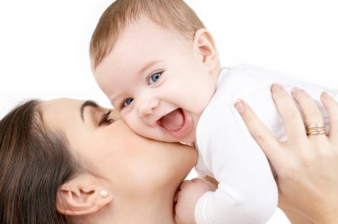
Emotional and Social Development of an Infant

Slide 2
Emotional Development
The process of learning to recognize and express one’s feelings and learning to establish one’s identity and individuality.
Emotional development begins the day the child is born.

Slide 3
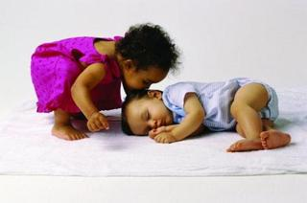
Positive Emotions
Delight
Elation
Affection

Slide 4
Negative Emotions
Distress
Anger
Disgust
Fear

Slide 5
Social Development
Here is an example of social development between two infants.
Show video clip

Slide 6
Social Development
Process of learning to interact with others and to express oneself to others.
Infants are born with social instincts.
They like to be held, talked to, and looked at.
Newborns prefer to look at and interact with the human face.

Slide 7
Social Development Stages
Newborns – Responds to human voices
1 month – Stops crying when lifted. Face brightens when sees a familiar face.
2 months – Smiles
3 months – Wants companionship
4 months – Laughs and looks for others to entertain them.

Slide 8
Social Development Stages
5 months – Interest in family
6 months – Loves company
7 months – Prefers parents over anyone else
8 months – Looks for company
9/10 months – Loves attention; underfoot
11/12 months – Center of attention

Slide 9
Trust vs. Mistrust
During the first year of life, the infant is learning to trust the world around themselves and the people in it.
This is Erickson’s developmental stage – Trust vs. Mistrust
Infants need consistency and a predictable routine to build trust.

Slide 10
Mistrust Cycle

Slide 11
Trust Cycle

Slide 12
How to Build Trust
Bonding with the baby
Showing love and affection
Getting to know the child
Meeting the baby’s needs in all areas of development

Slide 13
Benefits of Building Trust
Building trust helps the baby to:
Know that the world and the caregiver are comfortable and safe.
These things are good and can be depended upon.

Slide 14
Anxiety
Usually appears around 8 months.
Stranger anxiety
Someone comes to visit and the child cries or appears to be afraid of them.
Separation anxiety
Separation from a parent/caregiver or a sentimental item.

Slide 15
Role of Play
Play facilitates all aspects of development.
Children learn through play.

Slide 16
Types of Play
Solitary Play
Playing alone or engaged in activities that only need one person.
On-looker Play
Sitting back and watching other’s playing as if observing them or waiting for your turn to participate in the activity. (example – Duck, Duck, Goose)

Slide 17
Summary
Infants are hungry for interaction, for love, and for all of the affection and attention they can get.
Without emotional nurturing, infants have a difficult time growing in other aspects of their development.
A child needs all the love a parent can give.

