Slide 1
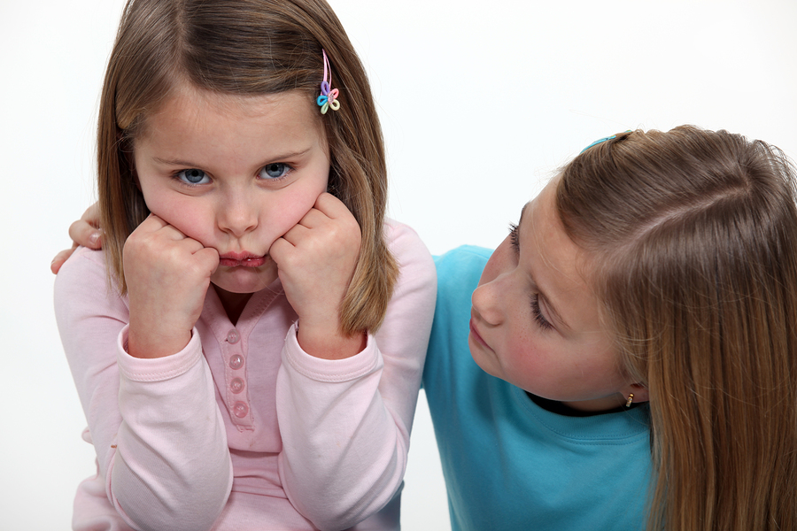
Emotional and Social Development of a Preschooler

Slide 2
Emotional Characteristics
Gaining stronger inner self-control and self-management of emotions.
Can begin to relate to other’s emotions.

Slide 3
Independency and Dependency
Sometimes they want to be and insist on being independent. They refuse help from adults and others.
Other times they are very dependent and want to be helped.
As a caregiver, show unconditional love and respect.
Know when to help and when to step back.

Slide 4
Fear and Anxiety
Fear and anxiety is a natural human protector against danger. Too much or too little fear and anxiety is not healthy.
Fear and anxiety become more intense during the preschool years. (monsters under the bed, vampires, etc.)
Caregivers should listen to and accept the fears, assure that you will protect them, be a role model of courage.

Slide 5
Anger and Aggression
Anger is a feeling, an emotion.
Aggression is an attempt to hurt someone or something.
Preschoolers need to learn how to get rid of and deal with their feelings of anger in an acceptable way.
Preschooler’s aggressiveness should never be disciplined with aggressive forms of punishment.
Prevent aggressive acts from occurring. Redirect behavior, eliminate competition, encourage cooperation.
Show video clip

Slide 6
Jealousy and Sibling Rivalry
Jealousy occurs when a child recognizes that they must share the love and attention of an adult with another person.
When that other person is a sibling, then it becomes sibling rivalry.
Caregivers should discuss the child’s feelings.
Caregiver and child should spend their own special time together.
Show video clip

Slide 7
Grief
Preschoolers are just beginning to understand the concept of death and grief.
Caregivers should answer the child’s questions openly and honestly.
Caregivers should explain, truthfully, their personal belief concerning death on the child’s level.
Adults should allow the child to see them cry or feel sad at times.

Slide 8
Social Characteristics
More able and willing to share with others.
Having imaginary friends is common, normal, and shows good social and emotional skills.
If a child does not play with real friends, then this could be a concern.
They are peer oriented and realize that having friends outside of their family is fun.

Slide 9
Social Characteristics
Can learn specific social skills in the preschool environment:
Taking turns
Sitting still for longer periods of time
Raising hands
Improving manners

Slide 10
Movement
Physical movement is the child’s first way of communicating.
Personal movement shows the mood or inner state of an individual.
Creative movement shows their personalities in their own way.
Movement also builds a child’s social skills.
Let’s practice our movement skills! ☺

Slide 11
Initiative vs. Guilt
Erickson’s stage of development
Initiative:
The decision and motivation to accomplish more tasks than expected or asked.
The desire to accomplish tasks is based on the child’s motivation and self-worth.

Slide 12
Initiative vs. Guilt
Play is a child’s work. Children are initiating play during this stage.
Children who are encouraged, allowed, and supported in these efforts develop self-confidence (the belief in one’s abilities).
Repeated discouragement or punishment may lead to feelings of guilt, inferiority, or inadequacy.
Case Studies Activity

Slide 13
Teaching Moral Behavior
Toddlers learn the rules their parents and other caregivers set, but they do not understand the reason behind the rules.
Toddlers do understand that some actions make a caregiver unhappy and others make a caregiver smile.
They choose the latter behavior so they do not lose the approval of their caregiver.

Slide 14
Teaching Moral Behavior
Preschoolers are beginning to understand the reasons behind the rules and develop a conscience (inner sense of right and wrong).
Their conscience will guide their behavior and help them to make proper judgments.

Slide 15
Teaching Moral Behavior
The caregiver has a responsibility to teach and help a child develop moral behavior.
They can be a good role model of it by:
Setting clear standards of behavior
Respond to inappropriate behavior and talk about them in private
Continue to show love despite the misbehavior
Show video clip

Slide 16
Summary
Preschoolers have many emotions.
The preschool years are the play years and a time of relationships.
Caregivers are responsible for teaching their preschoolers moral behavior.

