Slide 1
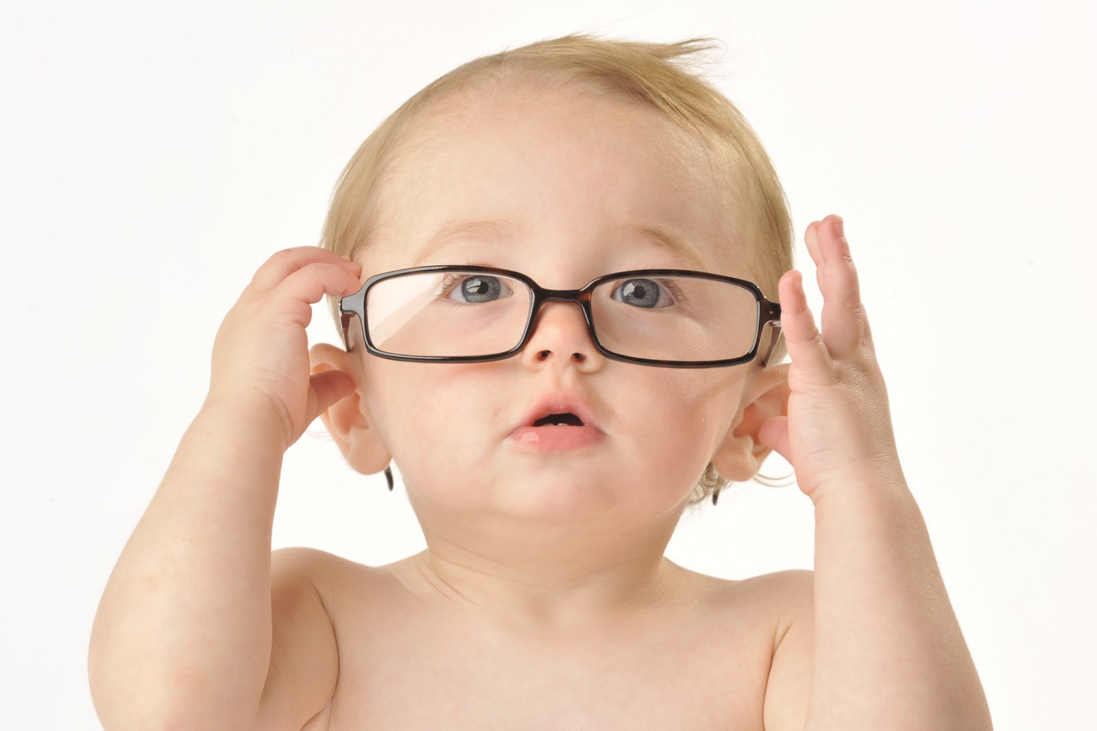
Developmental Theories

Slide 2
Erik Erikson
Personality develops continuously throughout the life cycle.
The individual’s personality is in constant motion and is always redeveloping itself.
Emotional development of children.
Eight specific stages of personality from birth to old age.

Slide 3
Erik Erikson
The stages we will focus on in this class are:
Infant Stage
Trust vs. Mistrust
Toddler Stage
Autonomy vs. Shame and Doubt
Preschool Stage
Initiative vs. Guilt

Slide 4
Sigmund Freud
Three theoretical components of personality
ID, EGO, SUPEREGO
Five psychosexual stages
Oral, Anal, Phallic, Latency, Genital

Slide 5
Arnold Gesell
Physical development of children.
Determined the normal sequence of development and at what age children should be able to do certain things.

Slide 6
Lawrence Kohlberg
Moral development of children.
Three levels:
Preconventional,
Conventional and
Postconventional

Slide 7
Abraham Maslow
Humanistic Theory
Each person has his/her own inner nature and a strong motivation to express that nature.
The basic survival needs must be met.
Hierarchy of needs
Physiological Needs, Safety Needs, Love and Belonging, Esteem Needs, Self-Actualization Needs

Slide 8
Jean Piaget
Cognitive development of children.
Defined the cognitive skills that children learn.
Four major stages
Sensoritmotor
Preoperational
Concrete Operational
Formal Operational

Slide 9
Jean Piaget
Infants are in the sensorimotor stage
Toddlers move through the sensorimotor and into the preoperational stages
Preschoolers are in the preoperational stage

Slide 10
B.F. Skinner
Entire theory is based on operant conditioning
Reinforcement Theory
Shaping
Aversive Stimuli
Behavior Modification

