Slide 1
Critical Thinking

Slide 2
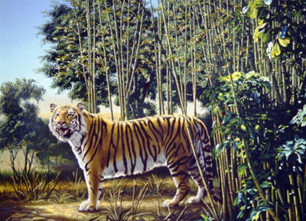

Slide 3
What is Critical Thinking?
Testing existing ideas and/or solutions for flaws and errors.
Being able to apply logic.
Allows us to make our own decisions regardless of the opinions of others.

Slide 4
What is Critical Thinking?
Integral part of decision making
Result in higher level of decision making
Provide logic for a clearer sense of direction

Slide 5
Critical Thinking Process
Step 1: Identify and describe a problem.
Step 2: Discriminate between fact and opinion.
Step 3: List possible solutions and consequences.

Slide 6
Critical Thinking Process
Step 4: Identify personal and family values that conflict with the situation.
Step 5: Take a position based on logic (make a decision)

Slide 7
Questions to Ask Yourself
Is it against the law, rules, or the teachings of my family or religion?
Is it harmful to me or to others?
Would it disappoint my family or other adults that are important to me?

Slide 8
Questions to Ask Yourself
Is it wrong to do? Would I be sorry afterwards?
Would I be hurt or upset if someone did this to me?
Is it within my value system?

Slide 9
What Words Do You See?
What two words do you see on the overhead projector?
The difference between knowledge and ignorance about something is frequently due to our perception.
Our perception can become more accurate through the use of the critical thinking process.

Slide 10
When to use Critical Thinking
In what situations would you use the critical thinking process?

Slide 11
A New Start For Silvia
What decisions will Silvia have to make to really get a new start?
If Silvia chooses to cut her hair and wear clothing styles that are not so extreme, and she feels good about her decision, what values would that reflect?

Slide 12
A New Start For Silvia
If Silvia continues on the same course as she did at her first school, what consequences might she have to face?
If Silvia choose not to alter her course at her new school, will this be the result of her having used the critical thinking process? Why or why not?

Slide 13
Julio’s Big Decision
Step 1: Identify and describe a problem.
Step 2: Discriminate between fact and opinion.
Step 3: List possible solutions and consequences.
Step 4: Identify personal and family values that conflict with the situation.
Step 5: Take a position based on logic (make a decision)

Slide 14
Brain Teasers
The human brain can be trained to think critically and creatively.
Split into groups and solve the following brain teasers.

