Slide 1
Communication

Slide 2
Types of Communication
Child-like
Parent-like
Adult-like
Non-verbal

Slide 3
Child-Like
Easiest and most natural to use
Very immature
Least effect method
Self-centered motives
You need not be a child to communicate in this form

Slide 4
Child-Like Characteristics
Giving orders
Not listening
Topping or “one-upping”
Throwing tantrums
Whining
Name calling
Yelling
Interrupting
Acting out of control

Slide 5
Child-Like Video Clip
Emperor’s New Groove

Slide 6
Parent-Like
Has nothing to do with being a parent!
Directs others’ behaviors
Get someone to comply or act a certain way.
One-way
Dictatorial

Slide 7
Parent-Like Characteristics
Giving instructions
Directing
Punishing
Demanding
Ordering
Not listening

Slide 8
Parent-Like Video Clip
Beauty and the Beast

Slide 9
Adult-Like
Highest level of communication
Most desirable and effective
Open two-way communication
Takes time to learn and use
Taking responsibility for comments and actions.
Involves active listening.

Slide 10
Adult-Like Characteristics
Everyone remains calm
Control of strong emotions
Respect for each other’s feelings
Win-win attitude

Slide 11
Adult-Like Video Clip
Finding Neverland

Slide 12
Non-Verbal
Expression through movement, posture and facial expressions.
Very powerful

Slide 13
Non-Verbal
Can be often misread or misunderstood
Often possible to send out one type of verbal message and a different type of non-verbal message at the same time.

Slide 14
Non-Verbal Video Clip
A League of Their Own

Slide 15
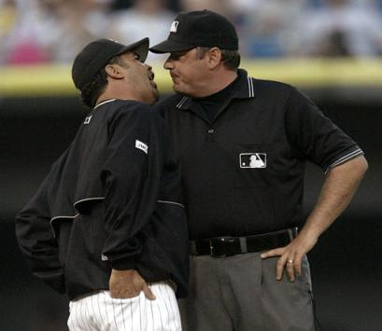
Communication Techniques
Constructive
Destructive

Slide 16
Constructive Communication
Positive communication that contributes to a meaningful exchange of ideas and builds up yourself and others.

Slide 17
Constructive Examples
Giving positive or encouraging messages
Using tact (saying something sensitive without hurting or offending).
Asking questions
Active listening

Slide 18
Constructive Examples
Sending clear messages
Being honest and open
Keeping the confidence/secrets
Speaking with respect
Using “I” messages

Slide 19
Destructive Communication
Negative communication that “tears down” yourself and others.

Slide 20
Destructive Examples
Not listening
Insults
Harassing
Teasing
Threatening
Sarcasm

Slide 21
Destructive Examples
Gossip
Lying
Accusing
“You messages”
Swearing
Topping/”One-upping”

Slide 22
Hammer Analogy
Which part of the hammer best describes…
Constructive Communication
Destructive Communication
Non-verbal Communication
Us

Slide 23
Communication Activity

Slide 24
Summary
We first need to realize how we are communicating.
Then we must improve and sharpen our communication skills so we can enjoy stronger relationships with our family members, friends and those with whom we associate.

