Slide 1
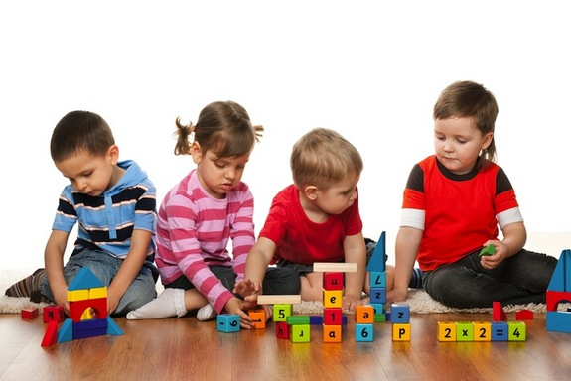
Child Development
Let’s Play ☺

Slide 2
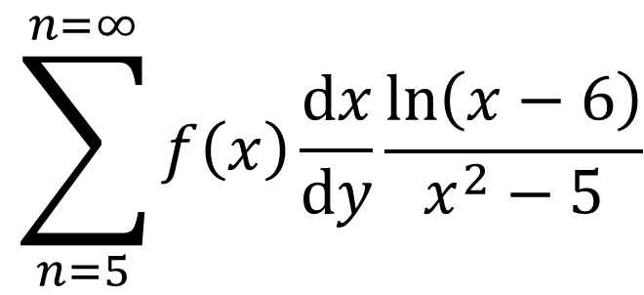
Math in FACS
$$\sum_{n=5}^{n=∞}{f\left(x\right)\frac{ⅆx}{ⅆy}\frac{\ln\left(x−6\right)}{x^{2}−5}}$$
Solve:
Solve:
Solve:
$$3x^{2}+9x−7=4x^{2}+2x+1$$
$$x+2=3$$

Slide 3
WHAT?!?!
How did you feel?
Was the questions really appropriate for your age?
What could I have changed to help you complete the questions?

Slide 4
What is DAP?
Developmentally Appropriate Practice
Teaching in a way that kids learn and grow

Slide 5
5 Guidelines for Effective Teaching
1
Caring
Community
5
2
Engaging &
Age - Appropriate
Relationships
4
3
What will they learn?
Learning Centers

Slide 6
Careers
Child Care Administrator/Director
Children's Museum Project Coordinator
Nanny
Preschool Teacher
Kindergarten Teacher
Family Child Care Home Owner
Family Service Worker
Instructional Coordinators
School Counselors
Childcare Worker
Teaching Assistants

Slide 7
Learning Centers
Dramatic Play
Construction
Kitchen/House
Mail/Post Office
Store
Library
Restaurant
Blocks
Car Track
Unifix Cubes
Dominos
Play Dough
Puzzles
Notes:
Dramatic play helps unlock a child's potential. Through imaginary play a child develops their creativity, then comes to understand abstract notions, including symbolism, and it helps them understand the framework of their world. Creativity is more than just drawing, painting and making up stories. Creativity is problem solving, understanding how things relate to each other, and abstract thought. Understanding symbolism is a basic step in learning to read and if a child can master pretending a block is a cookie they can grasp how a squiggle can be the letter s and how an s makes a particular sound. Imaginary play helps children understand family units, friendships, good and bad guys, emotions, and the desires of themselves and others.
Constructive play is when children manipulate their environment to create things. This type of play occurs when children build towers and cities with blocks, play in the sand, construct contraptions on the woodworking bench, and draw murals with chalk on the sidewalk. Constructive play allows children to experiment with objects; find out combinations that work and don't work; and learn basic knowledge about stacking, building, drawing, damming, and constructing. It also gives children a sense of accomplishment and empowers them with control of their environment. Children who are comfortable manipulating objects and materials also become good at manipulating words, ideas, and concepts.

Slide 8
Learning Centers
Math
Science
Counting Mats
Number Tracing/Writing
Large Clock
Materials for measuring
Assortment of objects for counting
Geometric shapes
Play money
Fish Aquarium
Magnets
Bird Feeder
Seeds
Thermometer
Compass
Shells and rocks to observe and classify
Magnifying glass
Notes:
http://www.earlychildhoodnews.com/earlychildhood/article_view.aspx?ArticleID=426 some of the ideas for centers came from this website
Math –
The understanding of basic math concepts begins very early in a child's life. Through play children begin to see relationship concepts like long and short, light and heavy, bigger and smaller. These are building blocks of all measurement concepts and innumerable math lessons in proportions. The greater the amount of objects and play involving them, then the greater the amount of discoveries your child will make.
Science –
Play is where a child develops social skills and learns the intricacies of give and take, cooperation and fair play. Taking turns is a basic concept in sharing and fairness that every child learns through play. Through play children can connect with their own culture, and the cultures of others in a safe environment. Building bonds of friendship through play are important to a child's social development and self-esteem. Interaction is a key element in playing with others, problem solving, leadership and empathy all develop through experience.

Slide 9
Learning Centers
Art
Literacy
Markers
Crayons
Colored Pencils
Scissors
Glue
Coloring Pages
Blank Paper
Scraps of colored paper
“Rainbow” write name
Homemade “Books”
ABC magnets to build names and words (words with pictures of objects on cards to reference)
Matching Game
Classroom Library – books to just “read”
Notes:
Language & Literacy –
One of the most important skills children aged 3 to 5 acquire is their ability to understand and become aware of printed material and to enjoy the use of language. These skills have significant impact on a child’s academic abilities as he/she enters elementary school. Early childhood language and literacy development isn't limited to reading, as writing abilities are important as well. Children need ample opportunity to scribble. Scribbling and drawing not only develop the fine motor skills that are required to hold a pencil, but it also helps fine-tune the child's hand-eye coordination to enable writing.
Art -
Children are able to use art as a way to express their feelings and a way to use various materials to describe their surroundings, emotions and understanding. Through the ability to demonstrate their experience with different materials they can learn how to manipulate the supplies, which tends to require gross motor skills which children are trying to learn and understand as well. Through practicing drawing line and colors students are able to make connections to their own experiences.

Slide 10
ABC Day Care Center Plan
Understanding the importance of DAP you want to come up with centers that will enhance the children’s learning and development.
Learning Centers
Math/Science
Dramatic Play
Construction
Art/Literacy

Slide 11
ABC Day Care Center Plan
“Learning Center”
Explain the activity you have chosen for the center
“How is it age appropriate?”
Explain how the activity is appropriate for the children participating.
“What will the children learn?”
Explain what the children will learn from completing the center.

Slide 12
ABC Day Care Center Plan
Work with a partner.
Everyone fill out their own sheet.
Due next class period.

