Slide 1
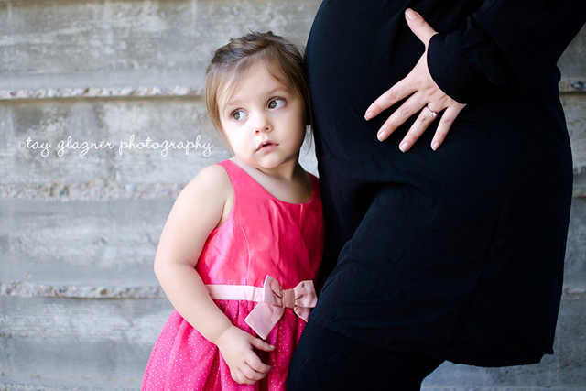
Characteristics of Pregnancy

Slide 2
How Long Are They Pregnant?
Women are pregnant for how long?
40 weeks
9 months
280 days
This period is called the gestation period.
Now try and guess who long the gestation period for some of these animals are.

Slide 3
How Long Are They Pregnant?
Beaver (guess in months)
3 months
Rat (guess in days)
22 days
Dolphin (guess in months)
10-12 months
Fox (guess in days)
49-55 days
Elephant (guess in months)
18-23 months

Slide 4
Female Reproductive System
Ovum (egg)
The female reproductive cell.
Ovaries
Two almond shaped organs that produce the female egg cell.

Slide 5
Female Reproductive System
Fallopian Tubes
A passageway to transport the egg from the ovary to the uterus.
During fertilization, they transport sperm cells from the uterus to the released ovum.

Slide 6
Female Reproductive System
Uterus
The place where the egg cell develops if it has been fertilized.
Provides protection and nutrients to the fetus.
The muscle expands during pregnancy to hold the growing fetus and contracts during labor to deliver the child.

Slide 7
Female Reproductive System
Endometrium Lining
Functions as the lining for the uterus.
Provides nourishment for the fertilized egg.
If it is not used, it is sloughed off as menstruation.

Slide 8
Female Reproductive System
Cervix
The opening in the uterus that leads to the vagina.
Helps to hold the baby in the uterus.
In order for birth to occur, the cervix must dilate.

Slide 9
Female Reproductive System
Vagina
The muscular tube leading from the external genitals to the cervix of the uterus.
Passageway for sperm, menstrual fluid, and the birth of a baby.
During birth, it is referred to as the birth canal.

Slide 10
Female Reproductive System
Perineum
The area between the vaginal opening and the anus.

Slide 11
Identify The Organs
Rectum
Uterus (twice)
Cervix (twice)
Urethra
Endometrium Lining
Fallopian Tube (twice)
Perineum
Ovary
Vagina (twice)
Urinary Bladder
Pubic Bone
Vaginal Opening

Slide 12
Ovulation and Conception
Eggs or ovum are released from the ovaries during ovulation to begin the menstrual cycle.
Fertilization of the ovum by the sperm takes place in the fallopian tubes.
Only one sperm may penetrate and fertilize the ovum.
The fertilized ovum implants into the endometrium lining within the uterus.

Slide 13
Signs and Symptoms of Pregnancy
Tender breasts
Nausea
Vomiting
Menstrual period stops
Frequent urination
Fatigue

Slide 14
Discomforts During Pregnancy
Emotional mood swings
Tired
Trouble breathing
Swelling ankles, feet and hands

Slide 15
Teen Pregnancy
Teens have a higher risk of low-birth weight baby which can cause many complications to the developing fetus.
Teens often cannot transfer essential nutrients to the fetus because they are still growing themselves.

Slide 16
Teen Pregnancy
Their diet, especially if it is a poor (typical) teen diet, may also be a factor in the transferring of nutrients.
The fetus receives the nutrients that are left over after the body of the teen mom receives the nutrients that it needs.

Slide 17
Teen Pregnancy Videos
Too Young
Mothers Too Soon
Fathers Too Soon

Slide 18
Summary
Be able to identify the many parts of the female’s reproductive system.
Understand the various symptoms and discomforts to pregnancy.
There are many health risks associated with Teen Pregnancy.

