Slide 1
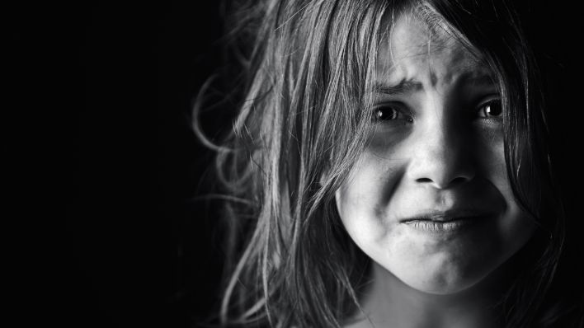
Challenging Situations

Slide 2
Challenging Situations = Stress
Challenging situations cause stress in a child’s life.
Stress results from changes in a routine, good or bad.
Examples: Handicaps, new baby, starting school, grief, death, divorce, illness or moving.

Slide 3
Signs of Stress
Biting
Crying
Power Struggles
Excessive attachment
Fears
Eating problems
Increased sensitivity

Slide 4
Childhood Feelings
Children usually understand what is going on.
Tell children the truth in a calm and reassuring way. No need to include everything, but enough.
Allow children to talk about their feelings.
Children need more help and support through issues than adults.
Support may need to come from an adult that is not involved in the stressful situation.

Slide 5
Coping Strategies for Children
Daily exercise or movement
Eating nutritiously
Having leisure time
Enjoying hobbies
Adequate sleep
Relaxation methods
Talking about feelings

Slide 6
Children Grieving
Grieving is not just for losing a loved one.
Children can go through the stages of grief for anyone or anything.
Examples:
Lost blanket or stuffed animal
Moving to a new house
Divorce of parents

Slide 7
Stages of Grieving
Denial
Feelings of shock
Anger
Blame someone or something for what they did to cause this.
Guilt
Blame oneself for something they did in the last few months to cause this.

Slide 8
Stages of Grieving
Bargaining
With other people or with God to not let it happen
Acceptance
Coming to terms, moving on, adjusting to the change.

Slide 9
Knowing Ahead of Time
Children sense the change in actions and the tension associated with the situation.
Tell the children about the situation so they have time to adjust to the events it will bring.
Examples:
Financial challenges
Illnesses
Moving situations

Slide 10
Divorce
Reassure the child that they are still loved by both parents.
The child should not be blamed for the divorce.
Maintain as much stability in the child’s life as possible. (same school, same home, same routines, etc.)

Slide 11
Divorce
Provide continuity in the child’s daily schedule and situation.
Children often believe that their parents will get back together again.
Parents should never belittle/bad mouth one another in front of the kids.

Slide 12
Effects of Divorce on Children
Preschoolers (ages 2-5 years old)
Major Theme
Fear of abandonment
Symptoms
Sleep disturbances
What to do
Explain that custodial parent will always return

Slide 13
Effects of Divorce on Children
Young Childhood (ages 5-9 years old)
Major Theme
Fear of being displaced
Symptoms
School and social grief
What to do
Discuss fears

Slide 14
Effects of Divorce on Children
Adolescence (ages 12-18 years old)
Major Theme
Fear of own relationship failure
Symptoms
Independence, promiscuous
What to do
Communicate

Slide 15
Death
Children dealing with death feel grief and need to express it.
Help children understand that they will not die just because someone else has.
Reassure children by being specific about when you will return whenever you leave.
Teach a child about death before the child is confronted with the death of a loved one.

Slide 16
Death
Under the age of 3
Children think of death as if the person has gone on a short vacation.
Believe that person will be back.
Death does not seem permanent to them.

Slide 17
Effects of Death on Children
Early Childhood (ages 2-5 years old)
Think it’s reversible and that the person comes back (video game mentality).
Think little kids can’t die.
Egocentric (they caused it).
Don’t understand forever.
Fear of abandonment.

Slide 18
Effects of Death on Children
Middle Childhood (ages 6-12 years old)
Understand physical death causes (gun, attack, illness)
Think that death is irreversible
Think death is only for old, sick and careless people
Still egocentric (won’t happen to me)
Intrigued by details of death

Slide 19
Effects of Death on Children
Adolescence (ages 12-18 years old)
Natural for all people
Death results in bodily deterioration
Feelings of invincibility (it won’t happen to me)
Visualize being old or sick and dying
Develops morals and values about death

Slide 20
Fears
Respect the fears of the child and do not belittle the child over them.
Children tend to be most fearful between the ages of 2-7 years.
They have an active imagination and cannot yet discriminate between real and unreal dangers.
Help the child overcome the fears
Be understanding and comforting

Slide 21
Overcoming Fears
Using the following techniques will allow the child to deal with and talk about fears more freely:
Make-believe play. Act out the fearful situations.
Draw pictures of the fear.

Slide 22
Abuse
Child abuse is anything that intentionally is aimed to hurt or harm a child.
Most child abuse is done by people the child knows and trusts.

Slide 23
Why Does Abuse Happen?
The adult was abused as a child and so they are just repeating what was done to them.
The adult does not know of any other methods for discipline or having a knowledge of appropriate child expectations.
The adult is stressed and has reached their coping threshold so they take this out on the child.

Slide 24
Why Does Abuse Happen?
Children with physical and mental disabilities are at risk for abuse.
Teens, parents, immature parents, single parents, parents involved in alcohol and drugs, and parents living in poverty are more likely to be abusers.

Slide 25
Emotional and Verbal Abuse
Rejecting children
Belittling them
Blaming them or constantly scolding them, particularly for problems beyond their control

Slide 26
Physical Abuse
Intentionally causing injury to a child.
Hitting
Shaking
Burning
Biting

Slide 27
Sexual Abuse
Includes any inappropriate sexual behavior with a child
Touching
Taking photographs
Inappropriate discussions

Slide 28
Neglect Abuse
Failing to provide for a child’s basic needs
Can be both physical and emotional
Examples include: food, water, shelter, clothing, love, attention and medical.

Slide 29
Reporting Abuse
Utah is a mandated reporter state.
It is required by law to report any maltreatment.
All reports are kept anonymous.

Slide 30
Where to Find Help?
To report child abuse, contact:
Child protective services
DCFS (Department for children, schools and families)
Local law enforcement

Slide 31
Summary
All children face challenging situations throughout their lives.
Those may include stress, grieving, divorce, death, fear or abuse.
Know how to help a child during those difficult times that will come.

