Slide 1
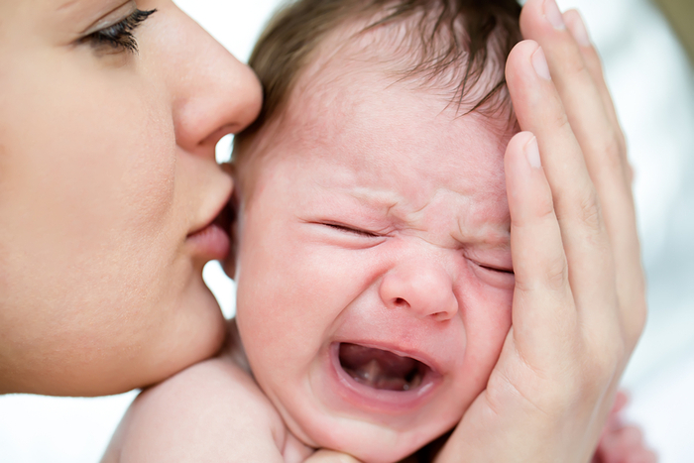
Caring for an Infant

Slide 2
SIDS
Sudden Infant Death Syndrome
The sudden, unexplained death of an apparently healthy child.
They are often under one year old.

Slide 3
Prevention Strategies for SIDS
Have the child sleep on their back.
Do not sleep with soft bedding, pillows, or stuffed animals
Avoid smoking and second-hand smoke both during and after pregnancy.

Slide 4
Four Basic Cries
Hunger - The most demanding cry
Pain - Most obvious, fearful cry of all
Bored - Grows louder and more intense if ignored
Anger - Loud, demanding and varied
Meeting crying needs appropriately develops trust and teaches a child about positive attention getting.

Slide 5
Crying Plan
Have a crying plan so that when the baby cries you know what to do or check and how to handle it.

Slide 6
Crying Plan
Check for the basic needs:
Hungry
Needing a diaper change
Is too hot or cold
Has a fever or illness
Sensitivities to milk consumed (breast or bottle)

Slide 7
Crying Plan
Try various calming techniques:
Rocking
Singing
Warm Bath
Car Ride
White Noise

Slide 8
Coping Threshold
How much a person can take of something.
If you reach your coping threshold for crying, try the following:
Put the baby in its crib
Close the door
Go do something to relieve your stress
Play loud music, vacuum, watch TV, sit on the front porch

Slide 9
Anyone Can Lose It
Everyone is a potential abuser based on the abuse formula:
Child + Caregiver + Stress = Abuse

Slide 10
Shaken Baby Syndrome
Caused by jostling an infant’s head and neck back and forth with enough force that the brain tissue moves inside the skull and becomes damaged.
Usually in an effort to make the child stop crying.

Slide 11
Consequences to the Infant
If the child is shaken and lives:
Child’s quality of life may be compromised
Suffer long term disabilities
Brain damage
Paralysis
Blindness
Shaking a child under 2 years old can cause permanent brain damage and possibly death.

Slide 12
What Can We Do?
We are all at risk for shaking a baby.
A tired, stressed out caregiver can lose control and shake a baby to get it to stop crying.
Our job is not to stop the crying, but to find out why the baby is crying and do our best to meet the baby’s needs.

Slide 13
Elijah’s Story
This is a shaken baby syndrome documentary.
The short life of Elijah, a 16-month-old baby boy who was shaken to death by his biological father.

Slide 14
Summary
SIDS is an unexpected death of an infant. Look for ways to prevent this from happening.
Babies will cry. Be prepared for that. Figure out your crying plan and never shake a baby!!

