Slide 1
Career Investigation
Family and Human Services Pathway

Slide 2
Family, Human Services and Education Careers
Family Consumer Science Educator
Employment Counselor
Marriage and Family Therapist
Social Worker
Counseling/ Psychologist
Community Service Director
Geriatric Service Worker
Vocational Rehabilitation Counselor
Adult Day Care Center Coordinator

Slide 3
CTE College and Career Pathways

Slide 4
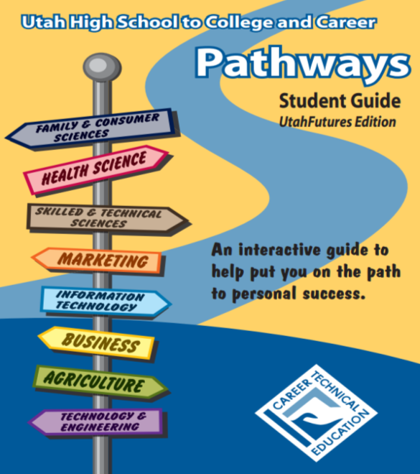
Pathways will help you to prepare for family life, work life and careers in FACS by:
Providing opportunities to develop the knowledge, skills, attitudes and behaviors needed for…

Slide 5
…character development, creative and critical thinking, interpersonal communication, practical knowledge and vocational preparation.

Slide 6
Pathways in Family and Consumer Sciences:
Consumer Economics Services
Early Childhood Education
Family and Human Services
Fashion Design, Manufacturing & Merchandising
Food Science, Dietetics & Nutrition
Food Services and Culinary Arts
Interior Design
Notes:
…will help to prepare you for family life, work life, and careers in family and consumer sciences by:
-Providing opportunities to develop the knowledge, skills, attitudes, and behaviors needed through
-Character development, creative and critical thinking, interpersonal communication, practical knowledge, and vocational preparation.

Slide 7
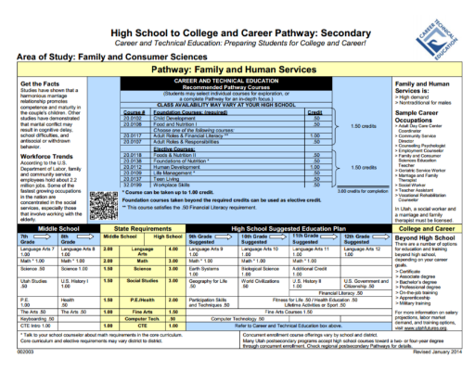
Concentrators vs. Completers:
Concentrators: Students that complete 1.5 credits in a Pathway
Completers: Students that complete 3 credits in a Pathway
Notes:
Concentrator vs completer
Concentrators: Completes 1.5 credits in a pathway
Completers: Completes 3 credits in a pathway , completes the pathway

Slide 8
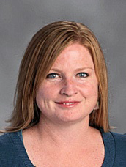
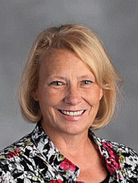
Talk to Your Counselor
Your counselor can direct you as to the pathways available at this school.
They can counsel you of which classes to take and how to best use your high school years.
Linda McGrath
9th & 10th
Graders
June Jensen
11th & 12th
Graders

Slide 9
Career Related Self-Assessments

Slide 10
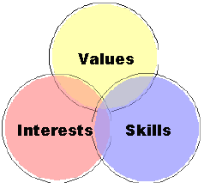
Self-Assessments
Personal interests
Values
Aptitudes
Skills
Personality traits
Learning styles
Notes:
Interest Profiler: https://utahfutures.org/assessments/interest-profiler
Color Code: Use hardcopy
Multiple Intelligence- be sure to look at the tab “What are multiple intelligences?”: http://www.bgfl.org/bgfl/custom/resources_ftp/client_ftp/ks3/ict/multiple_int/questions/choose_lang.cfm

Slide 11
Research and Explore Career Options

Slide 12
Career Research Project
Job descriptions
Duties and responsibilities
Entry level positions/advancements
Job outlook
Salary

Slide 13
Skills Critical in the Work Force

Slide 14
Critical Work Force Skills
Dress and Grooming
Positive Attitude
Work Ethic
Responsibility
Dependability
Integrity
Communication
Teamwork
Planning
Adaptability
Notes:
*Dress/grooming- the clothing you wear and your personal hygiene. Dress for the job you want, not the job you are interviewing for.
*Positive attitude- having an uplifting future vision, no matter how bad the current circumstance,
*Work ethic- the importance of work and its ability to strength character through getting the job done
*Responsibility- to being accountable for something
*Dependability- being consistent and reliable in work
*Integrity- obedience to moral and ethical principles and being honest
*Communication- expressing your ideas, thoughts, expressions, feeling and emotions in appropriate ways
*Teamwork- a coordinated effort of individuals as part of a group to work together
*Planning- preparing for what is coming up
*Adaptability- being capable to adjust

