Slide 1
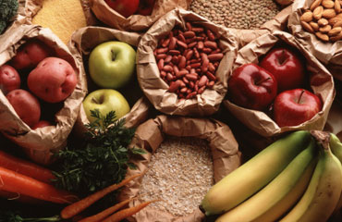
Carbohydrates and Fiber

Slide 2
What is a Carbohydrate?
Carbohydrates are the main nutrients found in the grain group.
Carbohydrates can be found in smaller quantities from the other food groups.
Carbohydrates should be 45-65% of our daily food intake.
The primary function of carbohydrates is to provide energy.

Slide 3
Caloric Content of Carbohydrates
Carbohydrates provide 4 calories per gram.
A calorie is the unit used to measure the energy value of foods.
So, for each gram of carbohydrate you eat, you are given four units of energy.

Slide 4
Types of Carbohydrates
Simple Carbohydrates
Also called sugars
Complex Carbohydrates
Also called starches
Fiber
Also called roughage or cellulose
A form of a complex carbohydrate

Slide 5
Functions of Carbohydrates
Simple Carbohydrates
Provides a quick energy source.
Complex Carbohydrates
Provides a long sustained, continuous energy source.

Slide 6
Functions of Carbohydrates
Fiber
Attracts water to our intestines and moves food through the intestines faster.
Helps to keep bowel movements soft in form and reduces problems related to constipation.

Slide 7
Food Sources of Simple Carbohydrates
Sucrose
Table sugar
Fructose
Fruit sugar
Lactose
Milk sugar
Maltose
Malt sugar
Glucose
Blood sugar

Slide 8
Food Sources of Complex Carbohydrates
Whole grains
Cereal products
Dried beans
Rice
Pasta

Slide 9
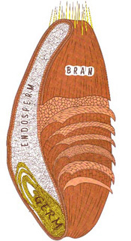
Parts of a Wheat Kernel
Endosperm
Nutrients Provided:
Starch
Protein

Slide 10
Parts of a Wheat Kernel
Germ
Nutrients Provided:
Unsaturated Fatty Acids
B Vitamins
Vitamin E
Iron
Zinc
Other Trace Minerals

Slide 11
Parts of a Wheat Kernel
Bran
Nutrients Provided:
Fiber
Vitamins
Minerals

Slide 12
Food Sources of Fiber
Fruits & Vegetables
Especially the skins or peels
Whole Grains
Legumes
Bran Cereals
Dry Beans
Nuts
Split Peas
Lentils

Slide 13
Digestive Process of Simple and Complex Carbohydrates
Simple Carbohydrates
Digested easily and quickly by the body.
Complex carbohydrates
Breaks down into simple sugars for an easier digestive process.

Slide 14
Digestive Process of Fiber
Cellulose is a non-digestible fiber.
Which means the body does not absorb or digest fiber.
It passes right through your body like a bull dozer, pushing the food as it goes.
Drinking plenty of liquids is key for a healthy digestive process.

Slide 15
Fiber and Water
In the small and large intestines, fiber attracts water just like a dry sponge soaking up water.
When fiber acts like a sponge, the amount of material in the intestine is increased.
Therefore, fiber creates bulk in the diet.
You are going to feel full longer.

Slide 16
Fiber and Water
The soft bulky mixture of fiber and water help move food through the intestines.
Low fiber diets do not attract water.
Without the presence of fiber and water in the intestines, the digested food mixture becomes solid, hard or stale – you become constipated!

Slide 17
Daily Recommendations
Make half your grain intake whole grains.
The National Cancer Institute recommends 20-35 grams of daily fiber.
Fiber may reduce the risks of diverticulosis, colon and rectal cancer.

Slide 18
Summary
For a complete and healthy diet, include foods with carbohydrates and fiber! ☺

Slide 19
Homework Assignment
Now let’s apply what was learned today!
Complete the following worksheets:
Sources of Carbohydrates
How Much Fiber
These will be due next class period.

