Slide 1
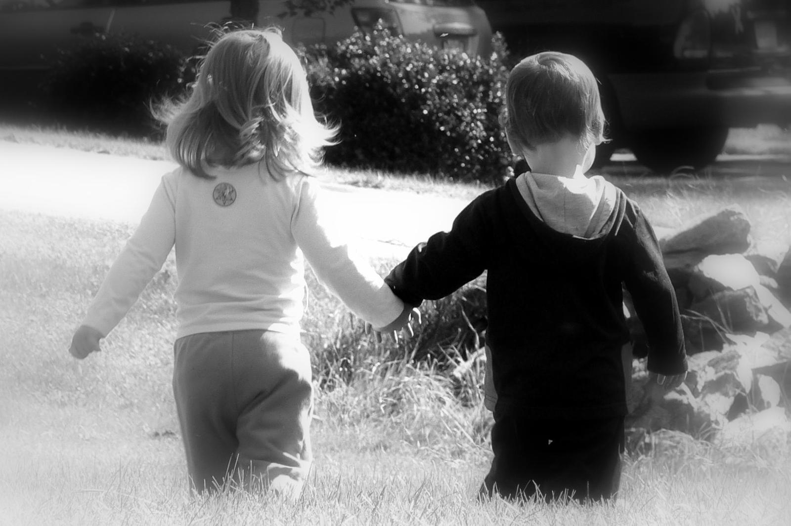
Adolescent Attractions

Slide 2
Normal Part of Adolescence
Read the story about 6-year old Megan.
“Young Love”, “Puppy Love”, and “First Loves” are very normal for adolescence.
As teens begin to enjoy the fascination of the opposite sex, they can quickly fall in and out of “love”.
There are different stages in relationships that adolescence will experience throughout their growing up years.

Slide 3
Stages of Adolescent Attractions
Getting Acquainted
Conversations during classes or in the hall, glances, smiles.
Friendships
Sharing common activities or friends, writing notes, friendly shoves, hits, or pushes. Common work places or community groups.
Texting/Phone Calls
Silly calls/texts, or calls for information about a school project or another friend. An occasional prank-call.

Slide 4
Stages of Adolescent Attractions
Socializing with Groups
Sharing gossip, hugging, working on school activities or projects, going to the movies, malls, or to another person’s home to watch movies or eat.
Group Dating
Groups of 3 or more girls and 3 or more boys, meeting for specific activities—movies, dinner, sports activities, etc. Pairing off does not occur; group members are simply friends.

Slide 5
Stages of Adolescent Attractions
Double Dating
Two girls and two boys who have paired off go together for an activity of any kind. A romantic attraction is involved.
Pairing/Single Dating
One girl and one boy who have paired off go together for an activity of any kind. The couple know each other well, and want to spend time alone.

Slide 6
Flirting Academy

Slide 7
Ways of Showing Interest
Divide into groups of 3-4 students.
Brainstorm ways of showing interest in someone.
Examples may include: writing notes, teasing, writing their name of folders or hands, etc.
Share your findings with the class.

Slide 8
How to Meet Someone
Read a story to the class.
What are some ways that a boy or girl could meet each other?
What are some things that you should be cautious of when arranging to meet someone you don’t really know?
What are some signs given by others that they might be interested in you?

Slide 9
Surefire Ways to Meet a Mate
The following are lovelorn remedies and foolproof ways to meet other people. These come from the Farmers Almanac.
Get a copy of the Romance Chain Letter. It has been going since 1904. Make four copies of this and give it to four of your friends. After you give it to them, drink a cup of water and think of the girl/guy you like A LOT. In four days, that person will say something important to you!

Slide 10
Surefire Ways to Meet a Mate
Swallow the heart of a wild duck.
On the last night in April, wash a handkerchief and hang it over a rosebush. When it dries in the morning, the initials of your true love will appear in the wrinkles.

Slide 11
Surefire Ways to Meet a Mate
Hard-boil an egg, cut it in half, discard the yolk, and fill the egg halves with salt. Sit on something you have never sat on before, eat the egg, and walk to bed backward. You will dream of your future mate.
Peel an apple without breaking the peel, swing the peel around your head three times, and throw it over your shoulder. When it lands, it will form your true love’s first initials.

Slide 12
Surefire Ways to Meet a Mate
Offer your “special someone” lemonade or cider containing a teaspoon of your own powdered fingernails.
Offer your “love” a double-fudge sundae. Chocolate is rich in phenyl ethylamine, which scientists say accounts for people in love acting so erratically and impulsively.

Slide 13
Surefire Ways to Meet a Mate
Count 50 white horses and one white mule. The next person you shake hands with will be the one you marry.
Measure your love’s forearms. If they are similar to the size of your own, you will have a happy future together. If they are not similar, run! You will have nothing but unhappiness together.

Slide 14
Worst Pick-Up Lines Ever!
Split into pairs (preferably boys and girls).
Read your assigned pick-up line and then role play in front of the class.
Have fun with this. These lines are pretty cheesy! ☺

Slide 15
Summary
There are many stages of adolescent attraction. Please remember that not every attraction or relationship will go through all of the stages.
There are a variety of ways to meet other people. Have fun trying new ways to meet those you like. It is a time of exploration and fun!

